Slide 1
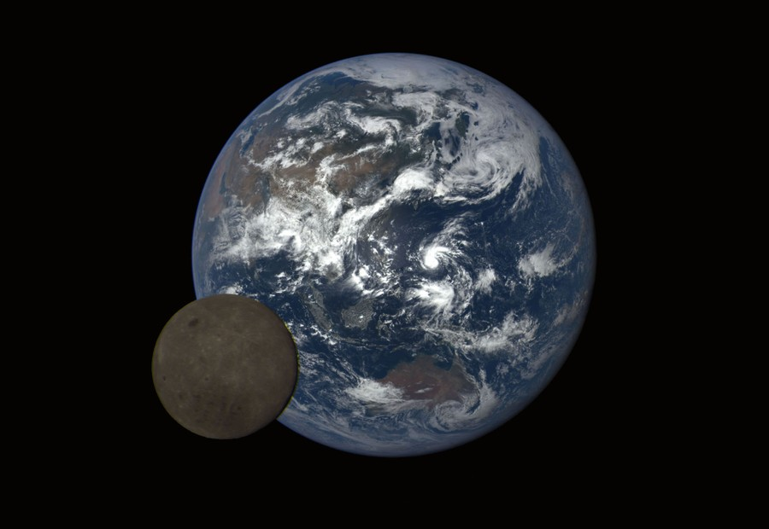
Bits and pieces
Asteroids, comets, dwarf planets
Image: NASA

Slide 2
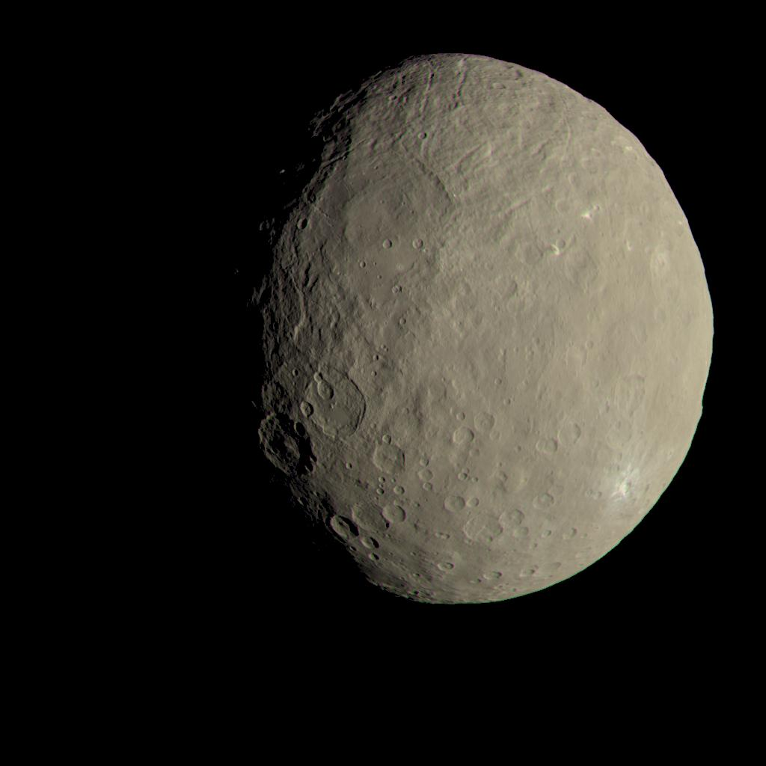
Ceres
Nearest ocean world
Image: NASA/JPL-Caltech/UCLA/MPS/DLR/IDA

Slide 3
Ceres
In asteroid belt
Mass 9.39×10²⁰ kg
  Over 1/3 of Asteroid belt
  1.28% Moon’s mass
Density 2000–2.030 kg/m³
Dimensions 965×961×891 km

Slide 4
Ceres’s Orbit
Semimajor axis 2.768 AU
Orbital eccentricity 0.0758
Orbital inclination to ecliptic 10.59°
Orbital period 4.60 y
Rotation period 9 hours
Axial obliquity 2–20 degrees (now 4)

Slide 5
Ceres
Distinct from asteroids
  spherical
  may have once held an ocean
Currently orbited by Dawn spacecraft (mission end 2018)
Dwarf planet
Animate the ball

Slide 6
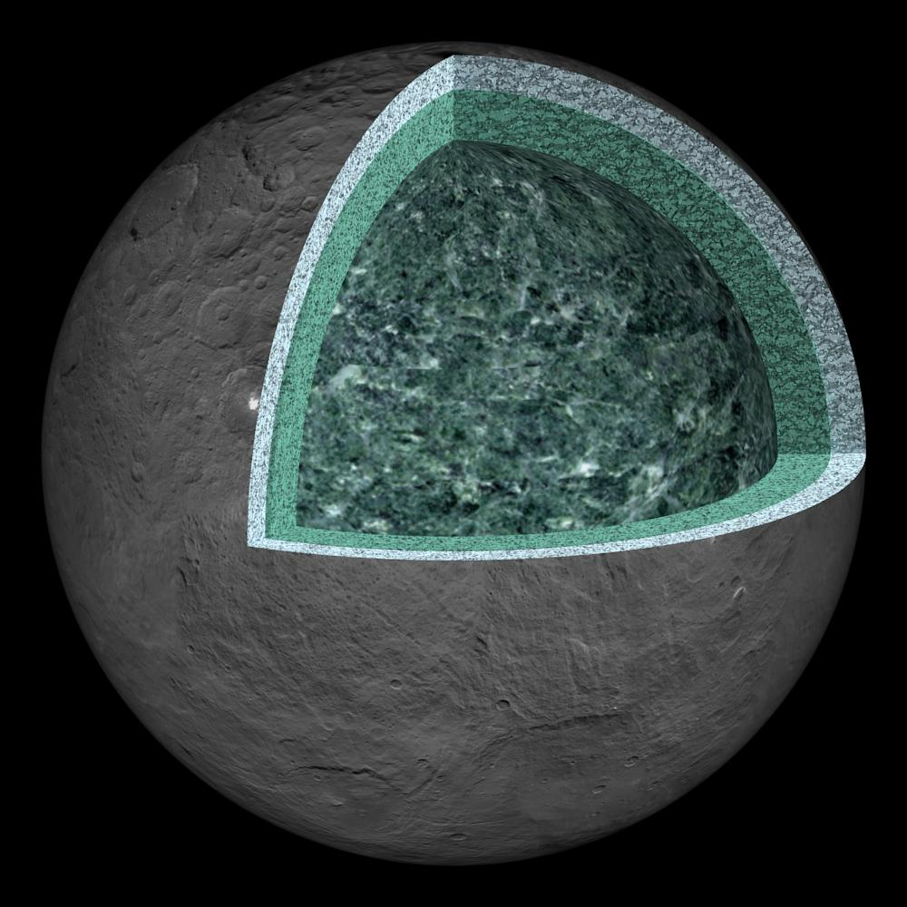
Composition of Ceres
Surface: clay, ice, salt
Brine
Mantle: hydrated clays
Image: NASA/JPL-Caltech/UCLA/MPS/DLR/IDA

Slide 7
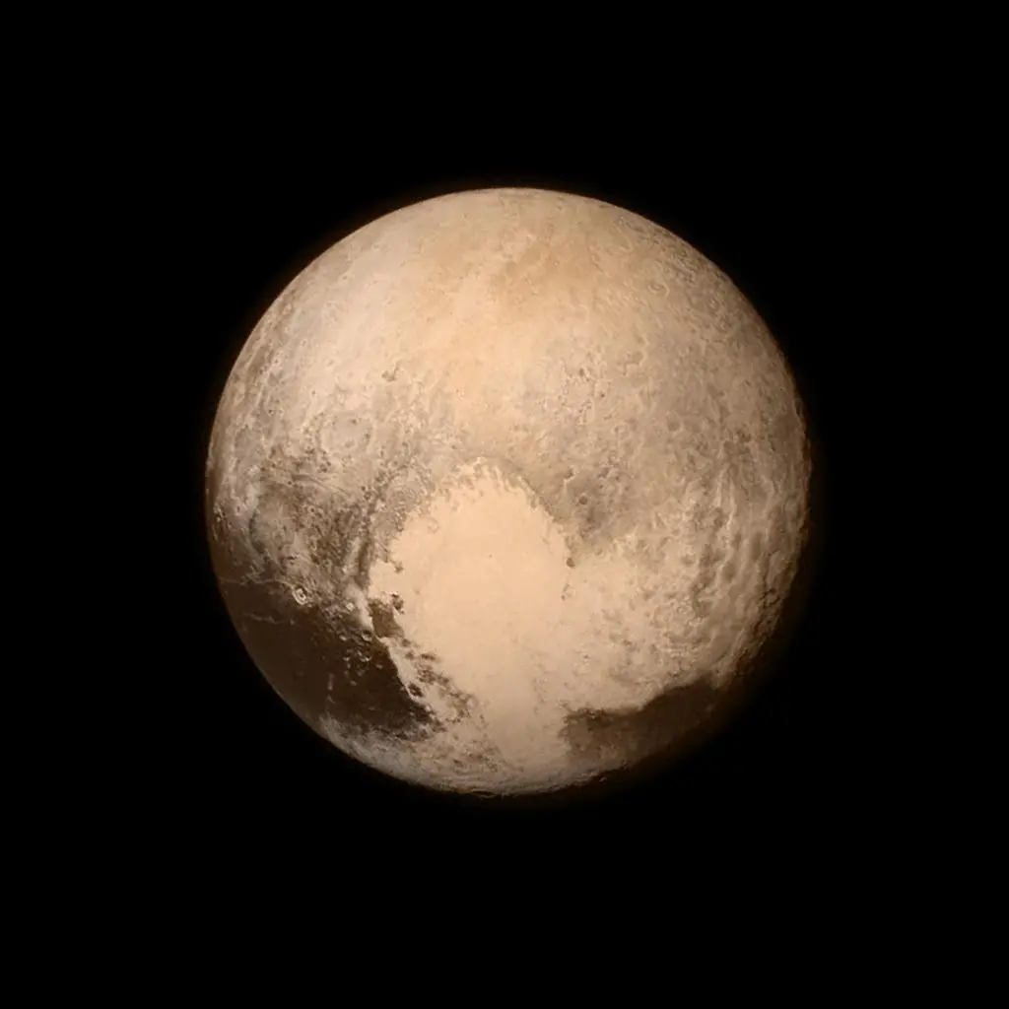
Pluto
Image: NASA/JPL, New Horizons

Slide 8
Pluto
Mass 1.3×10²² kg = 0.22% m_{E} = 17.7% m_{M}
Rotational period –153.3 h
Diameter 2376 km (0.186 of Earth)
Density 1854 kg/m³
Albedo 0.52
5 known satellites
Tenuous N₂, CH₄, CO atmosphere

Slide 9
Pluto’s Orbit
Semimajor axis 39.24 AU
Orbital eccentricity 0.244
Orbital inclination to ecliptic 17.16°
Orbital period 298 y
Axial obliquity 119°

Slide 10
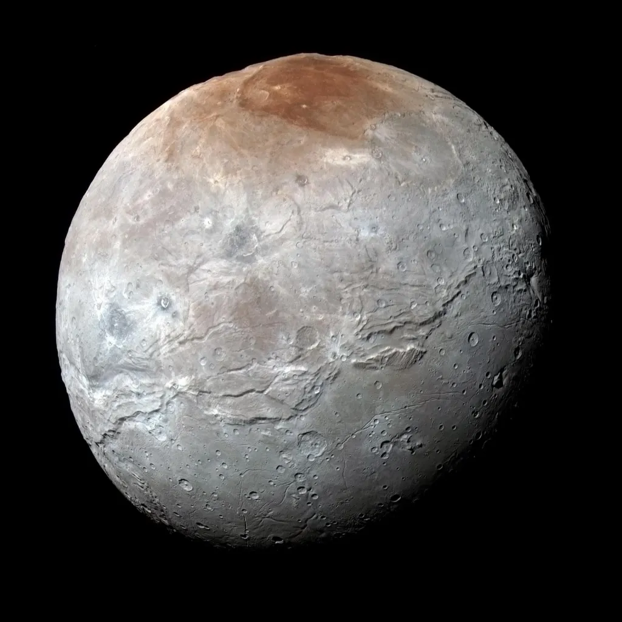
Charon
Pluto’s largest satellite
Image: NASA/JPL, New Horizons

Slide 11
Pluto and Charon
Image: NASA/JHUAPL, Comins Figure 10-4b

Slide 12
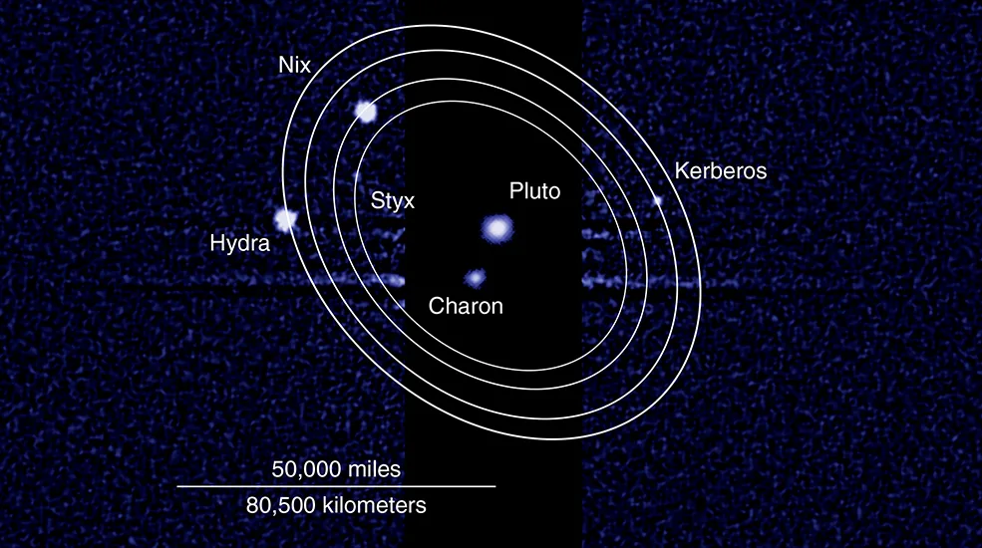
Pluto’s system
Double system with Charon
Further orbited by Styx, Kerberos, Nix, and Hydra
Image: NASA/JPL, New Horizons

Slide 13
Other Dwarf Planets
All TNOs
  Eris
  Haumea
  Makemake

Slide 14
Eris
Semimajor axis 67.9 AU
Orbital period 559 years
Eccentricity 0.436
Inclination 44°
Slightly smaller and heavier than Pluto
  0.0027 Earth masses
  Diameter 2326 km
Heaviest known SS body not visited

Slide 15
Comets
TNOs, at least initially
Kuiper Belt Objects
  Classical KBOs circular orbits 30–50 AU
  Scattered KBOs eccentric orbits 35–200 AU
Oort Cloud Objects
  5–100 kAU
  Not in ecliptic plane

Slide 16
Hale-Bopp
Comins, Fig 10-32

Slide 17
Comet Composition
Dirty snowballs or icy rocks?
Nucleus: rocky core
Coma: atmosphere
Tails
  Dust tail
  Gas tail
  Both stream away from the Sun

Slide 18
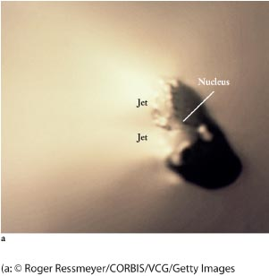
Comet Halley nucleus

Slide 19
Comet Origins
Thought to form in solar nebula 10–20 AU
Flung outward by gas planets

Slide 20
Meteorites
Three main classes
Chondrites
Stony
Iron

Slide 21
Chondrites
Contain glassy spherical “chondrules”
Often contain organic matter
Thought to be undifferentiated solar nebula material
Allende meteorite, Comins, Fig. 10-54b

Slide 22
Stony
Look like rocks
Fresh ones have a fusion crust
Getty images, Comins, Fig 10-51a

Slide 23
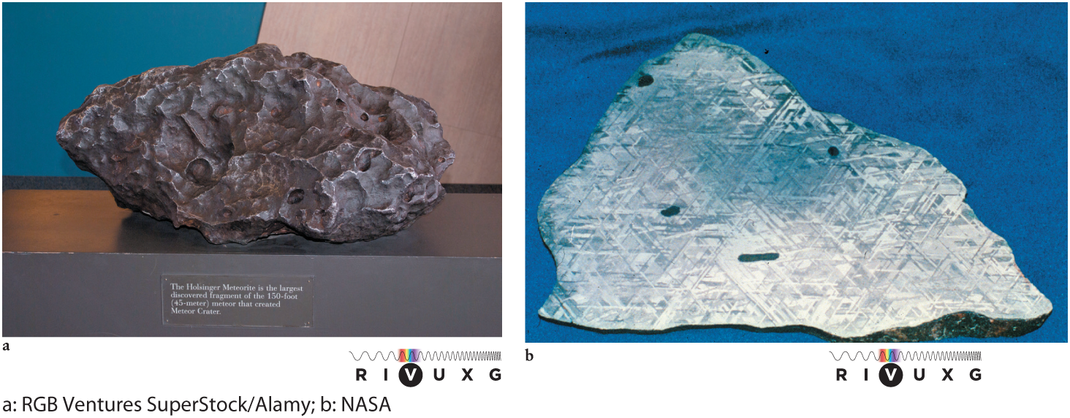
Iron
Also contain Ni and Pt group metals
Diagnostic Widmanstätten patterns

Slide 24
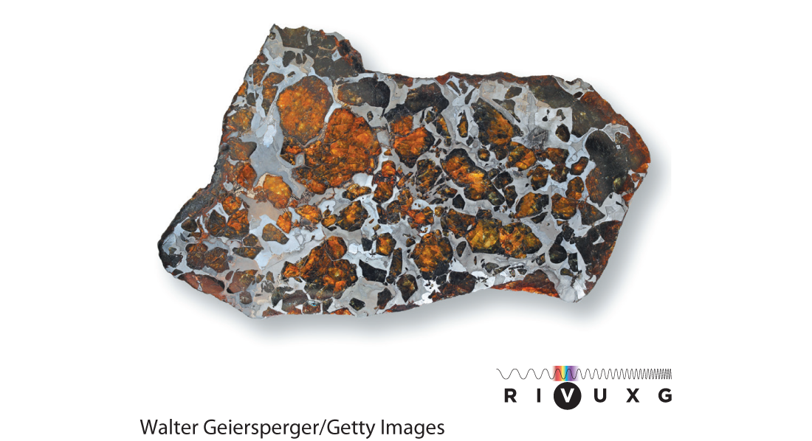
Pallasite
Comins, Fig; 10-53

Slide 25
Meteor origins
Most meteors are pieces of comets
Most meteorites are pieces of asteroids
  sometimes can trace to a specific asteroid
Some identified from Moon and Mars

Slide 26
Meteorites
Moon and Mars
Maine Mineral and Gem Museum, Bethel, ME

