Slide 1
Jupiter’s Moons
Four large and many small

Slide 2
Io
Innermost of the Galilean moons
Orbital period 1.8 days
Semi-major axis 421,800 km
Eccentricity 0.004
Phase locked
Density 3530 kg/m³
Diameter 5% bigger than Moon
Roll the ball

Slide 3
Io
Driest known object in the Solar system
Densest natural satellite in the Solar system
Strongest surface gravity of any natural satellite
Most geologically active object in Solar system

Slide 4
Io
Surface colored with sulfur
Lava composition: basaltic
Heat source: tidal flexing
Ejecta produce plasma torus around Jupiter
Image: Juno, NASA/JPL

Slide 5
Europa
Slightly smaller than the Moon (90% diameter)
Orbital period 3.6 days (resonance with Io)
Semi-major axis 671,000 km
Eccentricity 0.009
Density 3010 kg/m³
Phase locked
Roll the ball

Slide 6
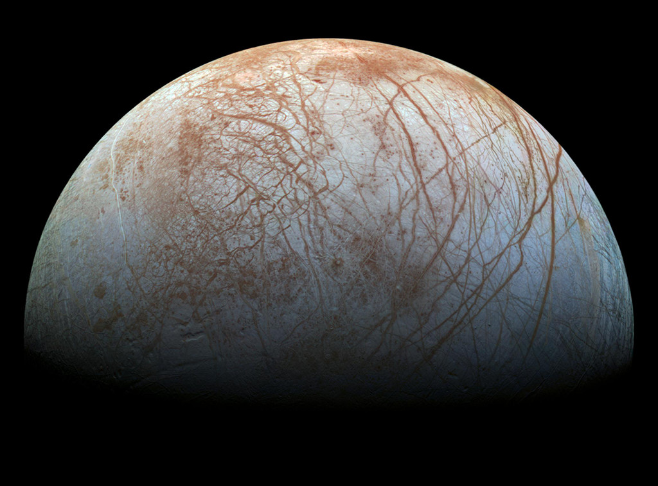
Europa
Image: NASA/JPL

Slide 7
Europa
Icy crust
Probable liquid subsurface ocean
Water geysers strongly suspected
Europa Clipper mission
  launched 10/14/24, reaches Jupiter 4/30
  Search for evidence of liquid subsurface water

Slide 8
Ganymede
Largest moon in the Solar system
  larger than Mercury (but lighter)
Orbital period 7.2 days (resonance with Io)
Semi-major axis 1,070,000 km
Eccentricity 0.001
Density 1940 kg/m³
Phase locked
has a magnetic field

Slide 9
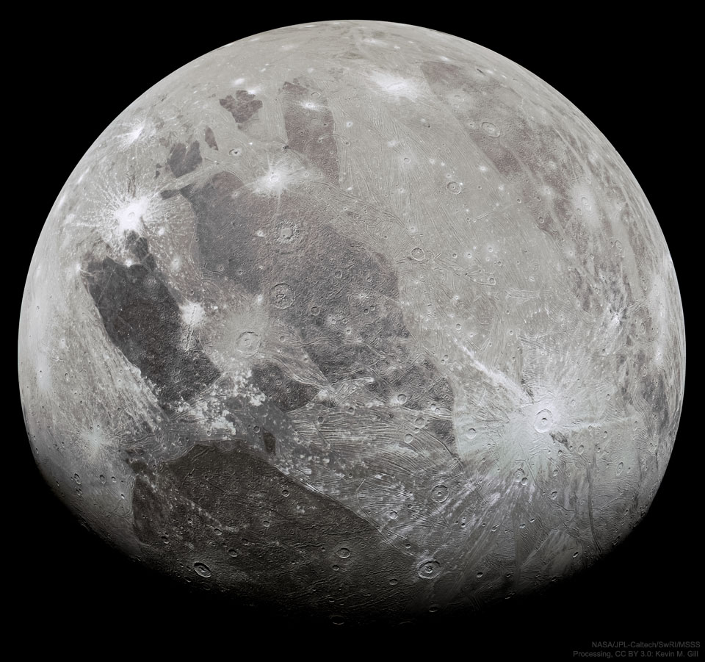
Ganymede
Image: NASA/JPL

Slide 10
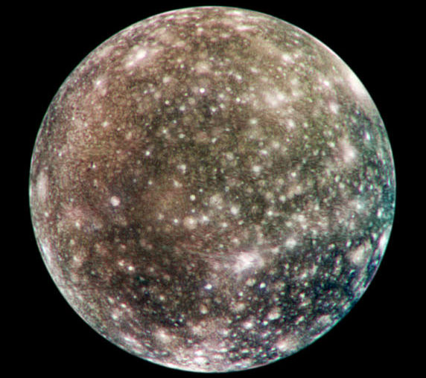
Callisto
Image: NASA/JPL

Slide 11
Callisto
Outermost of the Galilean satellites
Most heavily cratered body in the Solar system
Orbital period 16.7 days
Semi-major axis 1,883,000 km
Eccentricity 0.007
Density 1830 kg/m³
Phase locked

Slide 12
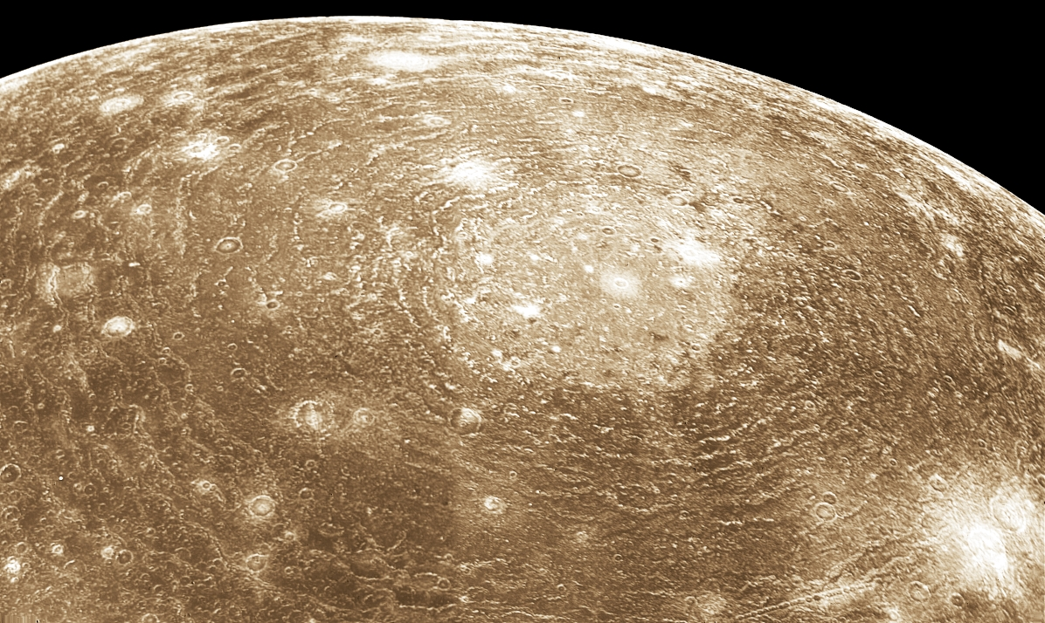
Valhalla structure
Image: NASA< Voyager 1

Slide 13
Valhalla
Largest multi-ring impact structure in the Solar system
No antipodal chaotic zone

Slide 14
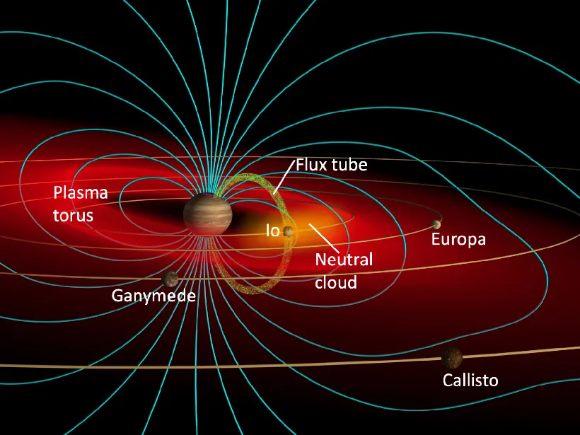
Gas/Plasma Torus
Gases ejected by Io and Europa
Interact with Jupiter’s magnetosphere
Image: John Spencer

Slide 15
Ring System
Within orbit of Io
Debris from small moons Metis, Adrastea, Amalthea, Thebe

Slide 16
Smaller Moons
Four within Io’s orbit
Remainder beyond Callisto’s orbit
Many outer moons orbit retrograde

Slide 17
How did this happen?
Jupiter’s Rocky core formed beyond snow line
  accreted ices
  then massive enough to H₂ and He
Moons too light to bind H₂ and He
Io probably lost ices through volcanism

Slide 18
Saturn’s Moons
One very big
and many many more

Slide 19
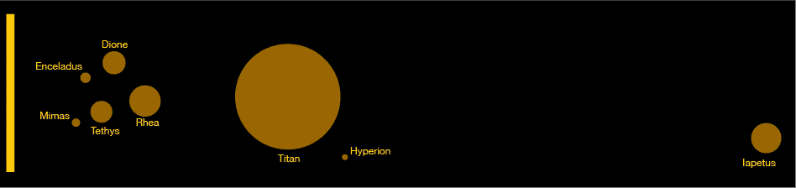
Moons
Sizes and Distances (different scales)

Slide 20
Titan
Largest moon after Ganymede
Orbital period 15.9 days
Semi-major axis 1,222,000 km (20 R_{S})
Eccentricity 0.0292
Density 1880 kg/m³
Synchronous rotation

Slide 21
Titan’s structure
(maybe)
Rocky core
Ice-VI
Brine
Ice
Hydrocarbon ocean
Atmosphere

Slide 22
Titan’s surface
Rivers and lakes of liquid methane
Dunes of hydrocarbon granules
Few visible impact craters

Slide 23
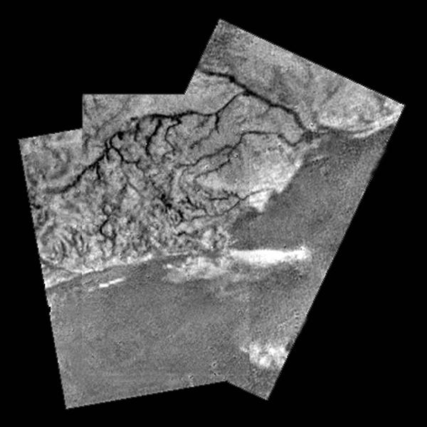
River on Titan
Image: Huygens probe

Slide 24
Landing Site
Image: Huygens probe

Slide 25
Titan’s atmosphere
Surface pressure 1.5 bar
Composition 95% N₂, 5% CH4
Photochemical smog haze
Methane rain

Slide 26
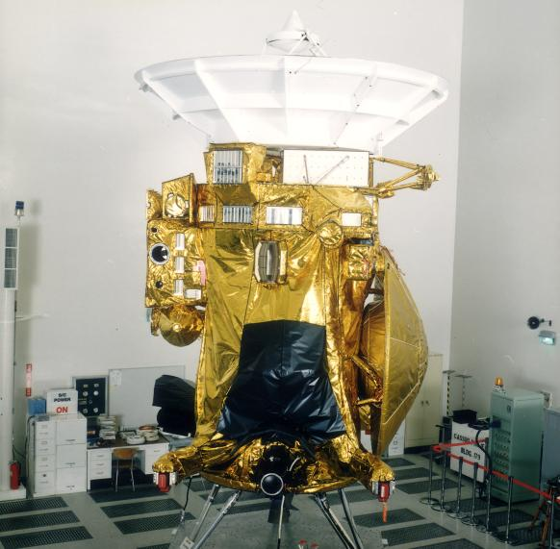
Cassini Spacecraft
Image: NASA/JPL

Slide 27
Enceladus

Slide 28
Enceladus
208 ×197 ×191 km
Orbital period 1.37 days
  (2:1 resonance with Dione)
Synchronous rotation
Semi-major axis 238,000 km (3.9 R_{S})
Eccentricity 0.0045
Density 1610 kg/m³
Albedo 1.0
Spin the ball

Slide 29
Enceladus activity
Water eruptions produce snow
Escape at “tiger stripes”
Produces Saturn’s E ring
Top spot for chance of life

Slide 30
Smaller Moons
New Saturn Moons. Scott Sheppard, Carnegie Institute

Slide 31
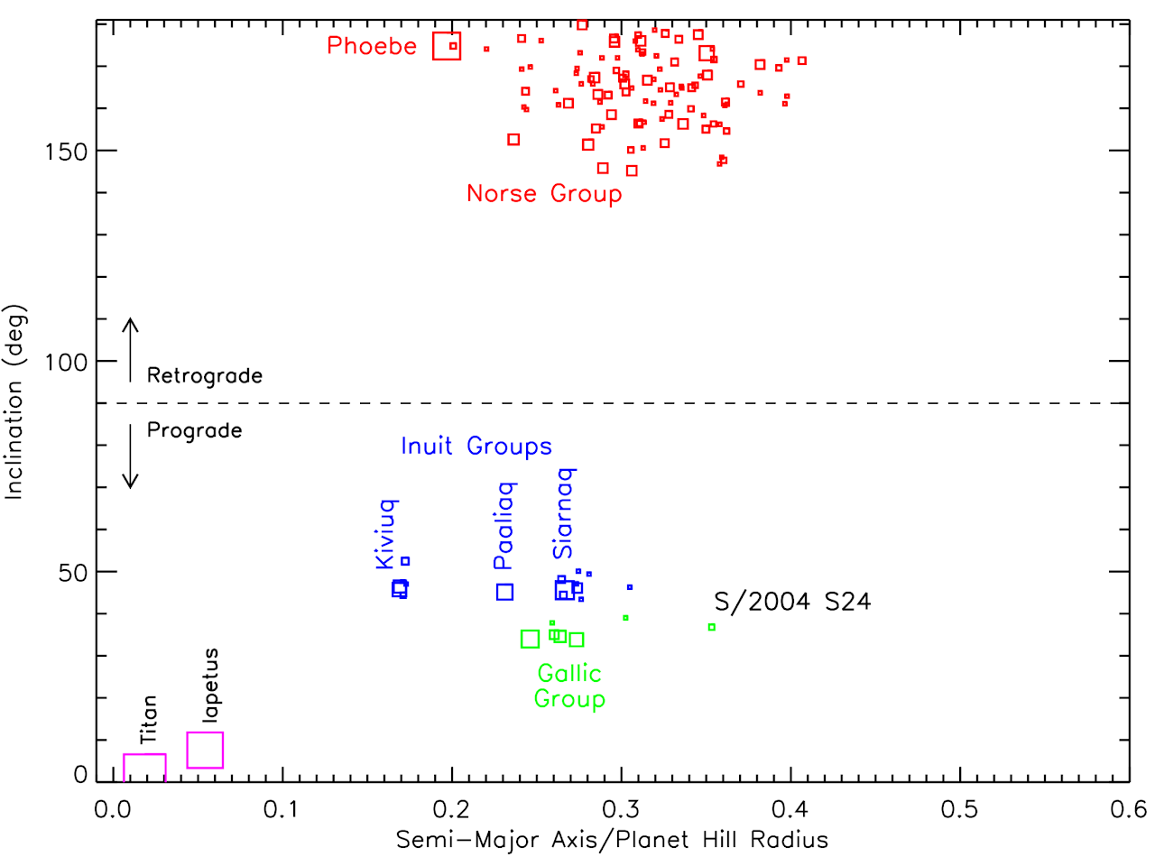
Smaller Moons
New Saturn Moons. Scott Sheppard, Carnegie Institute

Slide 32
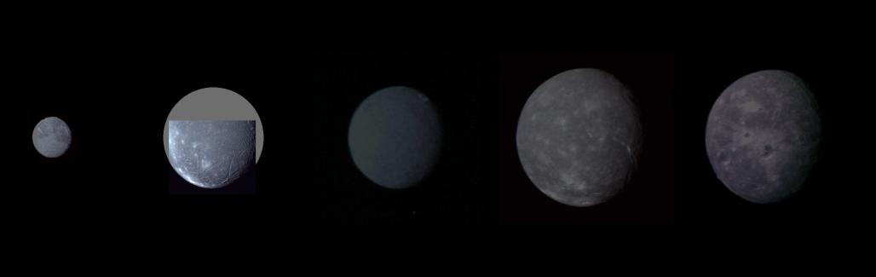
Uranus’s Major Moons
All rotate synchronously
ice-like densities
Titania
Oberon
Ariel
Umbriel
Miranda
Image: NASA, Voyager 2 (montage)

Slide 33
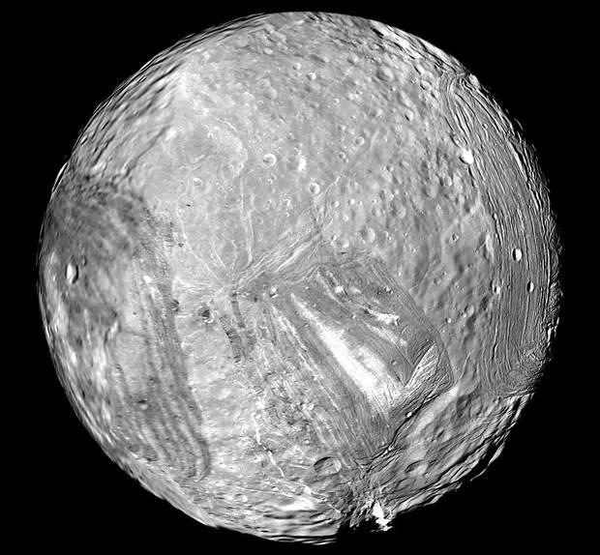
Miranda’s odd shape
Varied terrain
Regions of few impact structures
Tidal heating?
spin the ball

Slide 34
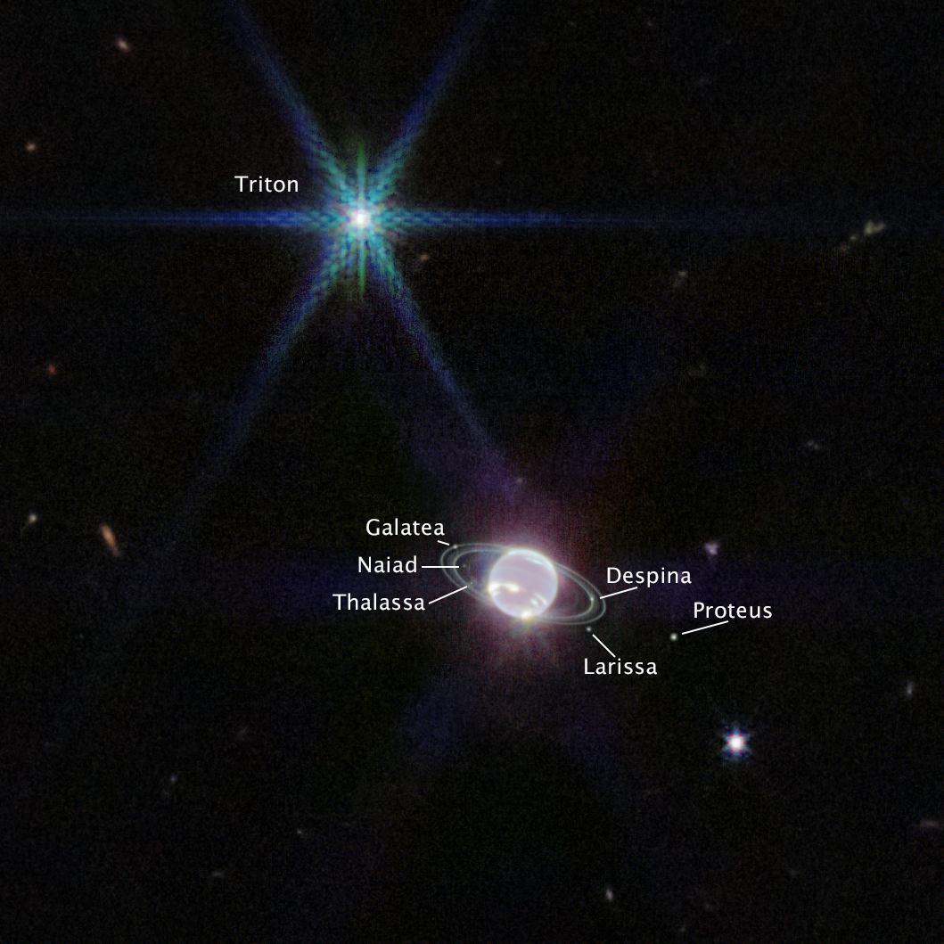
Neptune’s Rings
Image: NASA, ESA, CSA, STScI, Webb Telescope

Slide 35
Neptune’s Moons
One large moon, Triton
  about 78% Moon’s diameter
  density 2050 kg/m3
Irregular moons with eccentric orbits

Slide 36
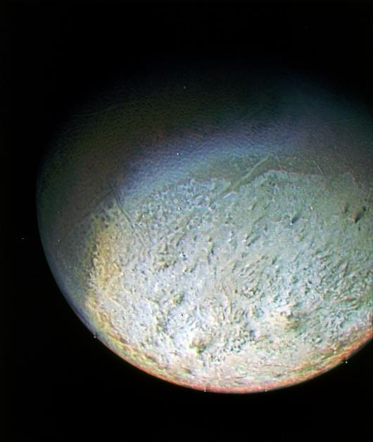
Neptune’s Moon Triton
Surface rock and ice
Contains ice-filled craters
Retrograde orbit
  radius decreasing
Captured KBO?
Image: NASA, Voyager 2

Slide 37
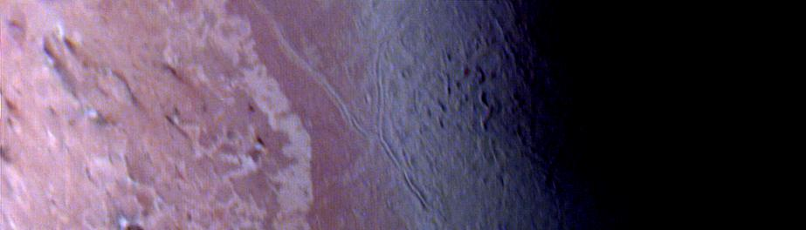
“Cantaloupe” Terrain
Image: NASA, Voyager 2

Slide 38
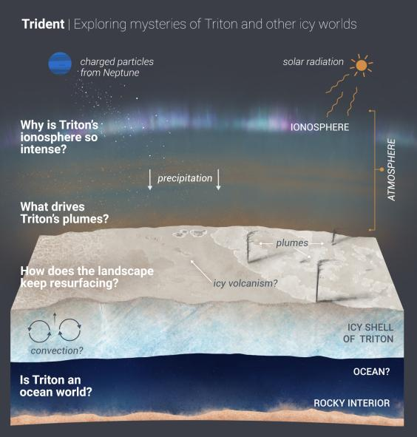
Image: NASA

Slide 39
Roche Limit
The gravitational pull of a planet or star decreases with distance form the center
This stretches an orbiting body
If the stretch is greater than the satellite’s gravitational cohesion, the satellite breaks apart
Inside this Roche limit, satellites are not stable

Slide 40
Fate of Triton
and also maybe Phobos

