Slide 1
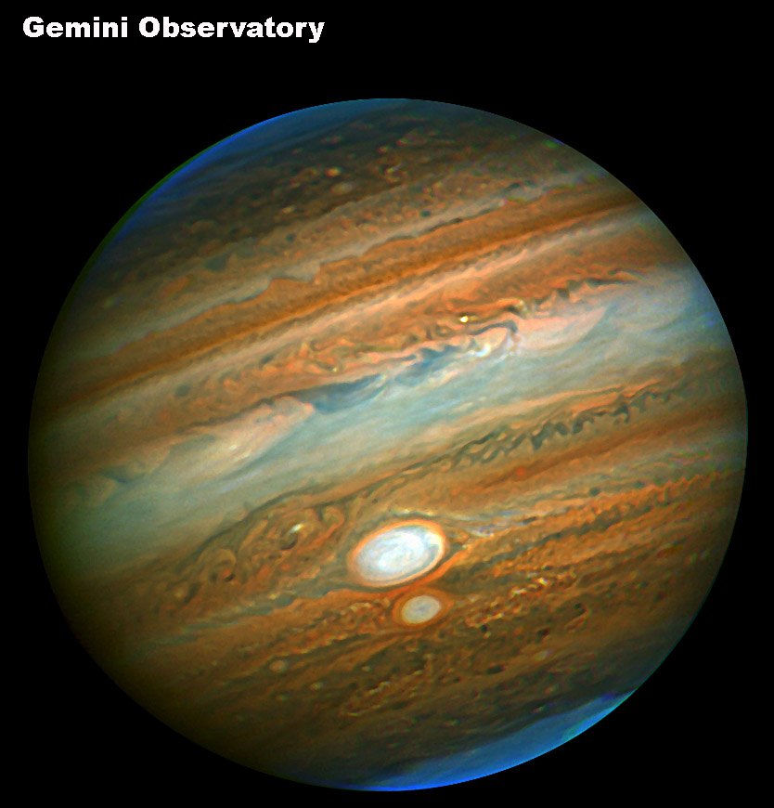
Jupiter
The largest
§8.1

Slide 2
Jupiter
Mass 1.90 × 10²⁷ kg = 318 m_{E}
2.5 times mass of all other planets combined
Semimajor axis 5.20 AU
Orbital eccentricity 0.048
Orbital inclination to ecliptic 1.30°
Orbital period 11.86 y

Slide 3
Jupiter
Axial obliquity 3.12°
Rotational period
9:50:28 equatorial
9:55:30 polar
Diameters
equatorial 11.3 Earth diameters
polar 10.48 Earth diameters
Albedo 0.52

Slide 4
Atmosphere
89.8% Hydrogen
10.2% Helium
Trace visible material
ammonia, water, ammonium sulfide

Slide 5
Surface
Only clouds visible
Arranged in latitudinal belts and zones
belts are white, high, cold
zones are reddish, lower, warmer
Image: Junocam, processed by Gerald Eichstädt and Seán Doran

Slide 6
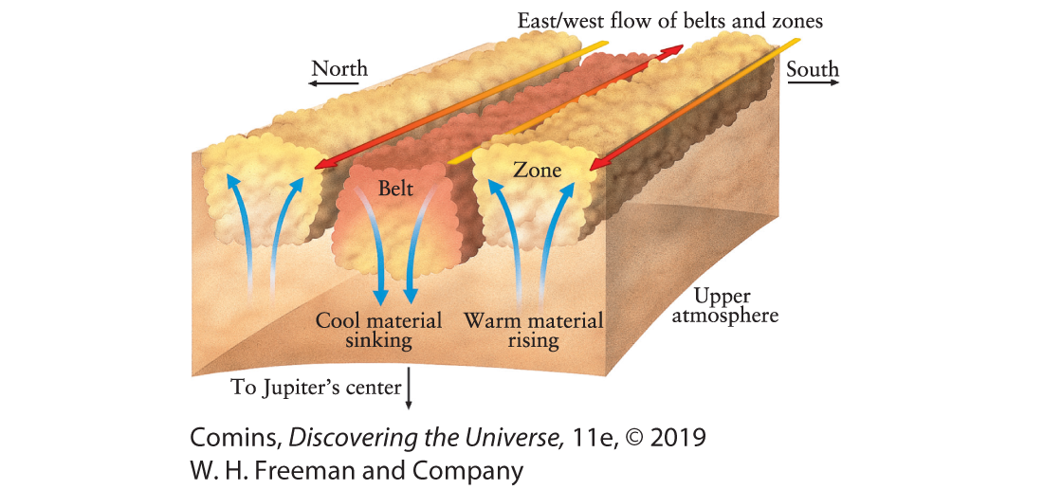
Belts and zones
Fig. 9.8

Slide 7
Storms (ovals)
Rotate cyclonically or anticyclonically
Long lasting features
Usually stay in a band
Interact with each other
Most white, some red
white = ammonia
red = ?

Slide 8
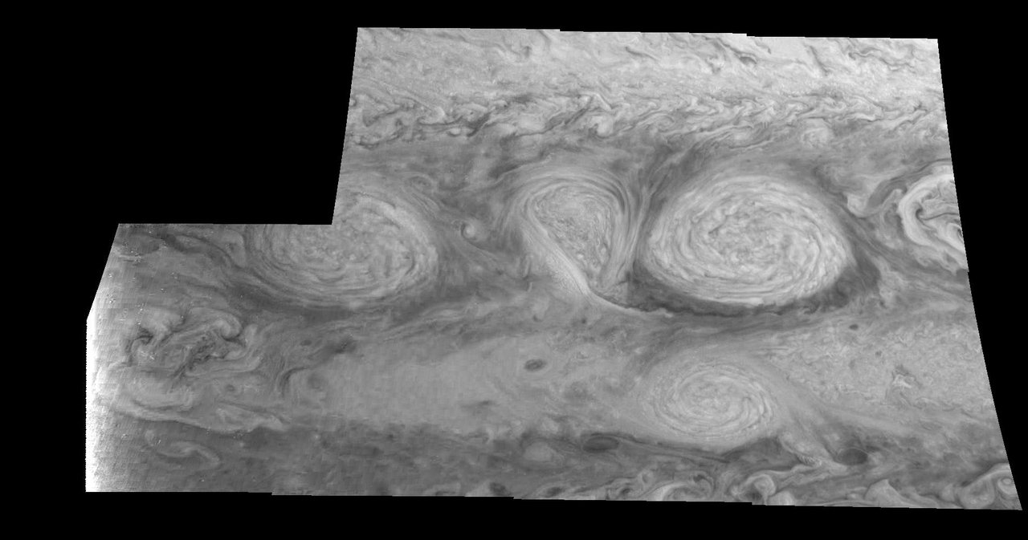
Ovals
Image: Galileo, NASA/JPL. Near IR

Slide 9
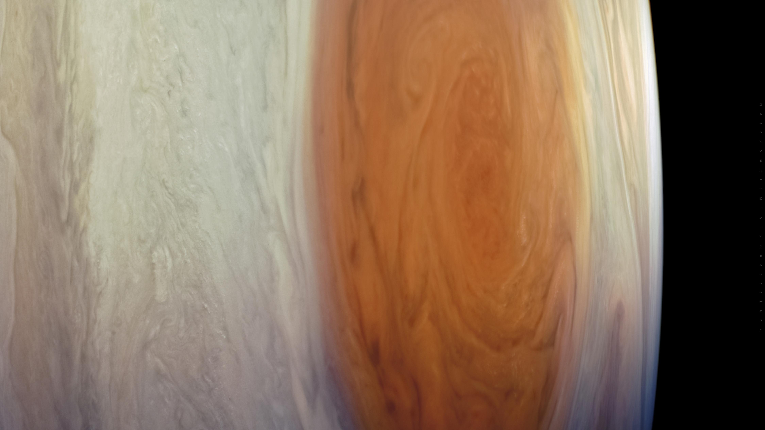
Great Red Spot
Image: Juno, NASA/JPL

Slide 10
Great Red Spot
Southern hemisphere
Anticyclonic rotation (counterclockwise)
Possibly observed since 1632
at least for past 150 y
Varies in size and speed
Source of red color uncertain

Slide 11
Magnetic Field
At surface ≥ 10× Earth’s surface field
Very strong dynamo

Slide 12
Jupiter’s interior
Really, anybody’s guess. Probably,
Liquid (SC) H₂ layer
Metallic H interior
Rocky core
Image: NASA

Slide 13
Saturn
a ring on it
Image: NASA/JPL, Cassini-Huygens mission

Slide 14
Saturn
Mass 5.68 × 10²⁶ kg = 95 m_{E}
Rotational period 10.656 h
Diameters
equatorial 9.45 Earth diameters
polar 8.55 Earth diameters
Density 687 kg/m³
Albedo 0.49
146 known satellites

Slide 15
Saturn Orbit
Semimajor axis 9.573 AU
Orbital eccentricity 0.0520
Orbital inclination to ecliptic 2.486°
Orbital period 29.45 y
Axial obliquity 26.73°

Slide 16
Atmosphere
96.3% Hydrogen
3.25% Helium
Trace visible material
methane, ethane, ammonia, water, ammonium hydrosulfide

Slide 17
Polar Hexagon
Polar storm(s) bounded by a hexagonal jet stream
Video

Slide 18
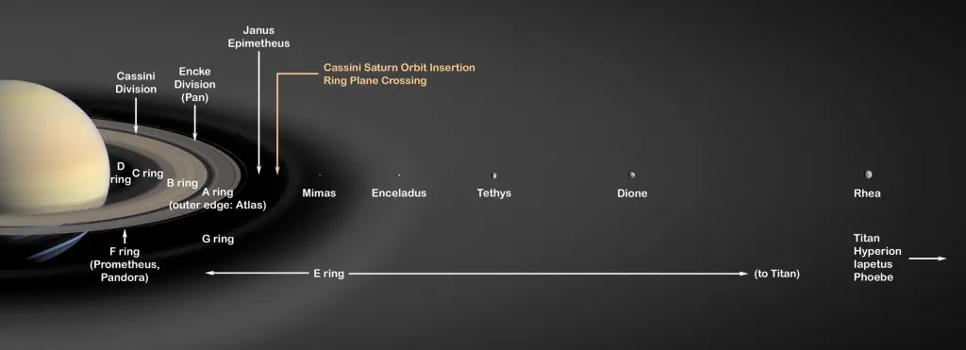
Rings
In equatorial plane
Change visibility throughout orbit
Thickness 100–300 m
Image: NASA

Slide 19
Rings
Designated A–G in order of discovery
Most visible rings A and B, separated by Cassini Division
B outer radius ~2 R_{S}
A outer radius ~2.3 R_{S}
Composed of ice grains
Probably short-lived (~500 My)

Slide 20
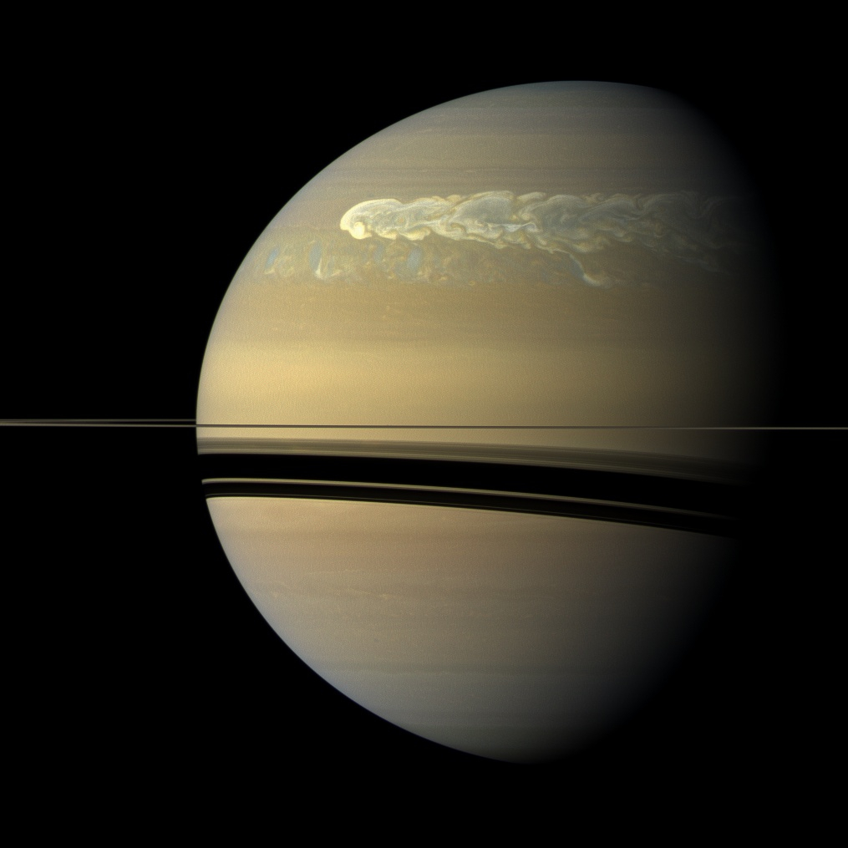
Storms
Great White Spot sometimes seen in N hemisphere Summer
Image: By NASA/JPL-Caltech/SSI

Slide 21
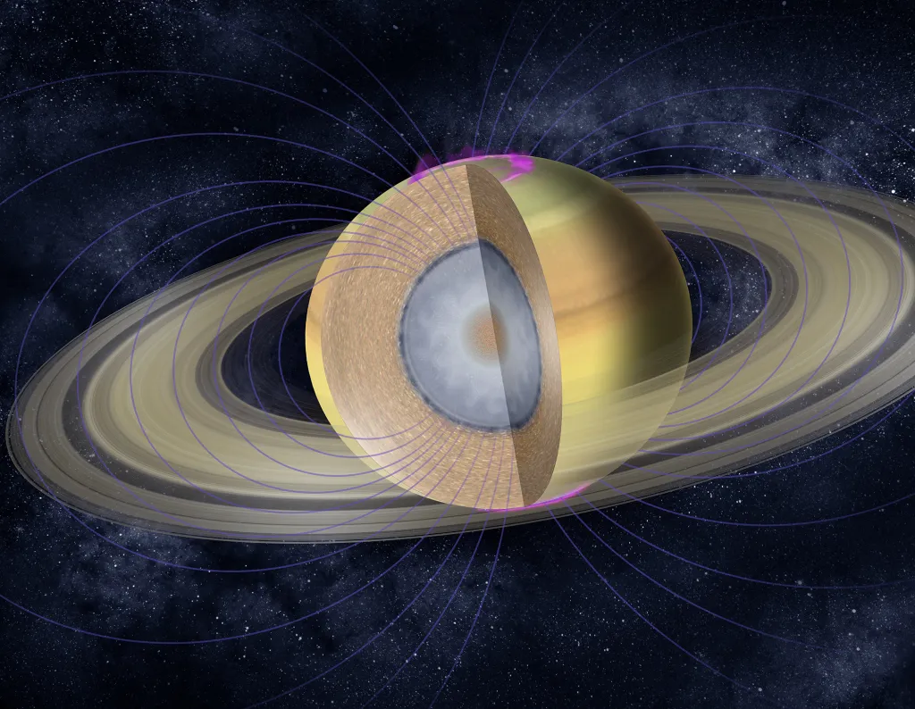
Saturn’s Interior
Rocky core
Metallic H
Molecular H₂
Image: NASA/JPL/Caltech

Slide 22
Saturn’s Magnetic Field
Second strongest after Jupiter’s
Mostly dipolar
Aligned with rotation axis
At surface about equivalent to Earth’s
Attributed to metallic H layer

Slide 23
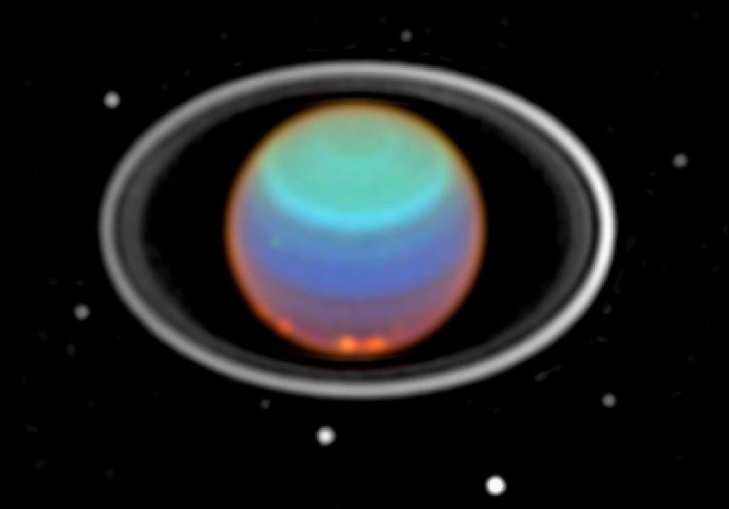
Uranus
Say that again?
Image: Hubble, Near IR mosaic

Slide 24
Enhanced View
NASA/JPL; Comins Fig. 9-43a

Slide 25
Uranus
Mass 8.68 × 10²⁵ kg = 14.5 m_{E}
Rotational period –17.24 h
Diameters
equatorial 4.01 Earth diameters
polar 3.93 Earth diameters
Density 1270 kg/m³ (second least dense)
Albedo 0.48
28 known satellites

Slide 26
Neptune
a lot like Uranus
Image: NASA/JPL, Voyager 2

Slide 27
Neptune
Mass 1.02 × 10²⁶ kg = 17.2 m_{E}
Rotational period 16.11 h
Diameters
equatorial 3.88 Earth diameters
polar 3.83 Earth diameters
Density 1638 kg/m³ (second least dense)
Albedo 0.44
16 known satellites

Slide 28
Uranus’s Orbit
Semimajor axis 19.16 AU
Orbital eccentricity 0.0469
Orbital inclination to ecliptic 0.77°
Orbital period 84.01 y
Axial obliquity 97.77°(sideways)

Slide 29
Neptune’s Orbit
Semimajor axis 30.18 AU
Orbital eccentricity 0.097
Orbital inclination to ecliptic 1.77°
Orbital period 164.8 y
Axial obliquity 28.3°

Slide 30
Uranus’s Atmosphere
82.5% Hydrogen
15.2% Helium
2.3% Methane (bluish)
Temperature 76K at 1 bar
Aerosols
ethane, ammonia, water, ammonium hydrosulfide

Slide 31
Neptune’s Atmosphere
80.0% Hydrogen
19.0% Helium
1.5% Methane (bluish)
Temperature 72K at 1 bar
Aerosols
ethane, ammonia, water, ammonium hydrosulfide

Slide 32
Uranus’s Weather
Cloud cover and activity change over time
Possibly seasonal
Near-IR shows latitudinal bands
retrograde winds at equator

Slide 33
Uranus’s Rings
Very low albedo, 0.015
Change visibility throughout orbit
Thickness 100–300 m

Slide 34
Internal structure (hypothesized)
Rocky core
mantle of hot “ices:” H₂O, CH₄, NH₃
H₂, He atmosphere

Slide 35
Uranus’s Magnetic Field
Mostly dipolar
Tilt 58.6°to rotation axis
Offset from center by 1/3 R_{U}
At surface about twice Earth’s
Attributed to “hot ice” layer

Slide 36
Neptune’s Magnetic Field
Mostly dipolar
Tilt 46.9°to rotation axis
Offset from center by 0.49 R_{U}
At surface about twice Earth’s
Attributed to “hot ice” layer

