Slide 1
Mars
The least uninhabitable
§7.3

Slide 2
Spin and Orbit
Semi-major axis 1.5 AU
Obliquity of spin axis 25°
Sidereal Day 24:37:22
Mean Solar Day (sol) 24:39:35
Orbital period 687 days = 669.6 sols
Orbital eccentricity 0.0935

Slide 3
Surface Features
Topographic relief
Solar system’s largest volcano
Canyon Valles Marineris
Flow features
Aeolian features

Slide 4
Surface
Spin the ball
  low resolution
Explore Mars
  slow, good detail
Global CTX Map
  slowest, best detail

Slide 5
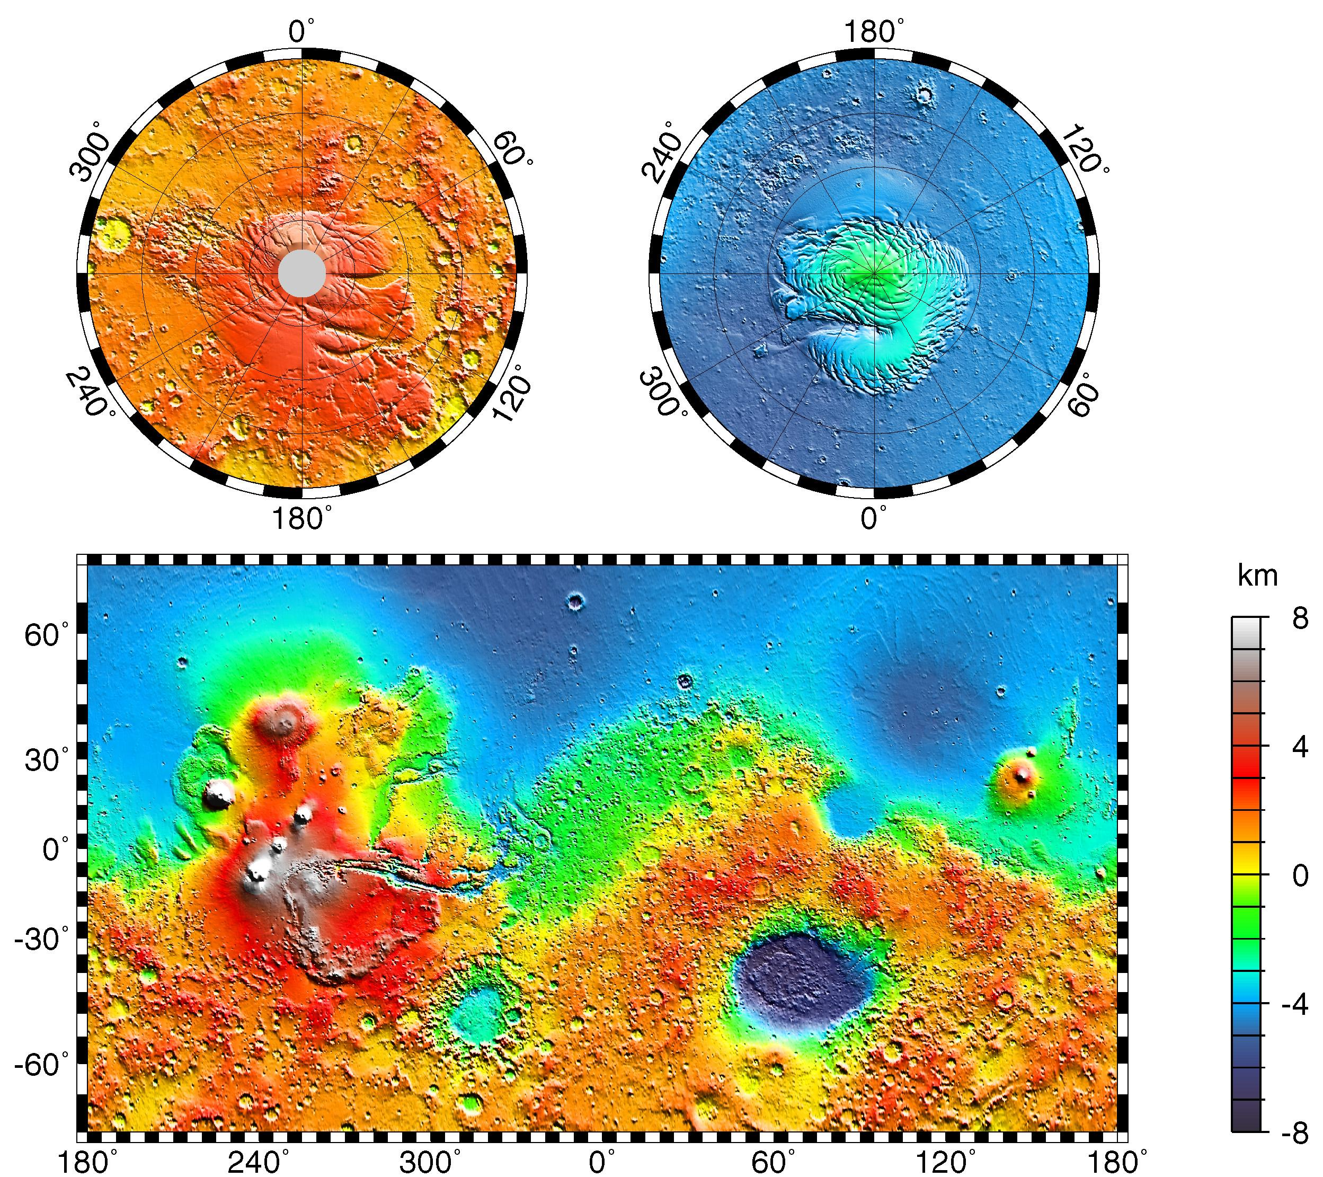
Topography
NASA/JPL

Slide 6
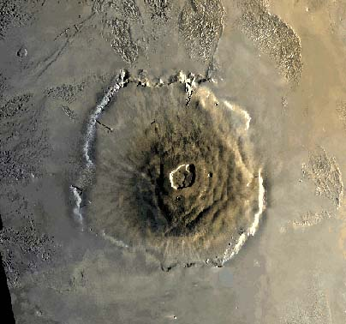
Olympus Mons
Inactive shield volcano
Source: exploringmars.com

Slide 7
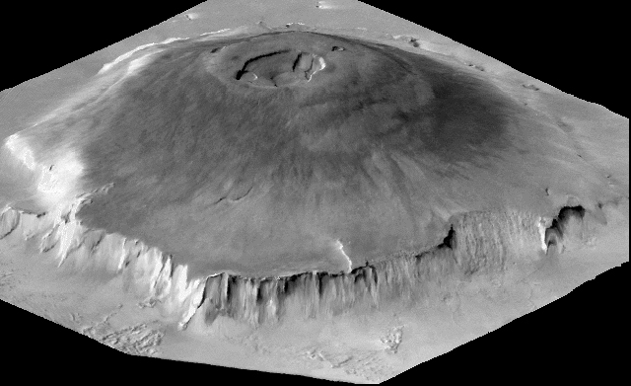
Olympus Mons
Source: exploringmars.com

Slide 8
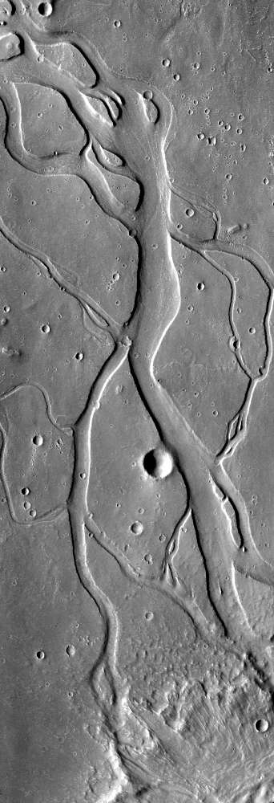
Hebrus Vallis
Image: NASA/JPL-Caltech/Arizona State University.

Slide 9
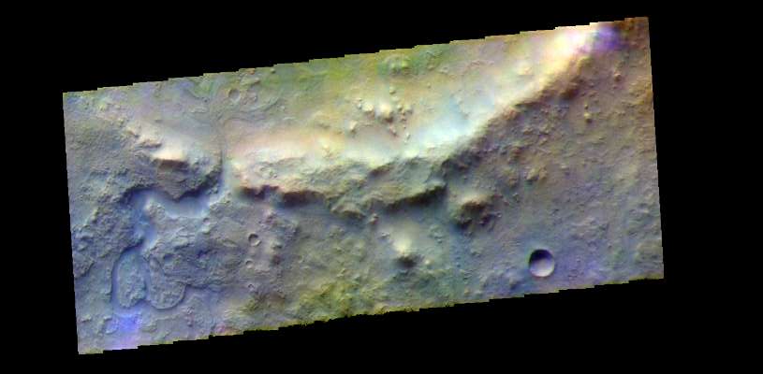
Jezero Channel and Delta
Image: NASA/JPL-Caltech/Arizona State University.

Slide 10
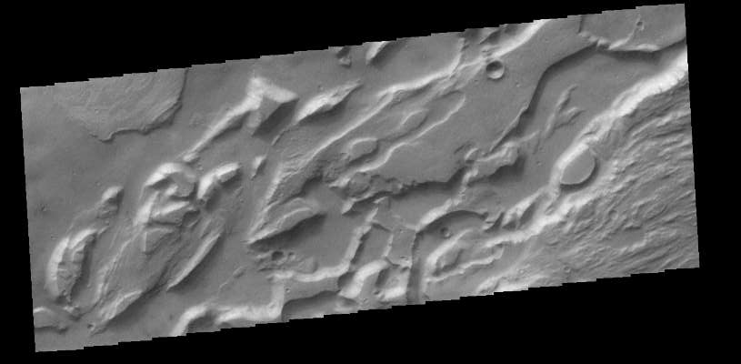
Ares Vallis
Image: NASA/JPL-Caltech/Arizona State University.

Slide 11
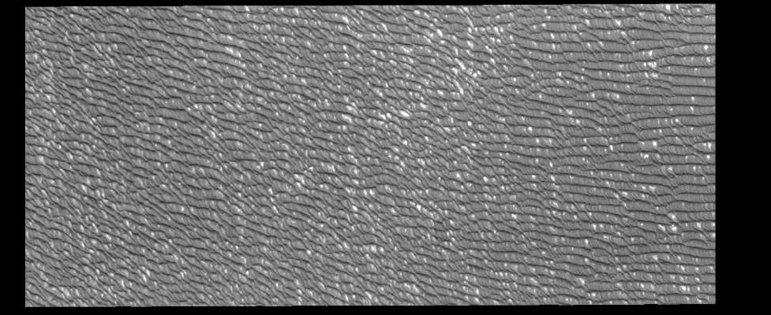
Olympia Undae Dune Field
Image: NASA/JPL-Caltech/Arizona State University.

Slide 12
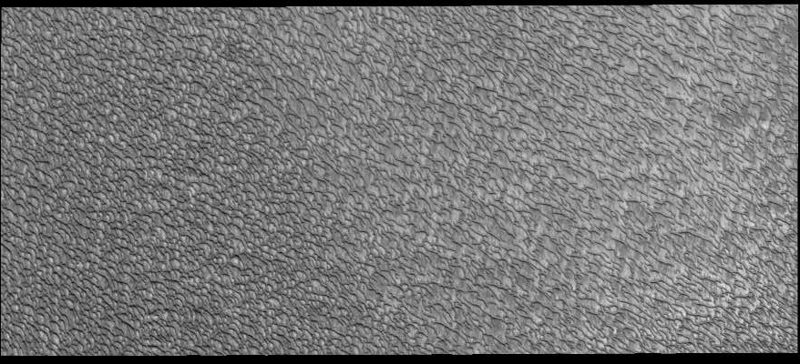
Crescent Dunes, Olympia Undae
Image: NASA/JPL-Caltech/Arizona State University.

Slide 13
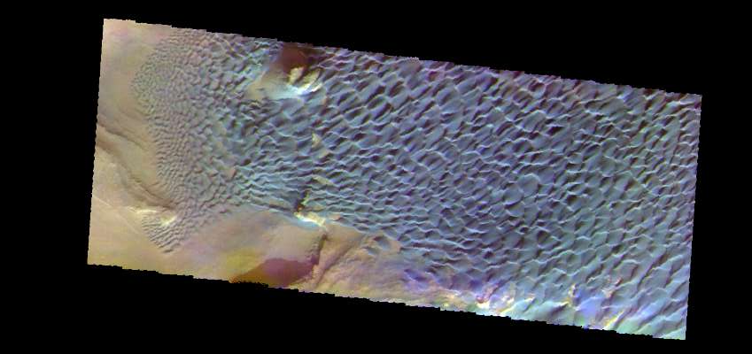
Rabe Crater Dunes
Image: NASA/JPL-Caltech/Arizona State University.

Slide 14
Why such relief?
Thick crust
  does not deform under weight
Low gravity
  less tendency to flatten heights

Slide 15
Composition
Thick crust
  24–72 km thick km in north
  Thicker than Earth’s
Hasn’t moved in about 4 Gy
All layers more solid than Earth’s
Small core

Slide 16
Atmosphere
0.006 bar
95.3% CO₂
2.7% N₂
Nonetheless, a prominent surface agent

Slide 17
Wind on Mars
Long-lasting dust storms
Dust devils
Aeolian geological surface features
  erosion
  transport
  deposition

Slide 18
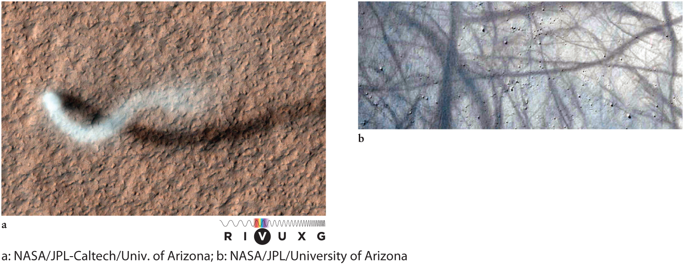
Dust devils

Slide 19
Water
No liquid surface water
Regolith contains about 2% water
Martian meteorites contain varying amounts
  Older meteorites are more hydrated
Some surface minerals and structures attributed to water

Slide 20
Life
Evidence of past life inconclusive
  fossils in a meteorite?
Little evidence of current life
  Certainly not on the harsh surface
  Methane jets may indicate subsurface life

Slide 21
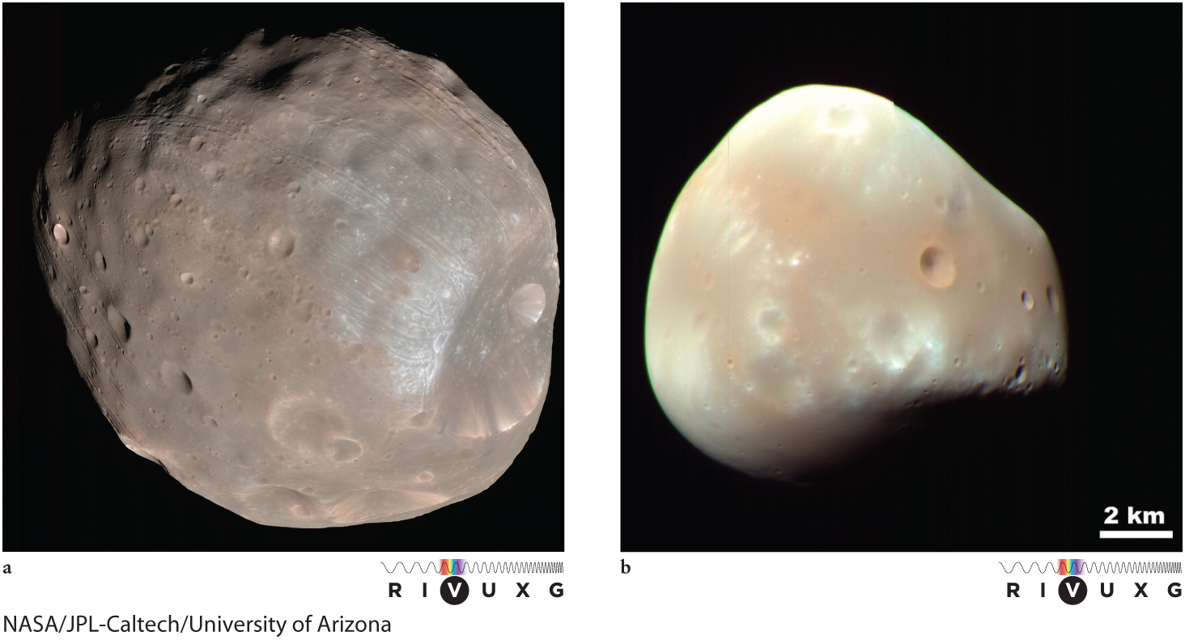
Moons

Slide 22
Phobos
First discovered, largest
  27 × 22 × 18 km
Tight orbit, tidally locked
  3 passes per day
Regular orbit
  low eccentricity 0.0151
  inclination to Mars’s equator 1.093°
Tidal forces deplete orbital energy

Slide 23
Deimos
Smallest
  15 × 12 × 11 km
Nearly synchronous, regular orbit
  sidereal period 30.312 h
  eccentricity 0.00033
  inclination to Mars’s equator 0.93
  tidally locked
Dark
  albedo 0.07

Slide 24
Magnetic Field
No planetary dipole
Some local surface magentization

Slide 25
History
Geologic activity probably greater in past
More water in past
  Probably substantial surface water
Obliquity may have changed over time
  lacks stabiliuzing (massive) moon

Slide 26
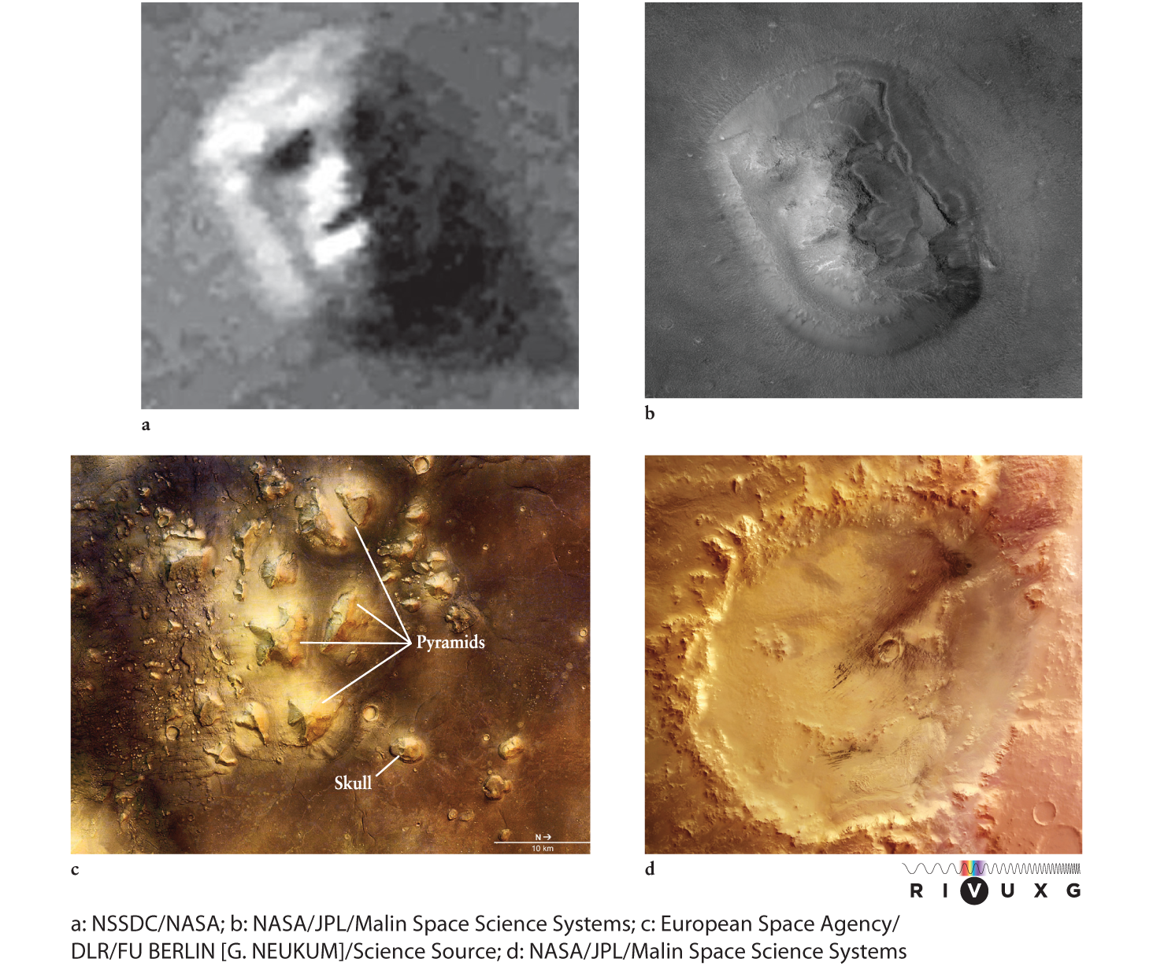
Pareidolia

