Slide 1
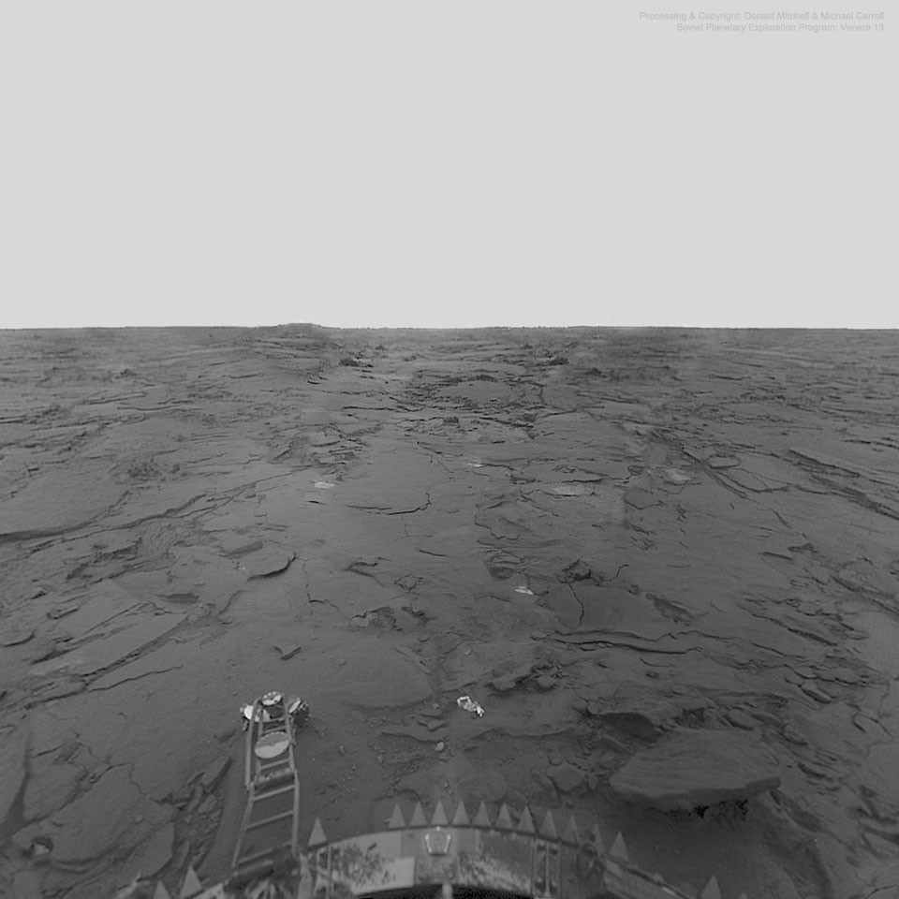
Venus
Earth’s (evil?) twin
§8.5–8.7

Slide 2
Compared to Earth
Diameter 0.949 of Earth
Mass 0.815 of Earth
Density 0.949 of Earth
Albedo 0.785
Atmosphere 92 bar
Composition similar to Earth’s second
96.5% CO₂, 3.5% N₂
Temperature 733 K

Slide 3
Surface Features
Imaged by hardy Soviet landers
Fractured basalt
Few craters
Many volcanoes
May be active
Evidence of recent eruption
Two major highlands
Ishtar (N), Aphrodite (S) Terras

Slide 4
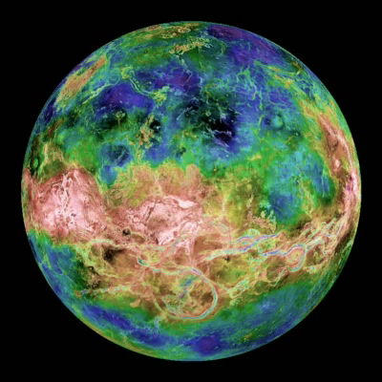
Global Topography of Venus
Source: NOAA

Slide 5
Global Topography of Venus

Slide 6
Spin and Orbit
Nearly circular orbit
eccentricity 0.0068
Slow, retrograde spin
Sidereal day –5832.6 h
Solar day 2802.0 h
Little orbital tilt
Obliquity 177.36° (–2.64°)

Slide 7
Geologic Processes
No plate tectonics
Thick crust?
Periodic resurfacing?

Slide 8
Magnetic Field
No intrinsic magnetic field, despite Earth-like iron core

