Slide 1
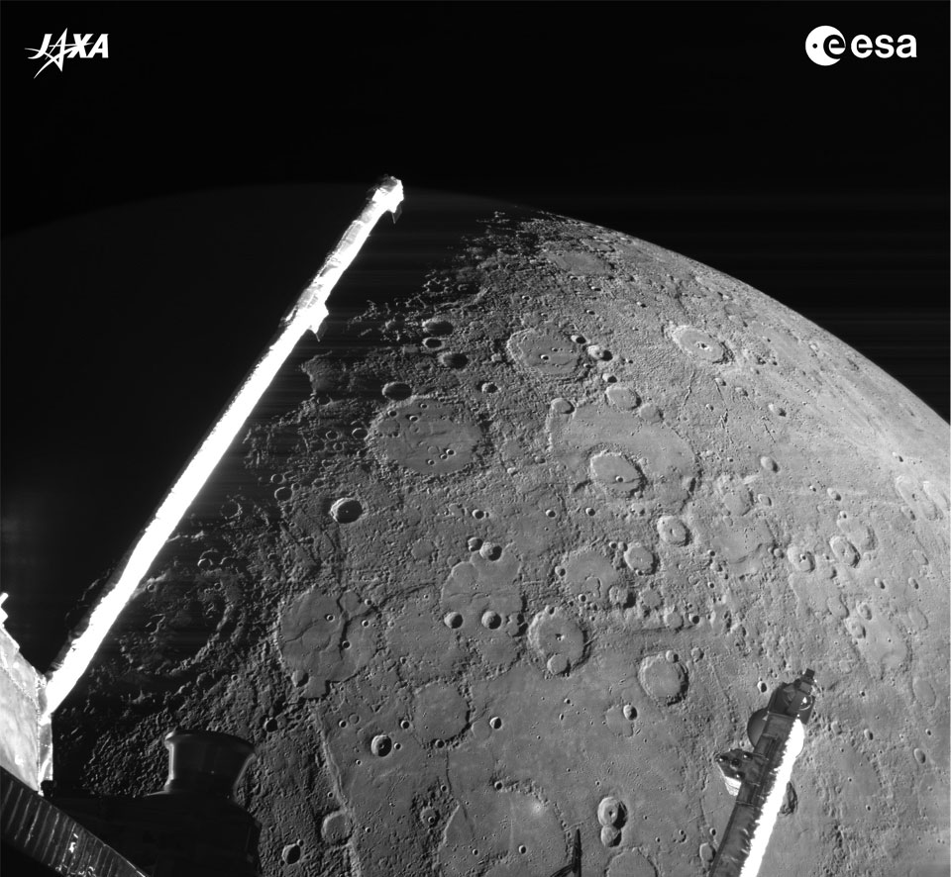
Mercury
the speedy one
§8.1–8.4
Image: JAXA and ESA

Slide 2
Mercury
The closest planet
The smallest planet

Slide 3
Compared to the Moon
Images: NASA, via Comins (Fig 8-2)

Slide 4
Compared to the Moon
Similar diameter
Cratered surface
Has lightly cratered lava plains (more cratered than maria)
Low albedo (0.12)
Higher density: 5430 vs 3340 kg/m³
Mostly core

Slide 5
Links
The surface of Mercury spinning
Spin the interactive disk
The Sun across the sky on Mercury

Slide 6
Caloris Basin
Largest surface feature
Giant impact structure
Fringed with mountains
Lava-filled
Central peak
Antipodal disturbance

Slide 7
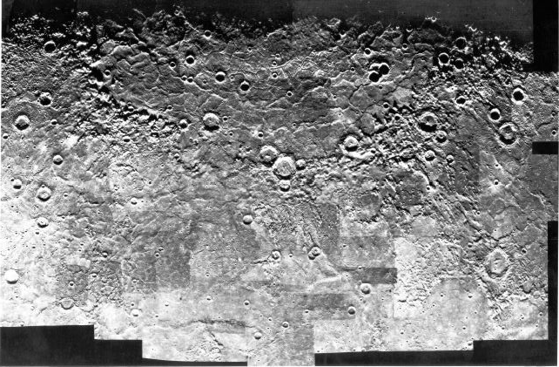
Caloris Basin
Image: NASA (Mariner 10)

Slide 8
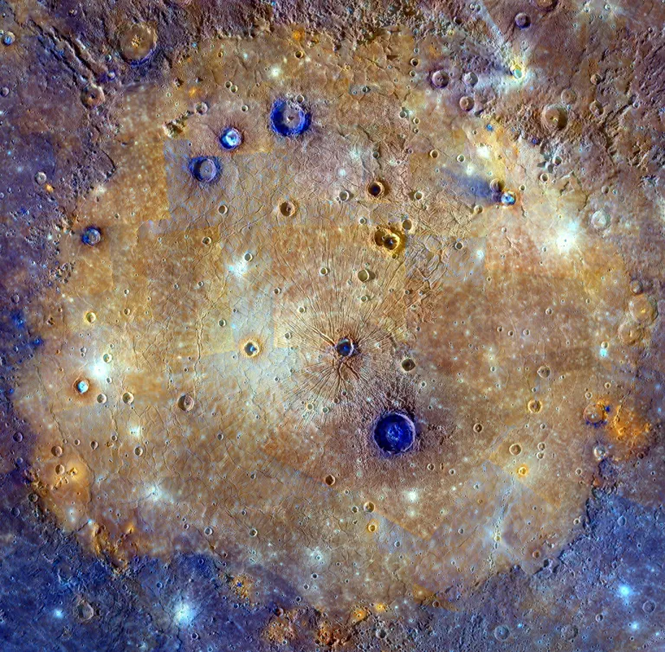
Caloris Basin

Slide 9
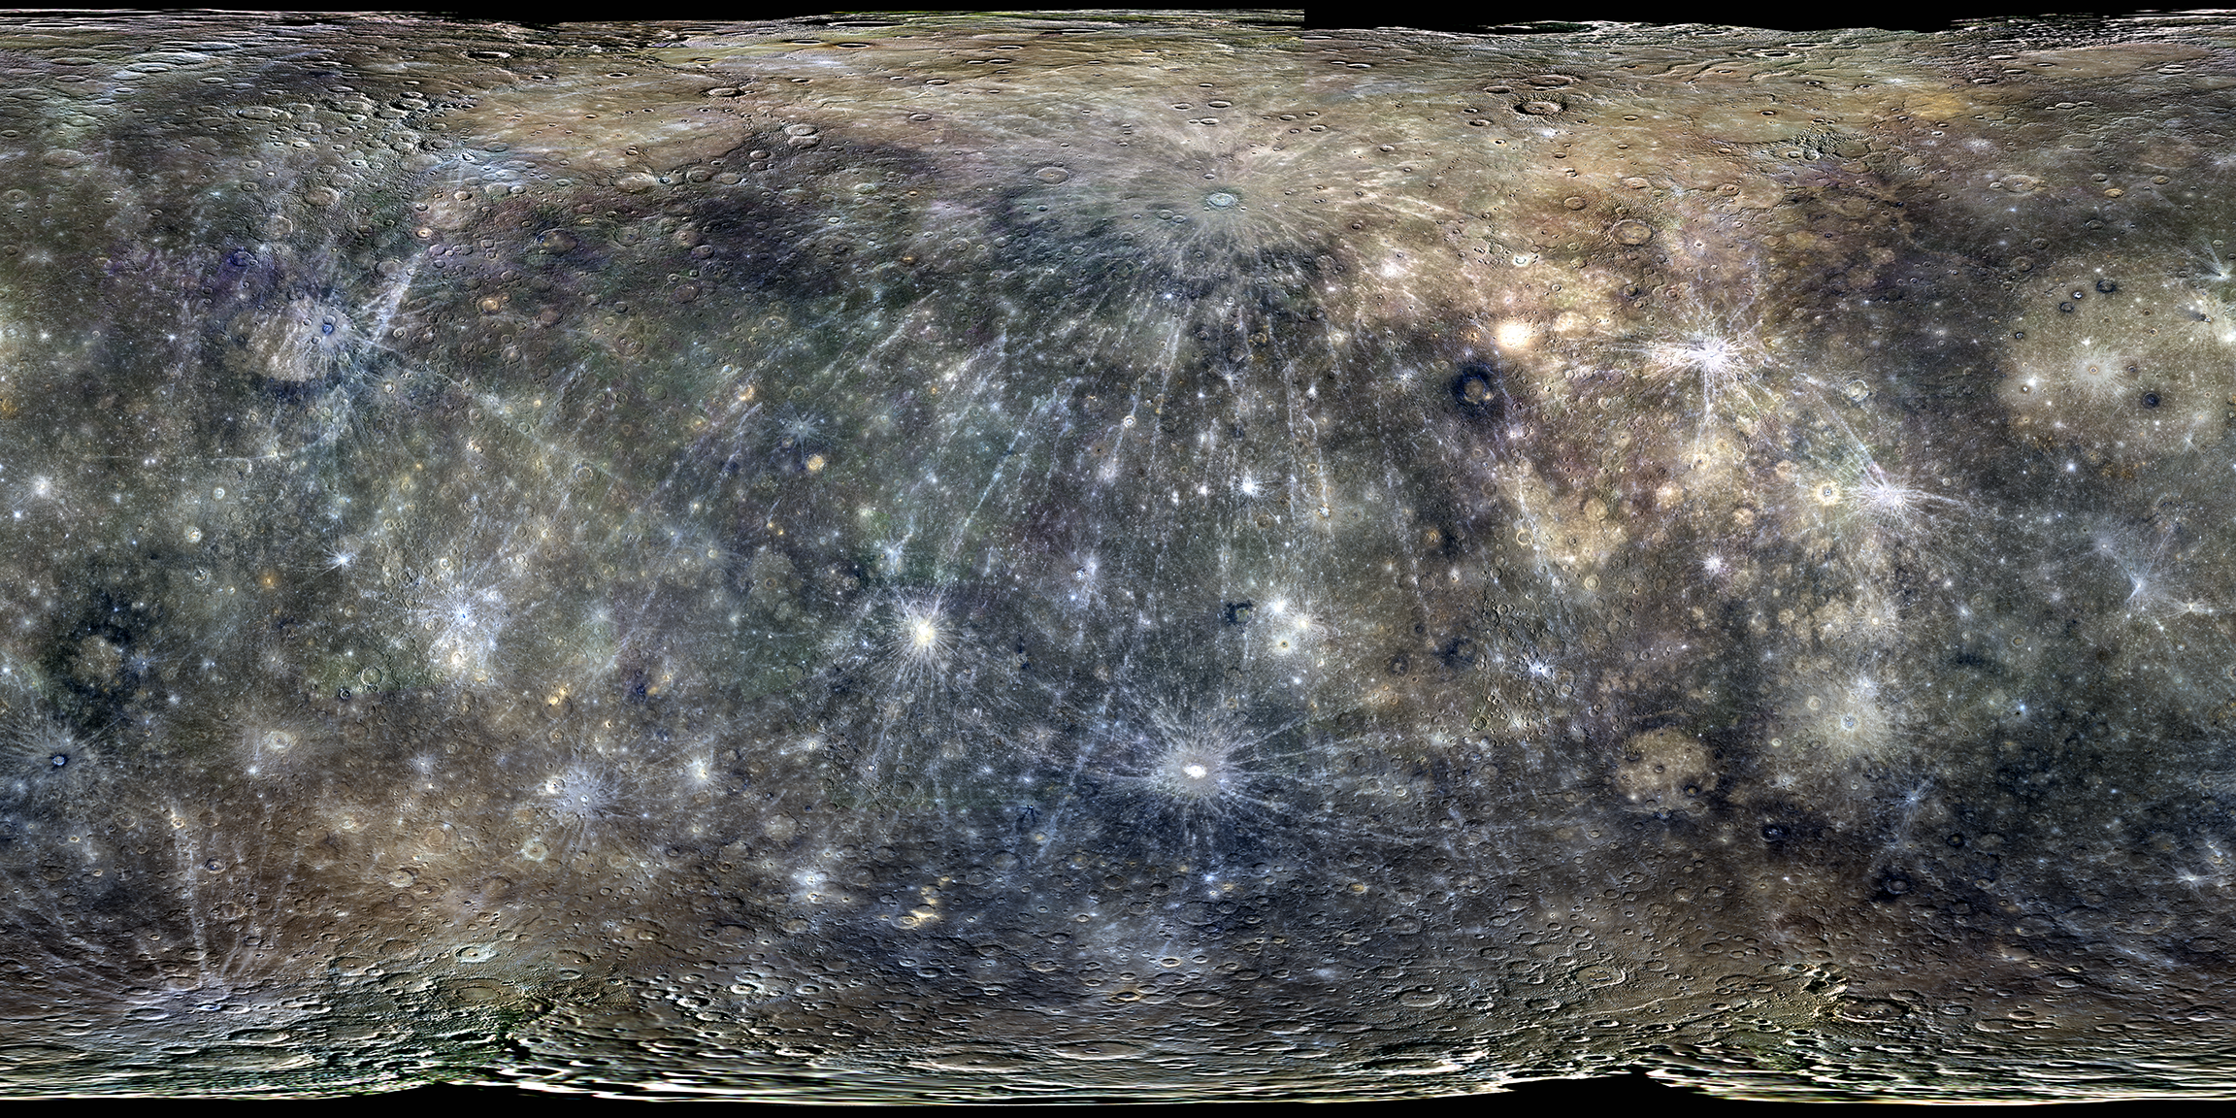
Conical Projection
MESSENGER mission, JHU APL

Slide 10
Why so dense?
Hypotheses
Difficulty accreting light material
Solar outburst
Giant impact

Slide 11
Spin and Orbit
Sidereal day 58.6 days
Sidereal year 88 days
Solar day 176 days (2 years)
3:2 resonance
3 sidereal days for every 2 sidereal years
Most eccentric orbit
eccentricity 0.2056; distance 0.31–0.47 AU

Slide 12
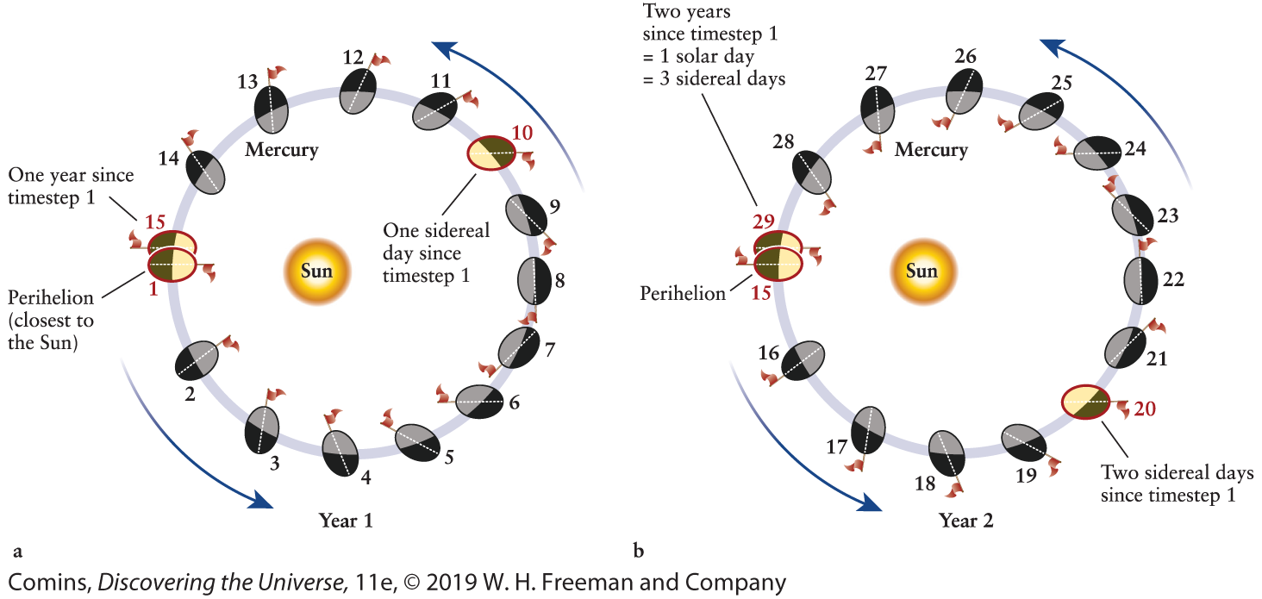
Spin and Orbit
Image: Figure 8-11

Slide 13
Magnetic Field
1% Earth’s strength, despite iron core
Offset 10°from rotation axis

