Slide 1
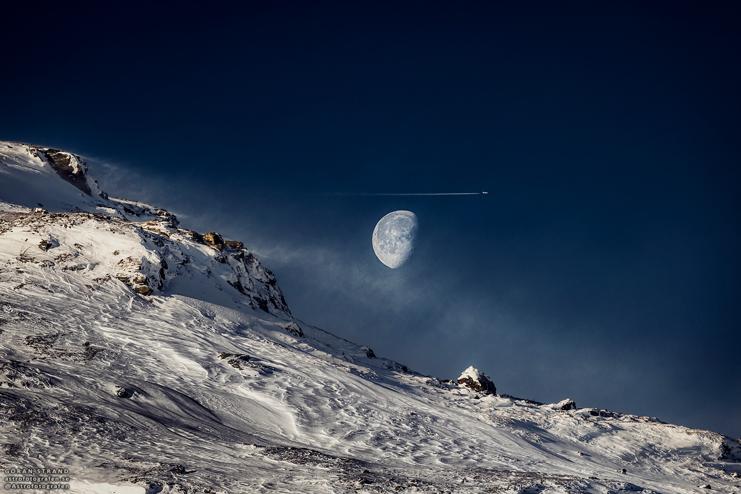
The Moon
a chip off the old block
Image: Göran Strand

Slide 2
Bright or Dark?
Second-brightest object in Earth’s sky
Albedo 0.12
Brighter per area when full
  shadow-hiding

Slide 3
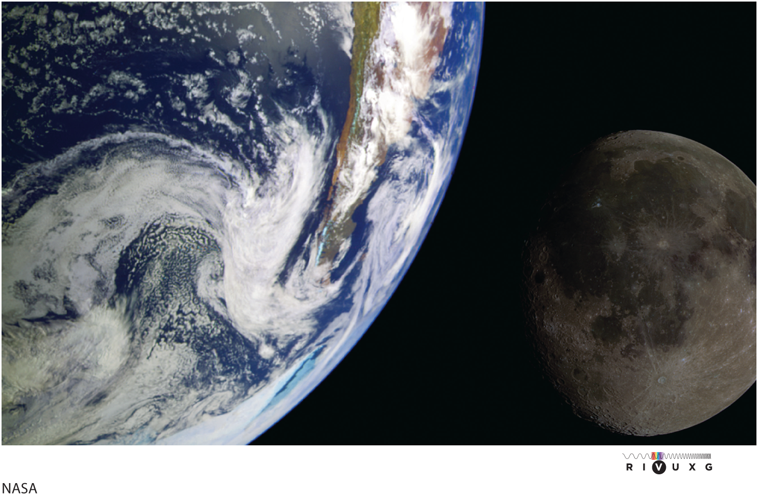

Slide 4
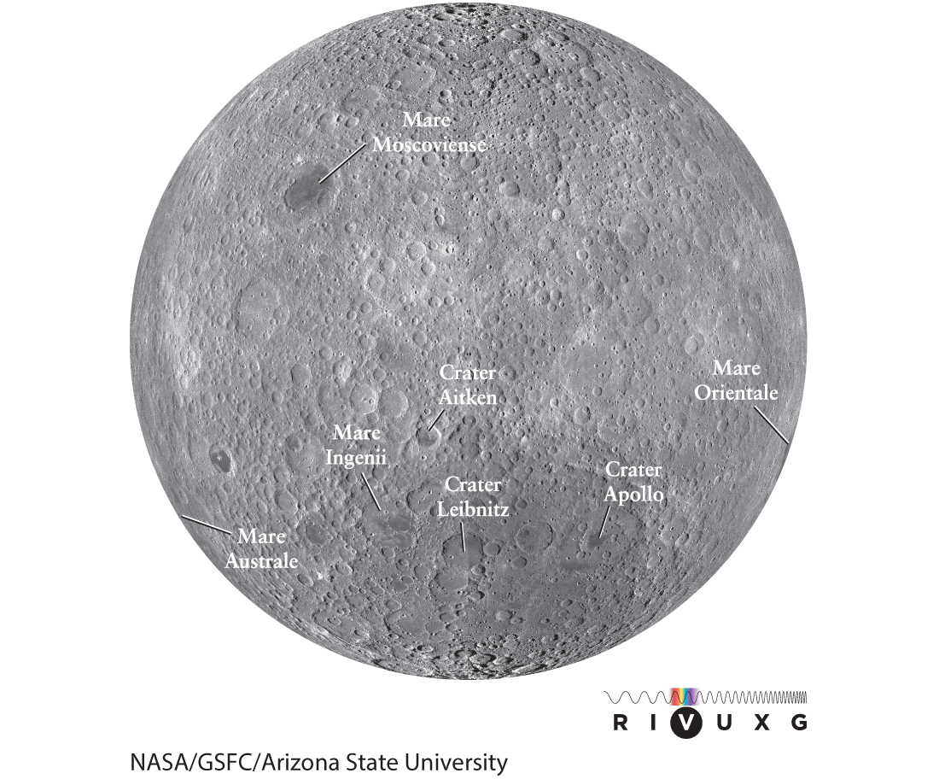
Far side

Slide 5
Surface
The Moon is cratered
The Moon has Maria
  darker than highlands
  less cratered than highlands

Slide 6
Craters
Highlands are most cratered
Maria are smoother
Far side is more cratered than near side

Slide 7
Crater Structure
Central peak
  Rebound of compressed substrate
Ejecta blanket
  Thinnest on side of impactor’s approach

Slide 8
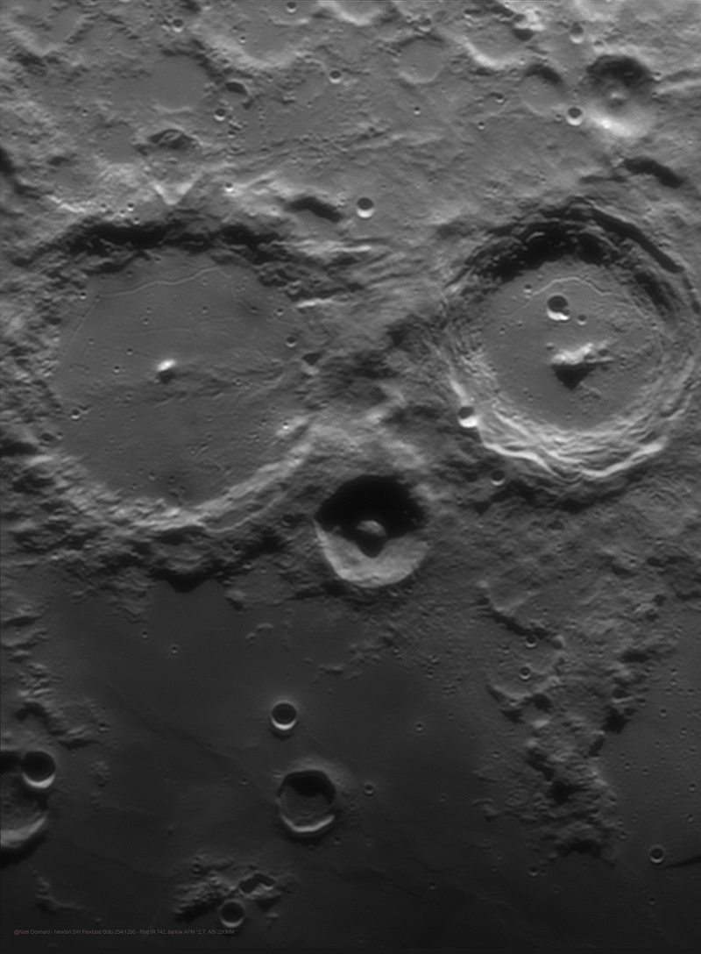
Alphonsus
Arzachel
Alpetragius
Imqge credit: Noel Donnard,
via NASA

Slide 9
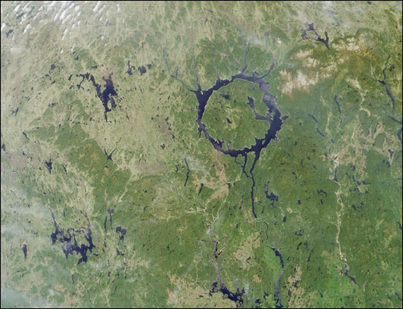
Manicouagan Impact Structure

Slide 10
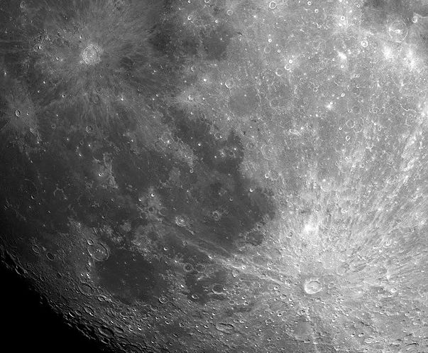
Craters Tycho and Copernicus
Image: Steve Mandel,
via NASA

Slide 11
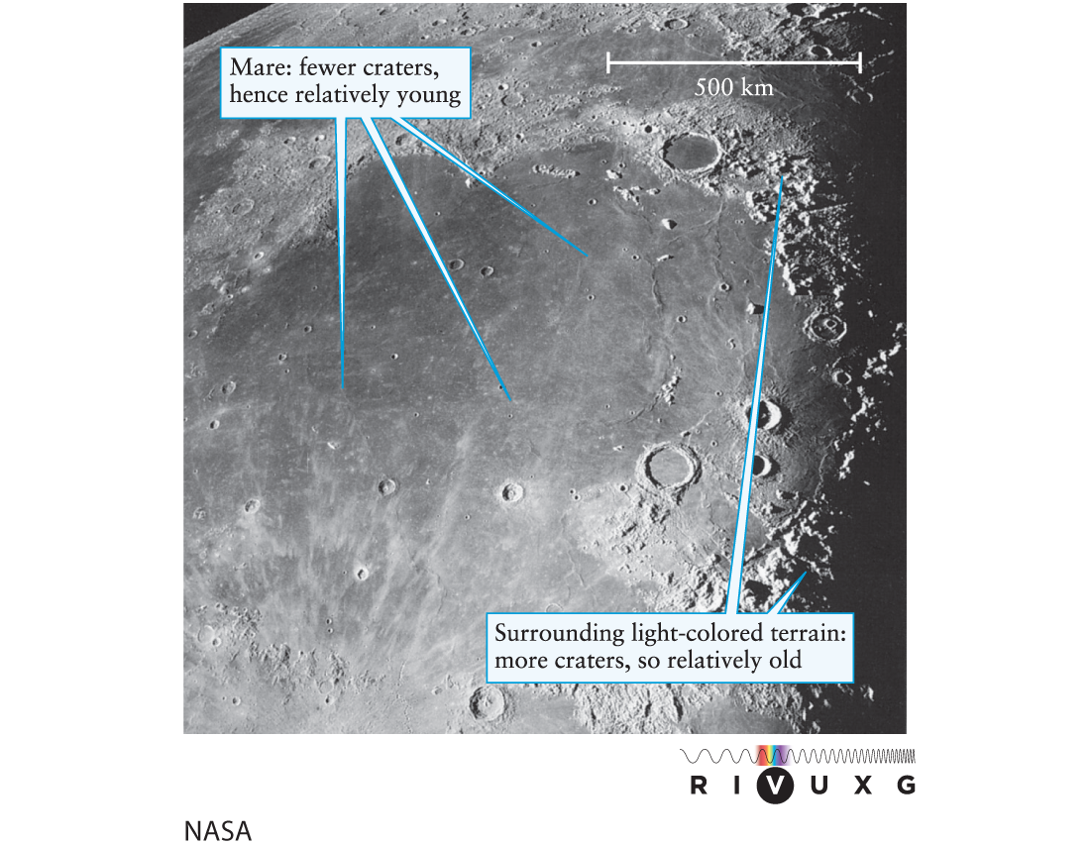
Maria

Slide 12
Maria
Flat, dark lowlands
Filled with relatively young basalt flows
May have arisen from extremely large impacts

Slide 13
Lunar Highlands
Older, lighter
Primarily anorthosite (largely Na/Ca feldspar)

Slide 14
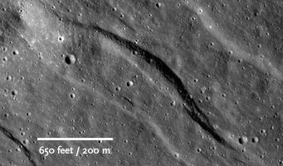
Lunar graben

Slide 15
Layers
Regolith
Crust
Mantle
Core
Moon lacks a magnetic field

Slide 16
Magnetic field
The Moon doesn’t have one
Some regions have minerals in magnetic alignment

Slide 17
Gravitational field
Irregular field near surface
Mascons: regions of higher density, gravity
Origin and composition uncertain

Slide 18
Moon Landings
Apollo 11, 12, 14–17 (1968–1972)
Placed scientific apparatus
  retroreflector
  seismometers
Collected samples
Took pictures
Great PR

Slide 19
How did the Moon form?

Slide 20
Creation Possibilities
Cocreation
  If so, why is Moon less dense than Earth?
Fission
  How could it have spun so fast?
  And what subsequently slowed it?
Capture
  How?
  Why so isotopically similar?

Slide 21
Impact hypothesis
Differentiated Earth struck by Mars-size body “Theia”
Impact debris formed a ring, which coalesced
Large Low-Velocity Provinces may be remnants of Theia

Slide 22
Tides
Force of gravity decreases with distance
  1/r²
Near side pulled more than far side
Creates tidal bulges

Slide 23
Tides
Earth’s spin advances bulge
Bulge pulls Moon forward
Moon speeds up
  moves farther away, slows down

Slide 24
Tidal forces
Push the Moon away from the Earth
  3.78 cm/y
Lengthen the Month
Lengthen the Day

Slide 25
Tidal locking
Moon does not reshape if one side always faces Earth
Synchronous rotation

