Slide 1
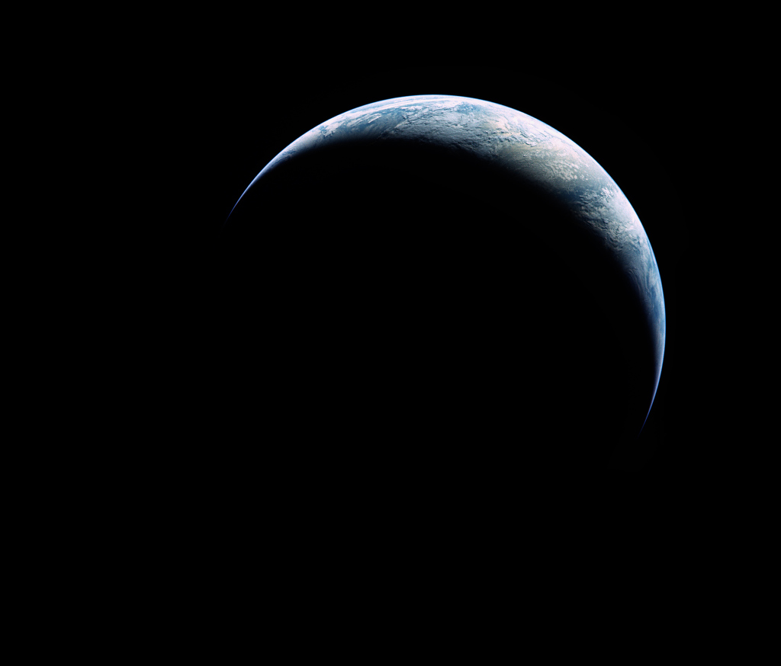
Earth
our dynamic planet
Image: Apollo 17, via Astronomy Picture of the Day

Slide 2
The Earth
Interior
Crust
Atmosphere
Magnetic field

Slide 3
Inside the Earth
mysterious and inaccessible

Slide 4
Sources of Information
Earthquakes
Magnetism
Gravity
Some rocks
Meteorites

Slide 5
Seismic Wave Findings
Speed increases with depth
Definite layers
Liquid outer core

Slide 6
Magnetism
Earth has a magnetic field
Interior too hot to be solid iron
So: electric currents in liquid metal core

Slide 7
Gravity
Earth has high density
  Much higher than rocks
  Deeper rocks are denser
  Deepest rocks are largely olivine
Gravity increases with depth in mines
So: interior must be denser than exterior

Slide 8
Meteorites
Types: stony, stony/iron, iron/nickel
Protoplanetary solar system bodies differentiated, then collided and fragmented
So: earth probably contains similar zones

Slide 9
Conclusions
Inner core: Dense solid. High pressure and temperature. Fe/Ni/S.
Outer core: Liquid Fe/Ni/S.
Mantle: Several layers. Plastic solid. Mafic minerals (olivines).
Crust: Thin (5–75 km) low-density solid.

Slide 10
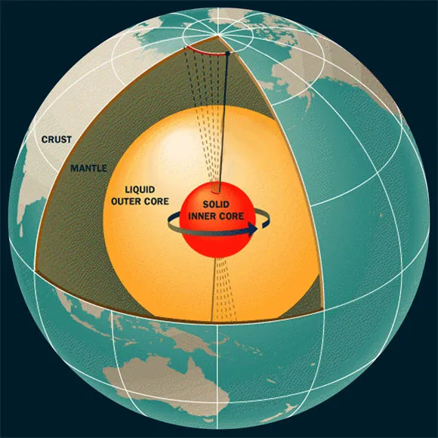
Interior
Source: NASA

Slide 11
Plate Processes
the surface is dynamic

Slide 12
Continental Collision
Image: Brian Cezar Penic, from Shutterstock

Slide 13
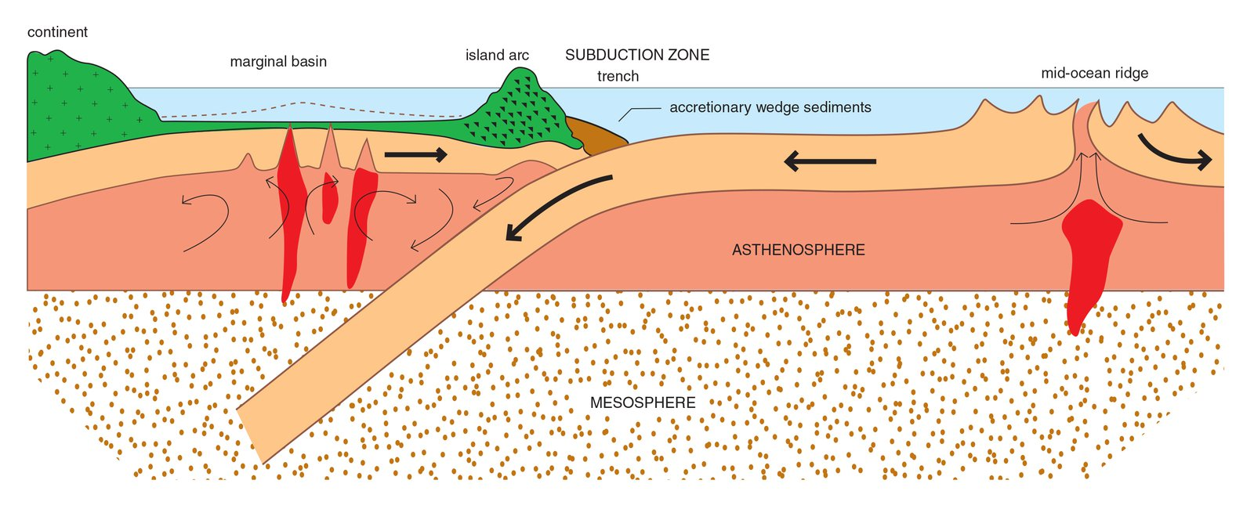
Subduction
Image: Australian Museum

Slide 14
Plate rifting
Source: Study.com

Slide 15
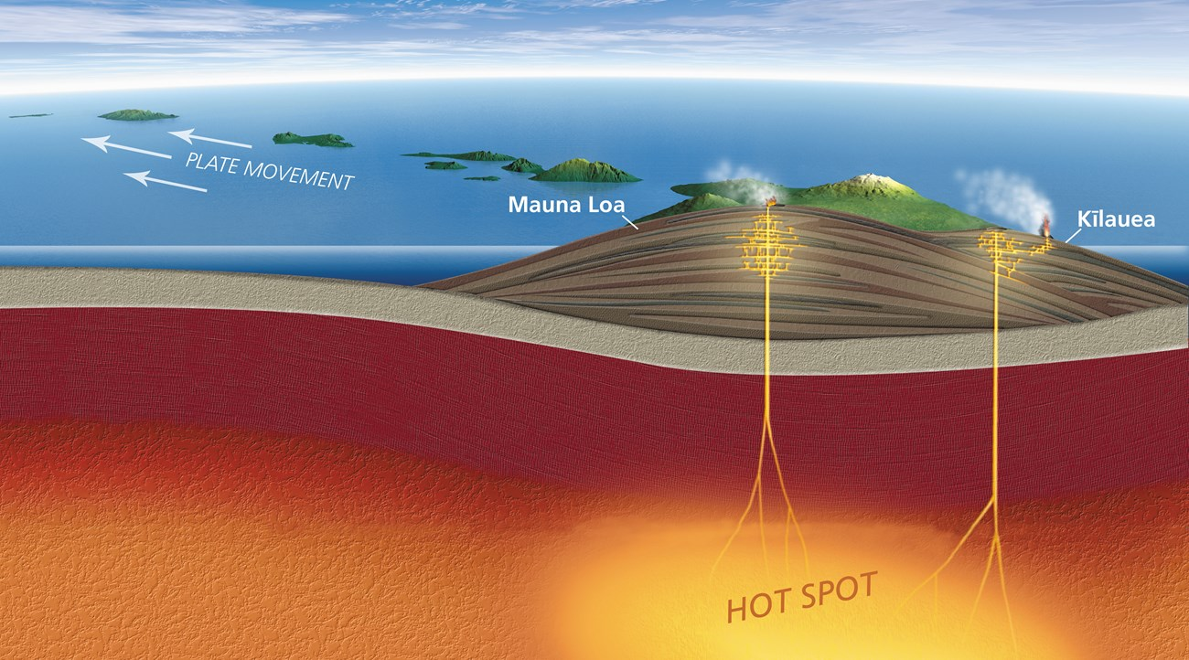
Hot Spot Volcanoes
Image: Hawaii Volcanoes National Park

Slide 16
Earth’s Atmosphere
Third time is the charm

Slide 17
Third atmosphere
Primordial nebula
Heavier gases
Current atmosphere

Slide 18
Primordial Nebula
Mostly H₂, some He
What happened?

Slide 19
Heavier Gases
CO₂, H₂O, N₂, CH₄
What happened?
  Water dissolves CO₂
  Carbonate replaces silicate
  Carbonates fixed in shells
  Photosynthesis consumes CO₂

Slide 20
Current Atmosphere
How did we get N₂?
How did we get O₂?
How did we get Ar?

Slide 21
Atmospheric Greenhouse
Keeps the surface warmer

Slide 22
Planet with No Atmosphere
Temperature rises if input > output
Output rises as temperature rises
Temperature steady when input = output
IR output to space
Surface energy changes with absorption and radiation
Solar energy input

Slide 23
With an Atmosphere
Atmosphere absorbs some outgoing IR
Atmosphere warms and radiates
Some radiation re-absorbed by surface
radiation by atmosphere
absorption by atmosphere
IR output to space
Surface energy changes with absorption and radiation
Solar energy input

Slide 24
Earth’s Magnetic Field

Slide 25
Earth’s Magnetic Field
Strongest magnetic field of the rocky planets
Largely a simple dipole
Slightly tilted from geographic axis
Axis wanders
Polarity flips chaotically

Slide 26
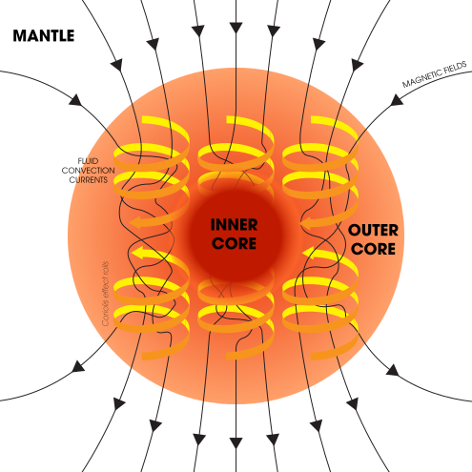
Geodynamo
Poorly understood
Target of active research
Source: NASA

Slide 27
Ions and Magnets
Magnetic fields act on electric charges
Ion paths are deflected if motion is across field lines
Ions move freely along field lines
Ions trapped in toroidal (van Allen) belts
Strike upper atmosphere near poles (Auroras)

Slide 28
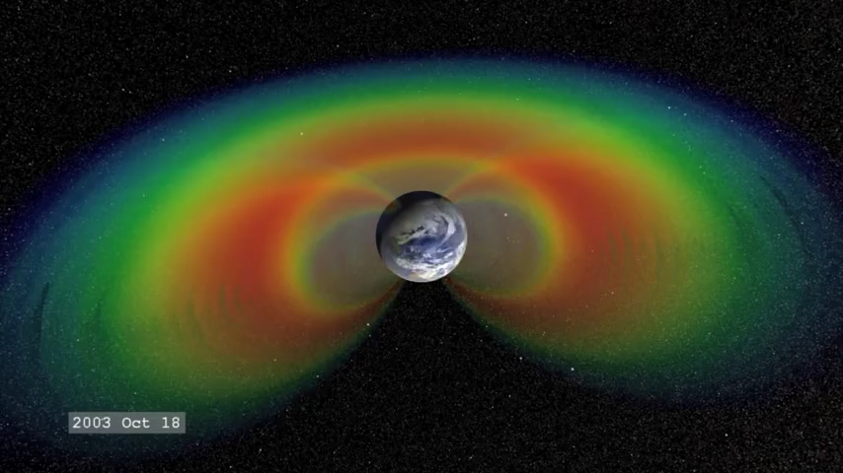
Van Allen Belts
Source: NASA

Slide 29
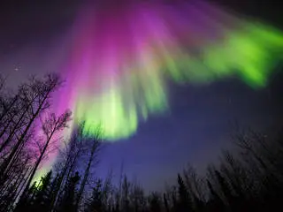
Aurora
Image: Sebastian Saarloos, via NASA

