Slide 1
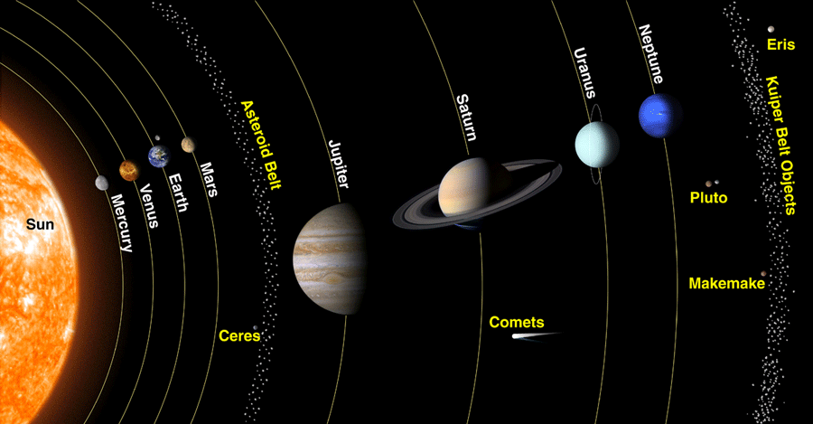
How We‡ Got Here
Image: NASA, via Wikimedia
‡Mercury, Venus, Earth, Mars, Asteroids, Jupiter, Saturn, Uranus, Neptune, KBO’s

Slide 2
What we have now
Rocky planets close to the Sun
mass increases with distance except for Mars
Giant planets more distant
Jupiter and Saturn mostly H, He
Uranus and Neptune contain “ices:” N₂, CH₄, NH₃, H₂O
Rocky fragments
Icy fragments

Slide 3
Kuiper Belt
TNOs approximately in the ecliptic
Pluto is a KBO
More are being discovered
Pluto
Image: NASA/APL/SRI
Pluto’s largest moon Charon
Image: NASA/APL/SRI
KBO Arrokoth
Image: NASA

Slide 4
Oort Cloud
Hypothesized reservoir of comets
Approximately spherical
not oriented with ecliptic
Why we think so: many comets approach far from ecliptic plane
No objects imaged in Oort cloud

Slide 5
Proto-Solar System
Condensed from a solar nebula which collapsed to a protostar and protoplanetary disk
Why we think so: concurrent rotation of Solar system bodies

Slide 6
When Did it Condense?
about 4.6 Ga
Why we think so: radioactive dating of meteorites

Slide 7
What Happened Before?
At least one generation of stars
Why we think so: presence of metals

Slide 8
What Caused the Jeans Instability?
Probably a supernova shock wave
Why we think so:
radioactive atoms
something had to do it

Slide 9
What about Pt, Au, U, etc.?
Neutron star merger
Why we think so: what else could make elements so much heavier than Fe?

Slide 10
Asteroids and Comets
Asteroids are mostly rocky
Comets about half rock, half ice
Asteroids probably condensed inside the snow line, comets outside
Why we think so: most comets have distant orbits

Slide 11
Questions
Are location and composition correlated?
How did planets establish their orbits?
Why is Mars so small?
What’s with the asteroids?
So few
Disparate compositions
Neither consolidated nor cleared
Ice giant composition (little H, He)

Slide 12
Nice Model
Constructed by computational simulations of collapsing nebula
Our best guess to date
Awaiting further observational and computational confirmation

Slide 13
Nice Model
Rocky planets formed inside snow line, giant planets outside
more material at greater radii
Jupiter formed first
head start
Jupiter moved inward as orbit decayed
disrupted Mars’s matter supply

Slide 14
Nice Model
Saturn halted Jupiter’s inward fall
“Grand tack”
Disrupted Asteroid belt
ejected many rocky bodies
pulled in icy bodies

Slide 15
Nice Model
Jupiter and Saturn have compositions similar to Sun
Uranus and Neptune comprise heavier substances
H, He difficult to gravitationally capture
Saturn pushed Uranus and Neptune outward
Jupiter pushed Saturn outward

Slide 16
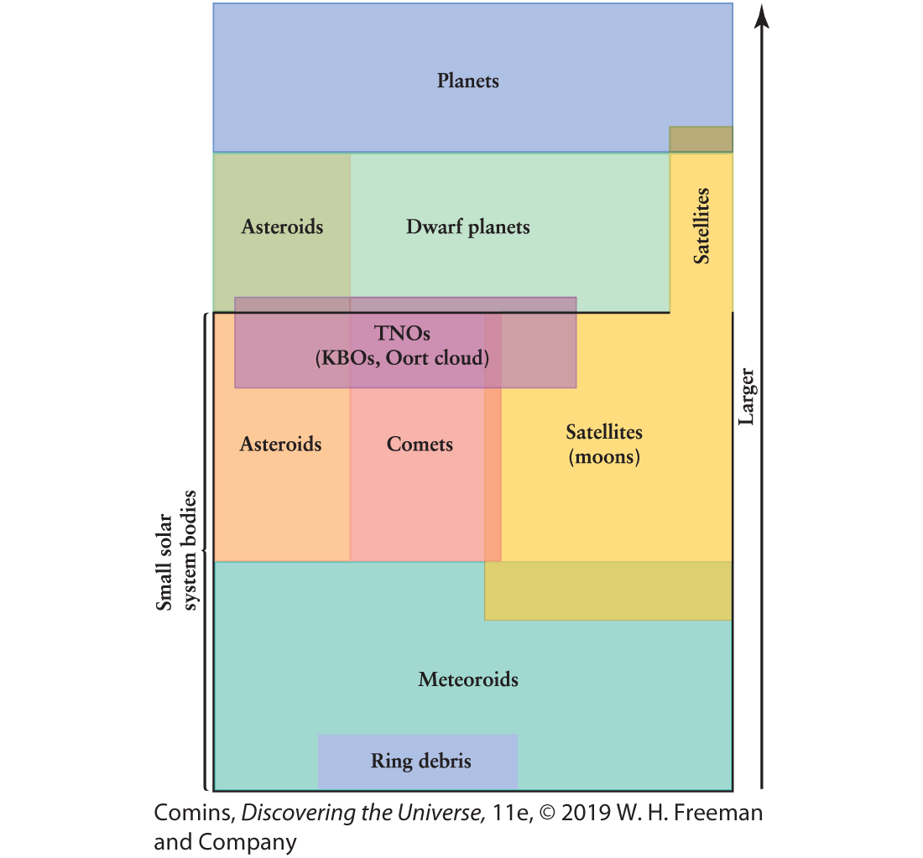
What we have

Slide 17
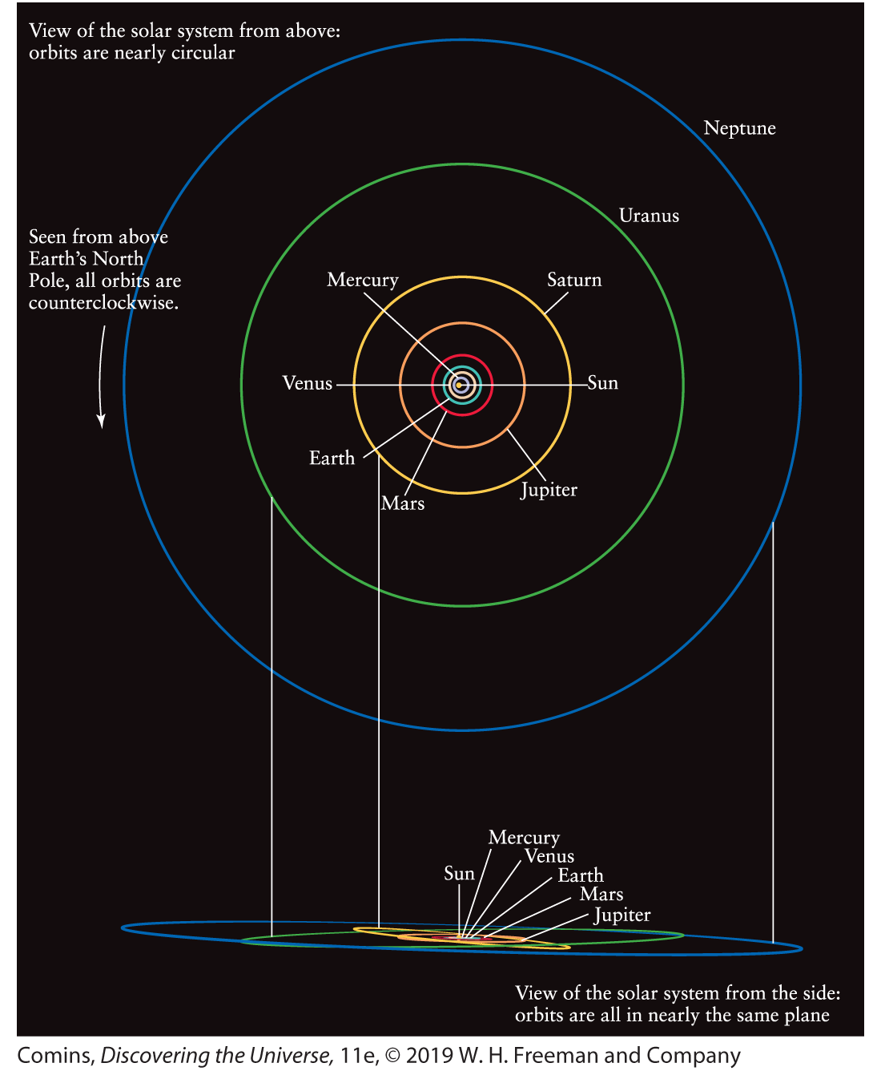
Orbit comparison

Slide 18
Sizes and Densities
 | Diameter:(km) | Diameter: (Earth = 1) | Mass: (kg) | Mass: (Earth = 1) | Average density: (kg/m³)
Mercury | 4878 | 0.38 | 3.3 × 10²³ | 0.06 | 5430
Venus | 12,100 | 0.95 | 4.9 × 10²⁴ | 0.81 | 5250
Earth | 12,756 | 1.00 | 6.0 × 10²⁴ | 1.00 | 5520
Mars | 6786 | 0.53 | 6.4 × 10²³ | 0.11 | 3950
Jupiter | 142,984 | 11.21 | 1.9 × 10²⁷ | 317.94 | 1330
Saturn | 120,536 | 9.45 | 5.7 × 10²⁶ | 95.18 | 690
Uranus | 51,118 | 4.01 | 8.7 × 10²⁵ | 14.53 | 1290
Neptune | 49,528 | 3.88 | 1.0 × 10²⁶ | 17.14 | 1640

Slide 19
Orbits
 | a (AU) | T (y) | a³ | T²
Mercury | 0.39 | 0.24 | 0.0593 | 0.0576
Venus | 0.72 | 0.62 | 0.373 | .384
Earth | 1.00 | 1.00 | 1 | 1
Mars | 1.52 | 1.88 | 3.51 | 3.53
Jupiter | 5.20 | 11.86 | 141 | 141
Saturn | 9.54 | 29.46 | 868 | 868
Uranus | 19.19 | 84.01 | 7067 | 7057
Neptune | 30.06 | 164.79 | 27162 | 27156

Slide 20
What we Observe
Distance
Size
Albedo
Spectrum
Mass
Spin
Magnetic field
Mass distribution
Age (if we can sample it)

