Slide 1
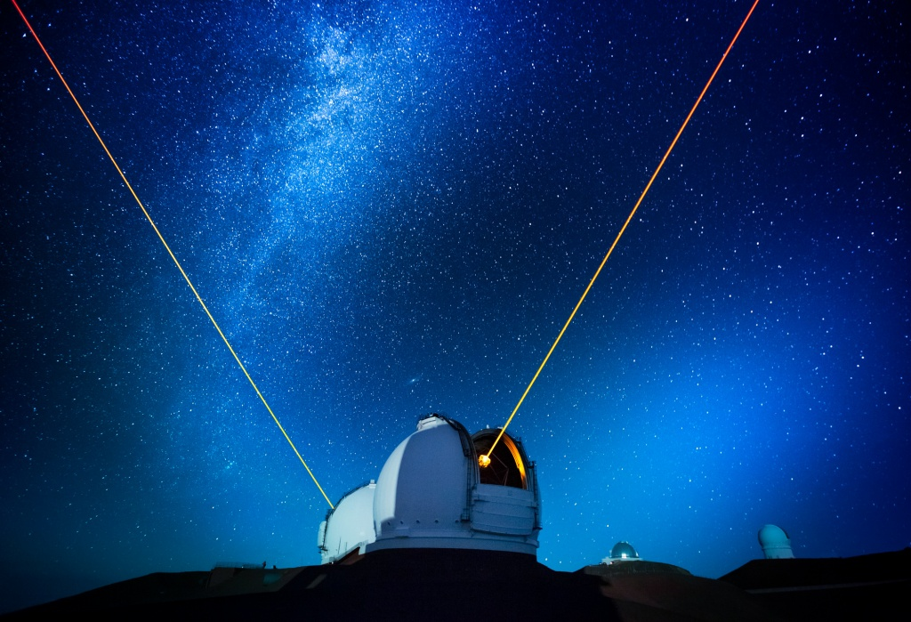
Telescopes
Seeing the heavens

Slide 2
Better than Our Eyes
Telescopes allow us to
See things that are too dim for our eyes
See things in finer detail than our eyes allow

Slide 3
Better than Our Eyes
Detectors allow us to
Keep accurate records
Observe for extended times
See wavelengths our eyes can’t
Make quantitative measurements

Slide 4
Focusing light
How images form

Slide 5
Wave refraction
θ₁
Snell’s Law:
u₂ sinθ₁ = u₁ sinθ₂
n₁ sinθ₁ = n₂ sinθ₂
Speed u₁
Refractive index n₁
Speed u₂
Refractive index n₂
n₂ > n₁
u₂ < u₁
θ₂

Slide 6
Refraction Through a Plate
θ₁
θ₂
θ₂
θ₃
n
sinθ₁ = n sinθ₂
sinθ₃ = n sinθ₂

Slide 7
Refraction Through a Prism
θ₁
θ₂
n
sinθ₁ = n sinθ₂

Slide 8
Refraction Through a Prism
θ₃
θ₄
n
sinθ₄ = n sinθ₃

Slide 9
Converging Lens
focus

Slide 10
Converging Lens
object inside focus
image
virtualupright
object

Slide 11
Converging Lens
object outside focus
object
image
real
inverted

Slide 12
Converging Lens
object at infinity
object
image
at the focal plane

Slide 13
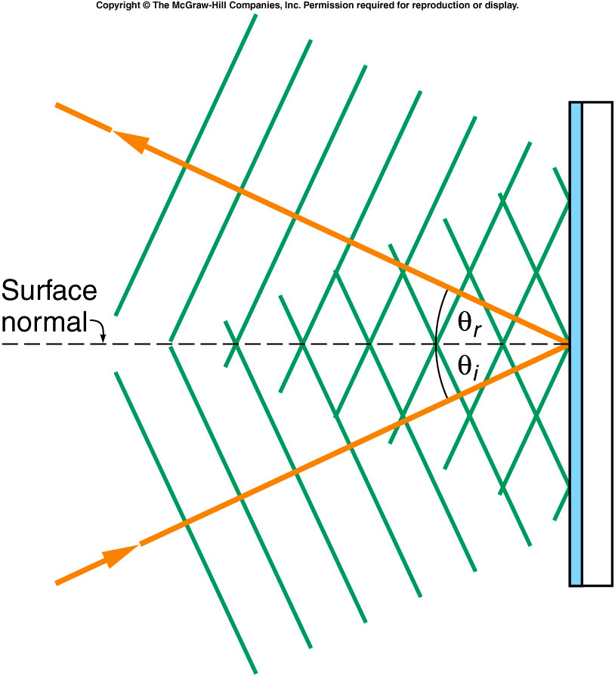
Plane mirror reflection
θ_{r} = θ_{i}
Source: Griffith

Slide 14
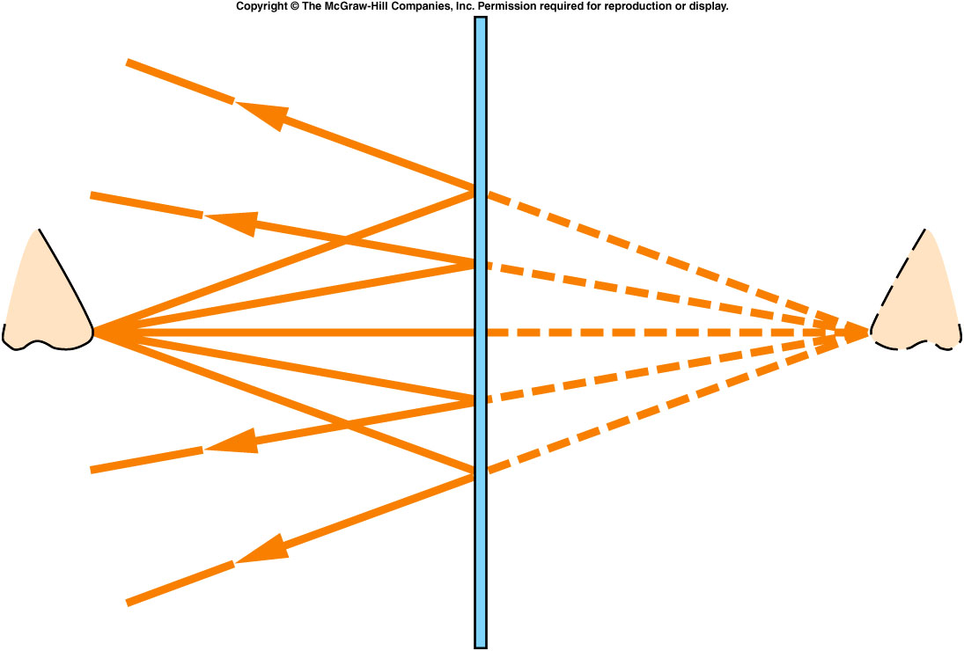
Plane Mirror Image
Source: Griffith, The Physics of Everyday Phenomena

Slide 15
Converging Mirror
focus

Slide 16
Converging Mirror
object inside focus
object
image
virtualupright

Slide 17
Converging Mirror
object outside focus
object
image
real inverted

Slide 18
Converging Mirror
object
object at infinity
image
at prime focus

Slide 19
Light is Faint
A larger aperture gathers more light
Proportional to area
Area proportional to square of radius

Slide 20
Mirrors vs. Lenses
Mirror disadvantages:
Detector or secondary mirror blocks incoming light
  dims the image
  Diffraction spikes

Slide 21
Mirrors vs. Lenses
Lens disadvantages:
Chromatic aberration
Uniformity is crucial
Large pieces sag
  differently at different orientations

Slide 22
Possible Goals
To see a picture
To take a spectrum

Slide 23
To see a picture
Place the detector at the focal plane

Slide 24
Light Diffracts
Even if the source is a point, the image is actually a diffraction pattern
Subtended angle θ such that sin θ = λ/D
  wavelength is λ
  aperture is D
One reason a large telescope gives better images

Slide 25
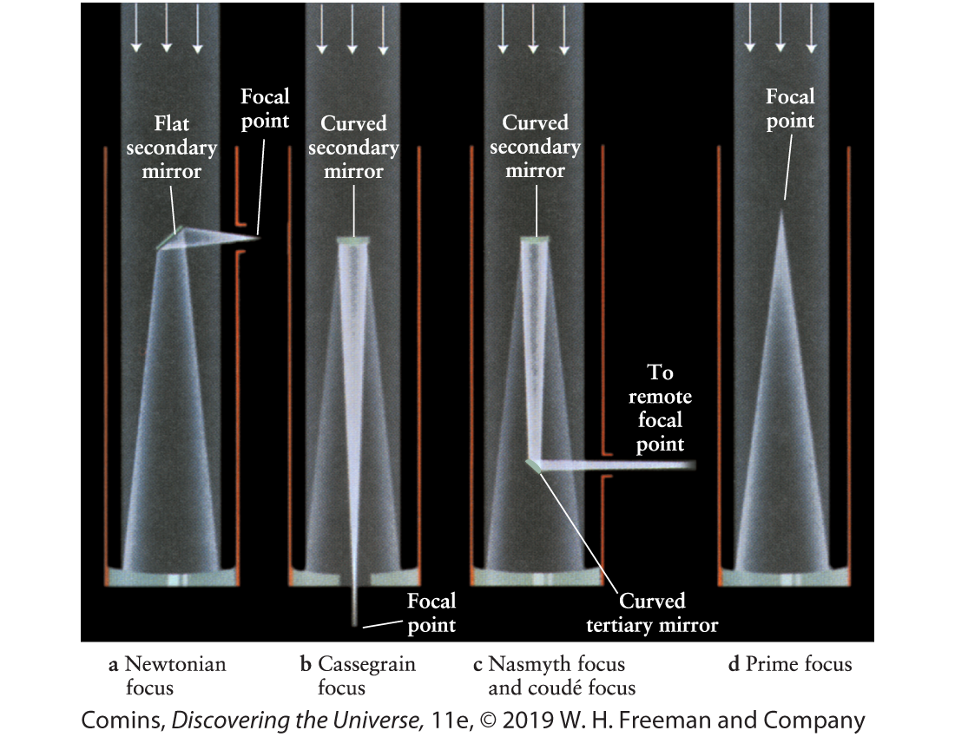
Reflector Designs

Slide 26
Observational Challenges
The atmosphere!
precipitation
clouds
turbulence
absorbance
light pollution
temperature changes

Slide 27
Coping with Challenges
Site telescopes high
Site telescopes dry
Site telescopes remotely
Site telescopes in the sky (orbit)

Slide 28
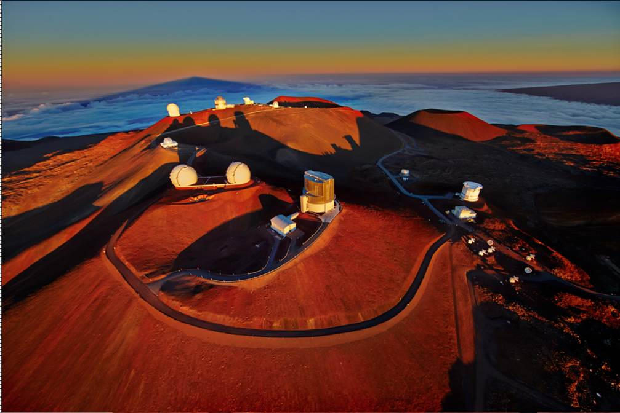

Slide 29
High-tech Coping
Active optics: adjusts mirror shape to compensate for changing stresses
Adaptive optics: re-shape mirror in real time in response to wobble of a reference signal

Slide 30
Detectors
Eyepiece
Photographic plate
CCD
CMOS

Slide 31
Interferometry
Combine signals from separate detectors
Achieves resolution advantage of large aperture
Especially useful for long wavelengths

Slide 32
All the Light We Cannot See
we still want to detect

Slide 33
Near-IR and Near-UV
can use optical technology
Some problems with atmospheric absorption

Slide 34
Infrared
long-wave shows cool dust
short-wave see through dust
red-shifted distant sources

Slide 35
Radio Astronomy
Not obscured by clouds, rain, etc
Detects objects that are visually unremarkable or invisible
Sees H atoms (21 cm)
Large dishes, large arrays

Slide 36
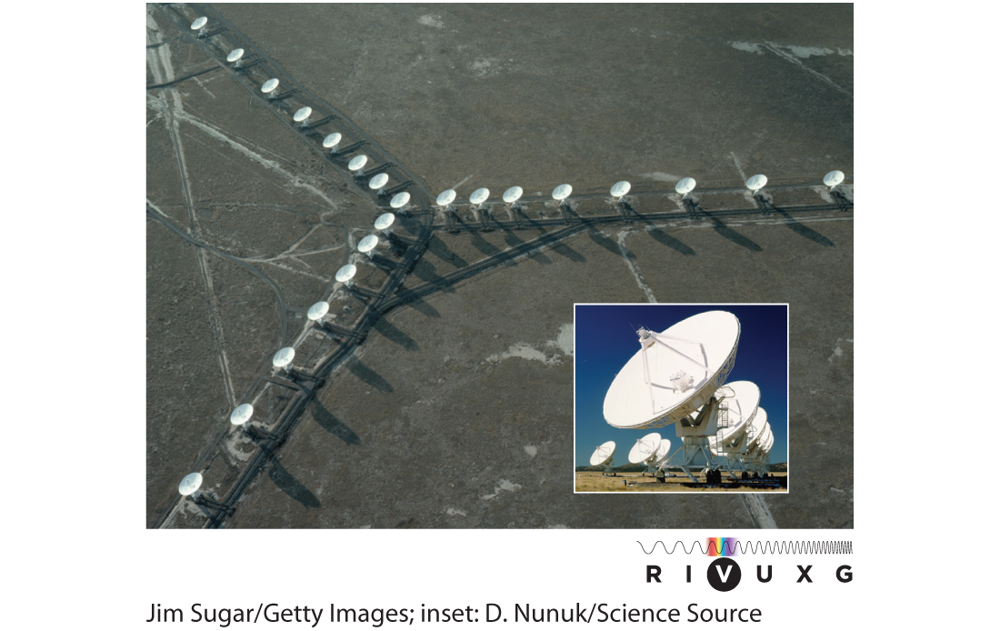

Slide 37
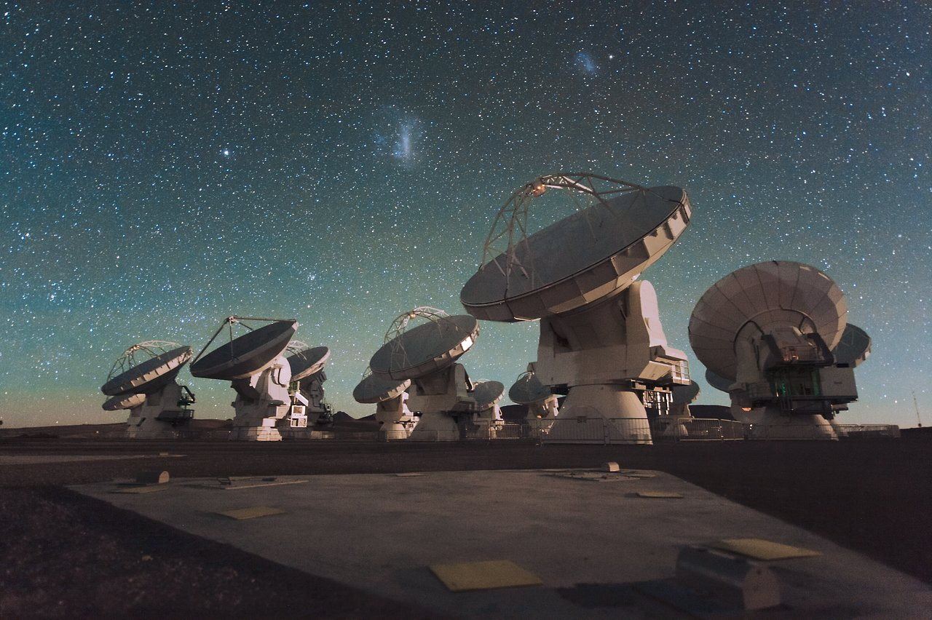

Slide 38
Microwave Astronomy
Atmospheric absorption
Important for cosmology (CMB)

Slide 39
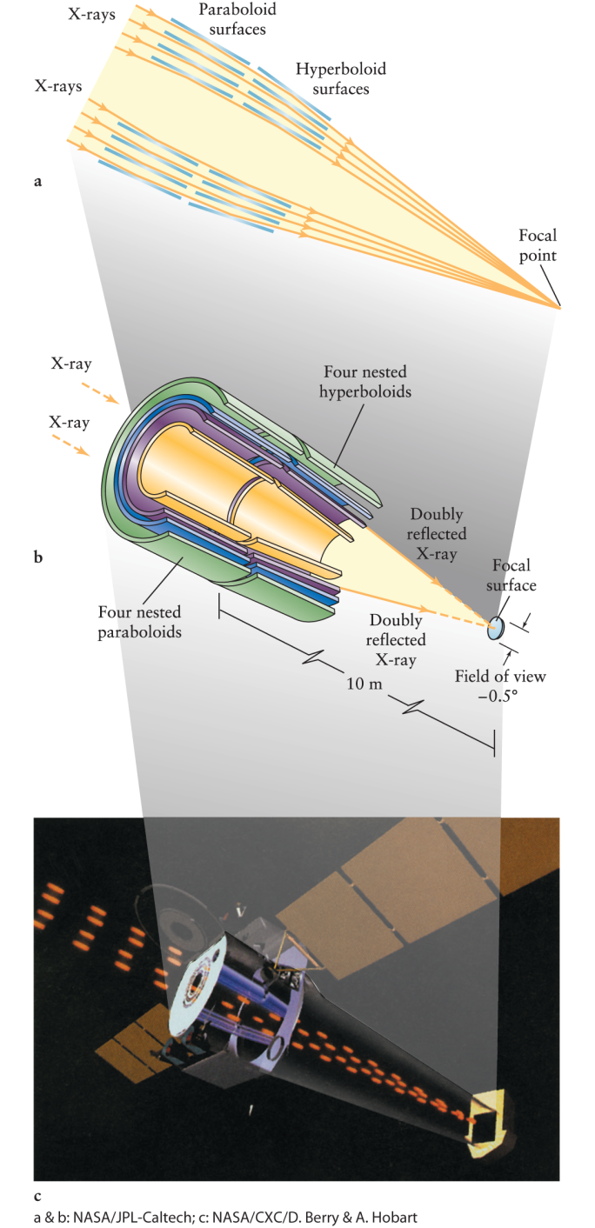
X-ray
Must be above the atmosphere
grazing incidence mirrors

Slide 40
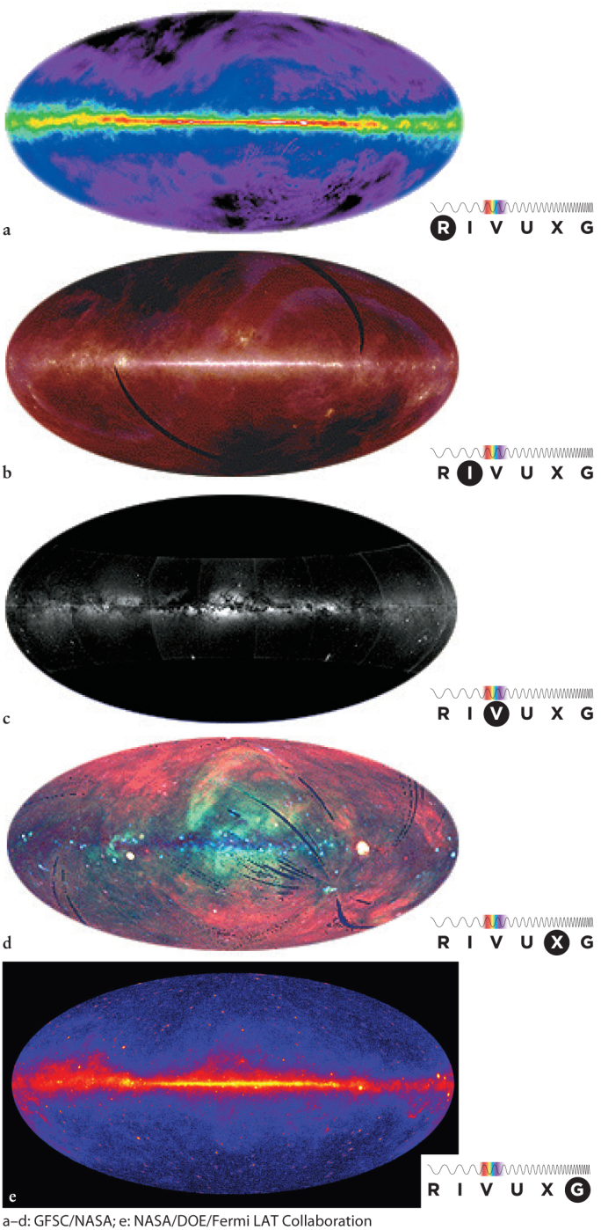
Pictures

Slide 41
Non-EM Observations
Meteorites
  our Solar system
Cosmic rays
  difficult to interpret
Neutrinos
  interiors of stars
Gravity waves
  eventually detected

