Slide 1
Learning from Light
What does it tell?
Notes:
This lecture takes lots of demonstration apparatus:
Transmission overhead projector with
Diffraction grating after focusing lens
Slit mask
Square mask
CMY filters
RGB filters
RGB filter wheels
Vertical-slit lamp and variac
Class set of diffraction gratings
R, G, B projectors

Slide 2
Doppler Effect
Seen with periodic waves
f_{s}
f = f_{s}
f < f_{s}
u
f < f_{s}
u

Slide 3
Doppler Effect
For sources v << c:
f = f_{s} (1 ± v/c)
+ if source approaches
– if source recedes
No correction for velocity relative to the medium
At high v, correction for time dilation

Slide 4
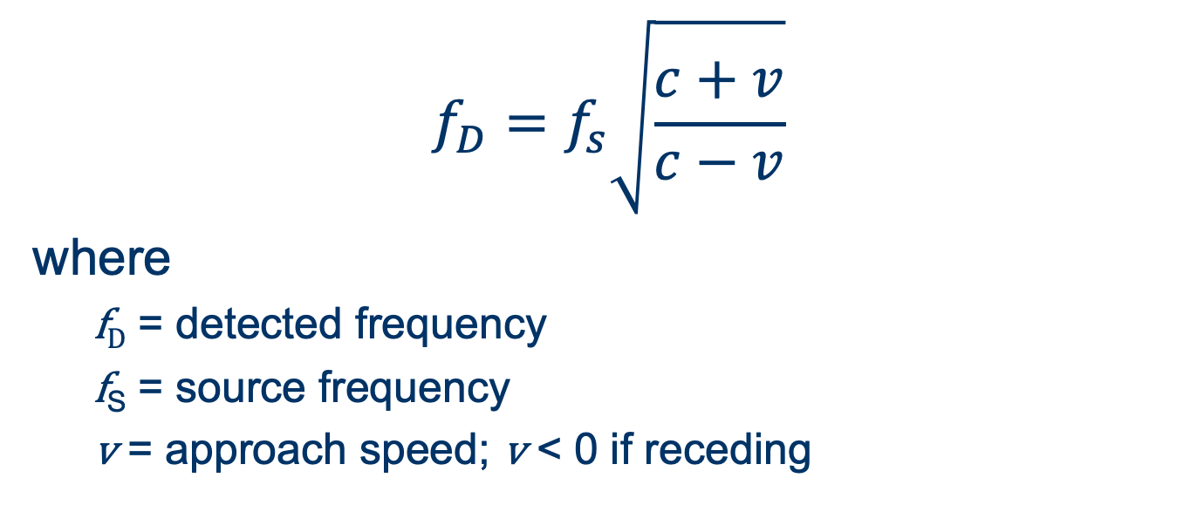
Relativistic Doppler formula
v

Slide 5
Three Types of Spectra
Continuous spectrum—smooth rainbow of light, though different intensities at different wavelengths
Emission line spectrum—only specific wavelengths of light, produced by low-density warm gas
Absorption line spectrum—a continuous spectrum, overlayed with dark lines at specific wavelengths

Slide 6
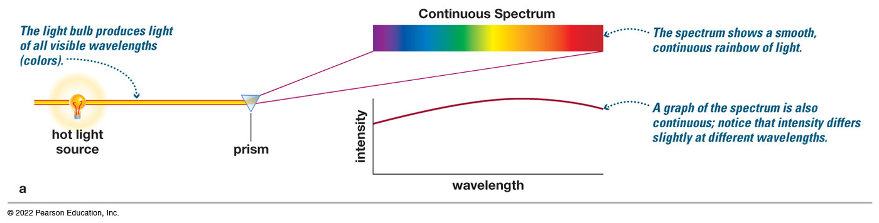
Continuous Spectrum
The spectrum of a common (incandescent) light bulb spans all visible wavelengths, without interruption.
Notes:
A light bulb is labeled, hot light source. The light bulb produces light of all visible wavelengths, colors. Light from the bulb passes through a small hole in a wall, and enters a prism. Light comes out of the prism at an angle and makes a horizontal band of colors. The colors range from violet through blue, green, yellow, and orange, to red. The spectrum shows a smooth, continuous rainbow of light. A graph plots wavelength on the horizontal axis, and intensity on the vertical axis. A line on the graph starts at moderate intensity, curves gently up and gently back down. A graph of the spectrum is also continuous. Intensity varies slightly at different wavelengths.

Slide 7
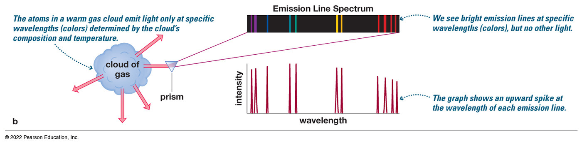
Emission Line Spectrum
A thin or low-density cloud of gas emits light only at specific wavelengths that depend on its composition and temperature, producing a spectrum with bright emission lines.
Notes:
The atoms in a warm gas cloud emit light in different directions only at specific wavelengths, colors, determined by the cloud’s composition and temperature. Light from the cloud passes through a small hole in a wall and enters a prism. Light comes out of the prism at an angle and makes a spectrum of narrow vertical lines of different colors, from violet on the left, through blue, blue green, and yellow to red. We see bright emission lines at specific wavelengths, colors, but no other light. A graph of the emission line spectrum plots wavelength on the horizontal axis and intensity on the vertical axis. The graph plots a sharp spikes under each bright line in the spectrum.

Slide 8
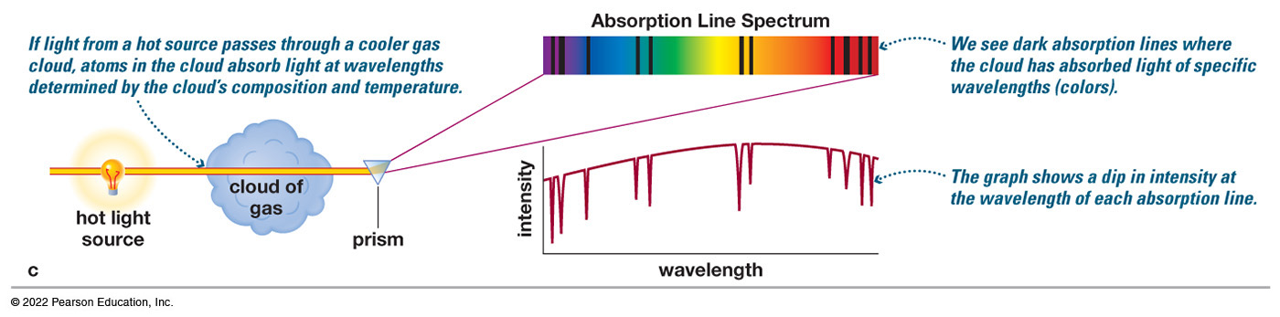
Absorption Line Spectrum
A cloud of gas between us and a light bulb can absorb light of specific wavelengths, leaving dark absorption lines in the spectrum.
Notes:
A light bulb is labeled, hot light source. Light from the bulb travels through a cloud of gas. If light from a hot source passes through a cooler gas cloud, atoms in the cloud absorb light at wavelengths determined by the cloud’s composition and temperature. Light continues through the cloud, passes through a small hole in a wall, and enters a prism. Light comes out of the prism at an angle and makes a band of colors, from violet to red. Several dark vertical lines appear in the spectrum in the violet, blue, blue green, orange, and red spectrum regions. We see dark absorption lines where the cloud has absorbed light of specific wavelengths, colors. A graph of the absorption line spectrum plots wavelength on the horizontal axis and intensity on the vertical axis. A line curves gently up and back down similar to the graph in part A, but there are deep downward spikes in the line below each dark line in the spectrum. The graph shows a dip in intensity at the wavelength of each absorption line.

Slide 9
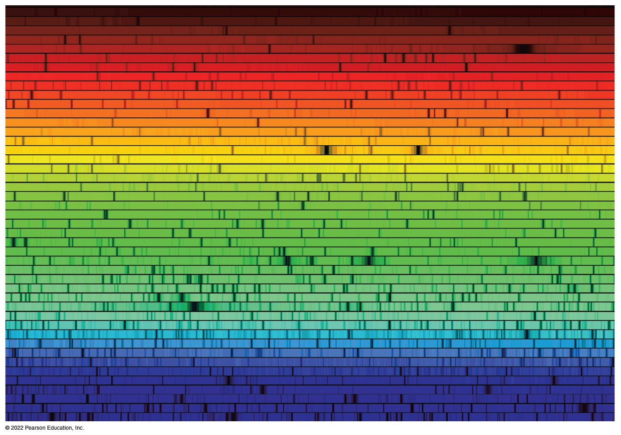
Spectra Tell Us What Things Are Made of
Spectrum of the Sun

Slide 10
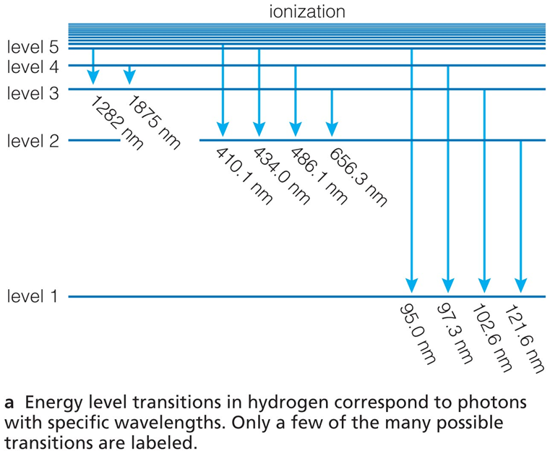
Chemical Fingerprints
Each type of atom has a unique set of energy levels.
Each transition corresponds to a unique photon energy, frequency, and wavelength.
Energy levels of hydrogen
Notes:
Energy level transitions correspond to photons with specific wavelengths. Horizontal lines are labeled, level 1, level 2, level 3, level 4, level 5. Several more lines close together lie above level 5. The space above the top line is labeled, ionization. Vertical arrows point down from various energy levels and are labeled in nanometers as follows.
• From above level 5 to level 2, 410.1.
• From level 5. To level 3, 1282. To level 2, 434.0. To level 1, 95.0.
• From level 4. To level 3, 1875. To level 2, 486.1. To level 1, 97.3
• From level 3. To level 2, 656.3. To level 1, 102.6.
• From level 2. To level 1, 121.6.

Slide 11
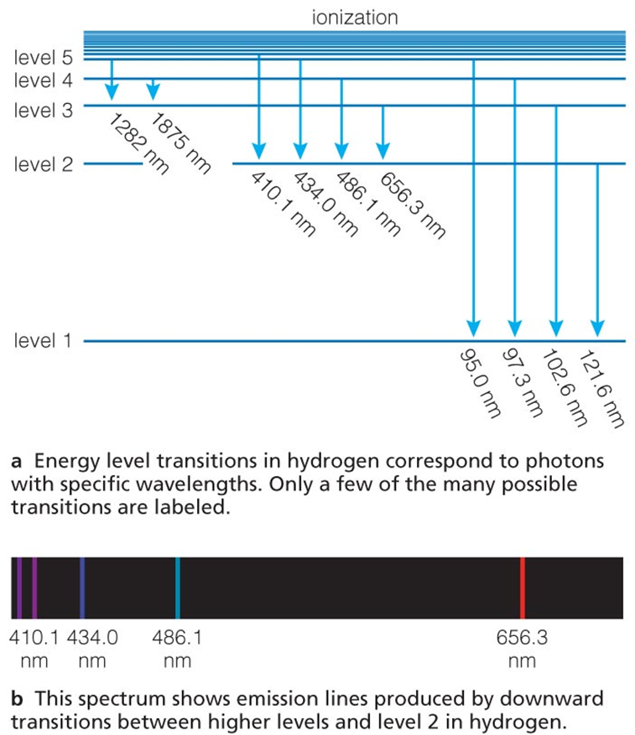
Chemical Fingerprints
Downward transitions produce a unique pattern of emission lines.
Notes:
Energy level transitions correspond to photons with specific wavelengths. Horizontal lines are labeled, level 1, level 2, level 3, level 4, level 5. Several more lines close together lie above level 5. The space above the top line is labeled, ionization. Vertical arrows point down from various energy levels and are labeled in nanometers as follows.
• From above level 5 to level 2, 410.1.
• From level 5. To level 3, 1282. To level 2, 434.0. To level 1, 95.0.
• From level 4. To level 3, 1875. To level 2, 486.1. To level 1, 97.3
• From level 3. To level 2, 656.3. To level 1, 102.6.
• From level 2. To level 1, 121.6.

Slide 12

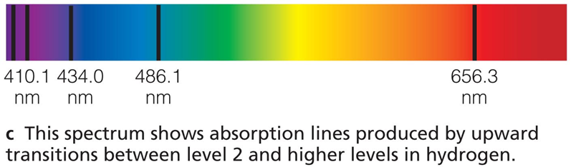
Chemical Fingerprints
Because those atoms can absorb photons with those same energies, upward transitions produce a pattern of absorption lines at the same wavelengths.
Notes:
Energy level transitions correspond to photons with specific wavelengths. Horizontal lines are labeled, level 1, level 2, level 3, level 4, level 5. Several more lines close together lie above level 5. The space above the top line is labeled, ionization. Vertical arrows point down from various energy levels and are labeled in nanometers as follows.
• From above level 5 to level 2, 410.1.
• From level 5. To level 3, 1282. To level 2, 434.0. To level 1, 95.0.
• From level 4. To level 3, 1875. To level 2, 486.1. To level 1, 97.3
• From level 3. To level 2, 656.3. To level 1, 102.6.
• From level 2. To level 1, 121.6.

Slide 13
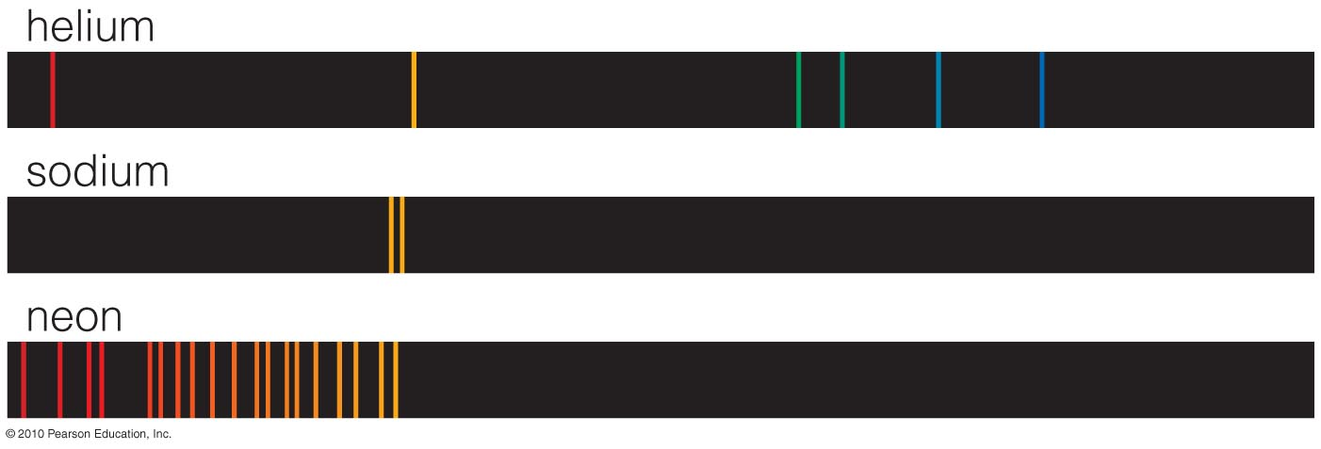
Chemical Fingerprints (4 of 5)
Each type of atom has a unique spectral fingerprint.
Notes:
• Helium. A black bar with 6 vertical strips in blue, light blue, green, yellow, and red.
• Sodium. A black bar with 2 vertical strips of orange.
• Neon. A black bar with 17 vertical strips of yellow, orange, and red. 2 orange strips have a much larger width than the rest.

Slide 14
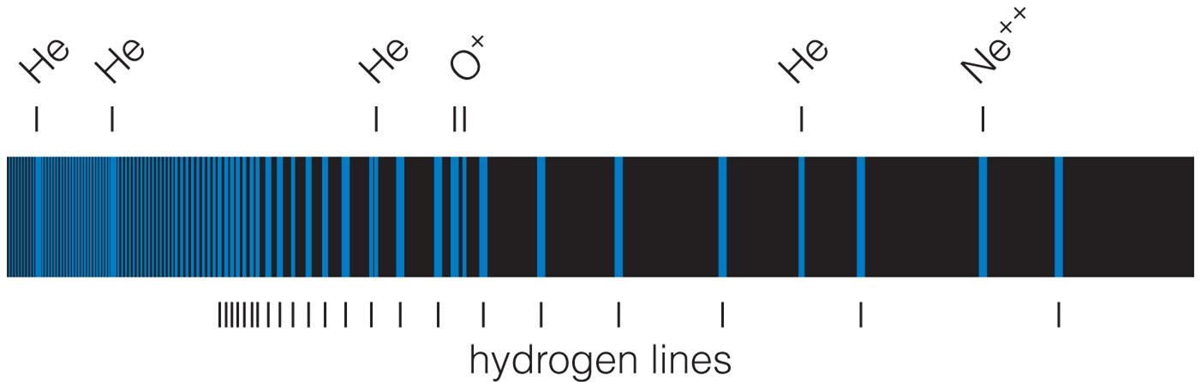
Chemical Fingerprints (5 of 5)
Observing the fingerprints in a spectrum tells us which kinds of atoms are present.
Notes:
Blue vertical lines present on the bar. Above the bar, chemical elements and ions are shown from left to right as follows. Helium, helium, helium, oxygen, helium, neon. Markers underneath the bar reads, hydrogen lines.

Slide 15
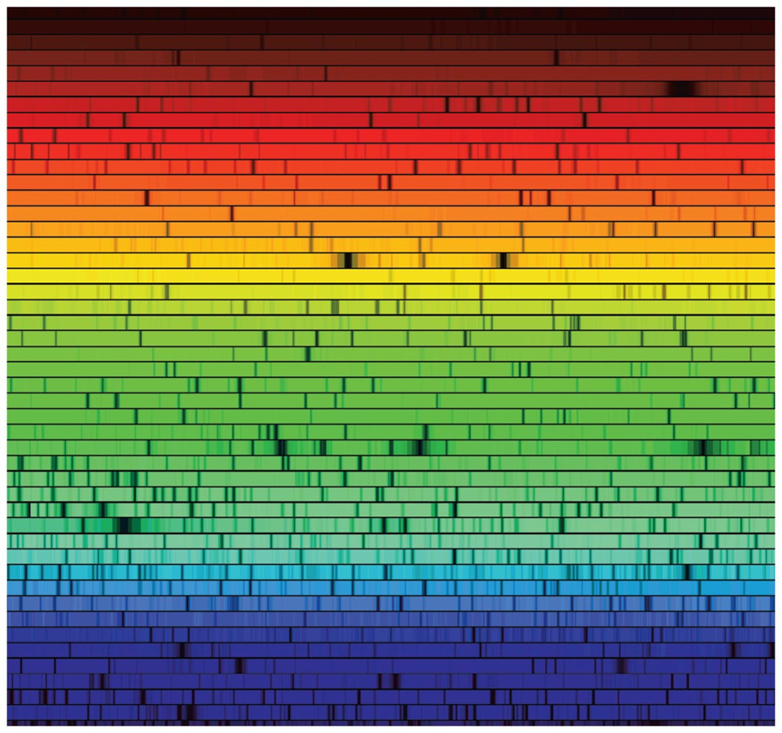
Example: Solar Spectrum
Notes:
You can use this slide as an example of real astronomical spectra made from a combination of the idealized types. Here we have the continuous (thermal) spectrum from the solar interior; dark absorption lines where the cooler solar atmosphere (photosphere) absorbs specific wavelengths of light.

Slide 16
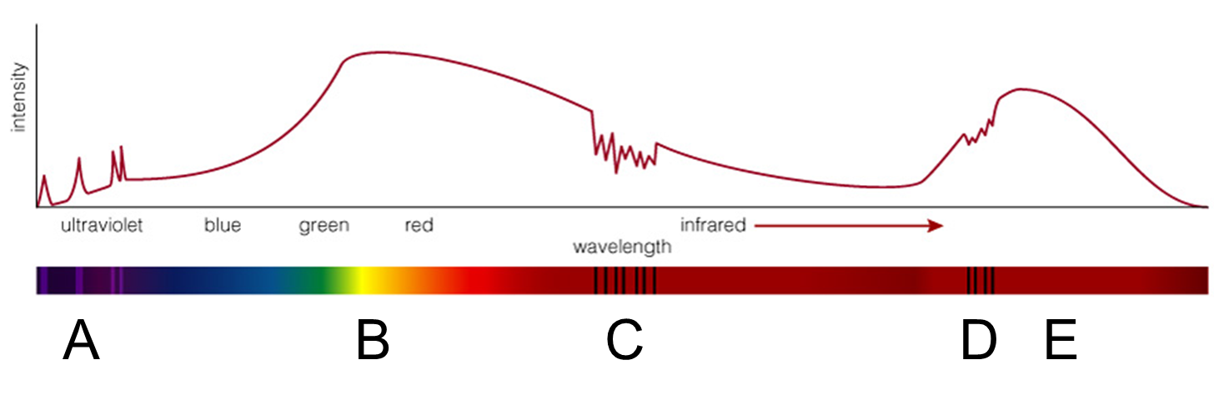
Thought Question
Which letter(s) label(s) absorption lines?
Notes:
The graph plots intensity versus wavelength, starting with ultraviolet then moving through visible light spectrum and infrared. The plot rises and falls in several short peaks through ultraviolet, labeled A. It then rises with increasing steepness through the visible light spectrum to a peak near green, labeled B. It then falls gradually into infrared where it rises in falls in several quick, short peaks, labeled C. It continues to a minimum before rising through several short, quick peaks, labeled D, to a maximum, labeled E, before falling again.

Slide 17
Thought Question
Which letter(s) label(s) the peak (greatest intensity) of infrared light?
Notes:
The graph plots intensity versus wavelength, starting with ultraviolet then moving through visible light spectrum and infrared. The plot rises and falls in several short peaks through ultraviolet, labeled A. It then rises with increasing steepness through the visible light spectrum to a peak near green, labeled B. It then falls gradually into infrared where it rises in falls in several quick, short peaks, labeled C. It continues to a minimum before rising through several short, quick peaks, labeled D, to a maximum, labeled E, before falling again.

Slide 18
Thought Question
Which letter(s) label(s) emission lines?
Notes:
The graph plots intensity versus wavelength, starting with ultraviolet then moving through visible light spectrum and infrared. The plot rises and falls in several short peaks through ultraviolet, labeled A. It then rises with increasing steepness through the visible light spectrum to a peak near green, labeled B. It then falls gradually into infrared where it rises in falls in several quick, short peaks, labeled C. It continues to a minimum before rising through several short, quick peaks, labeled D, to a maximum, labeled E, before falling again.

Slide 19
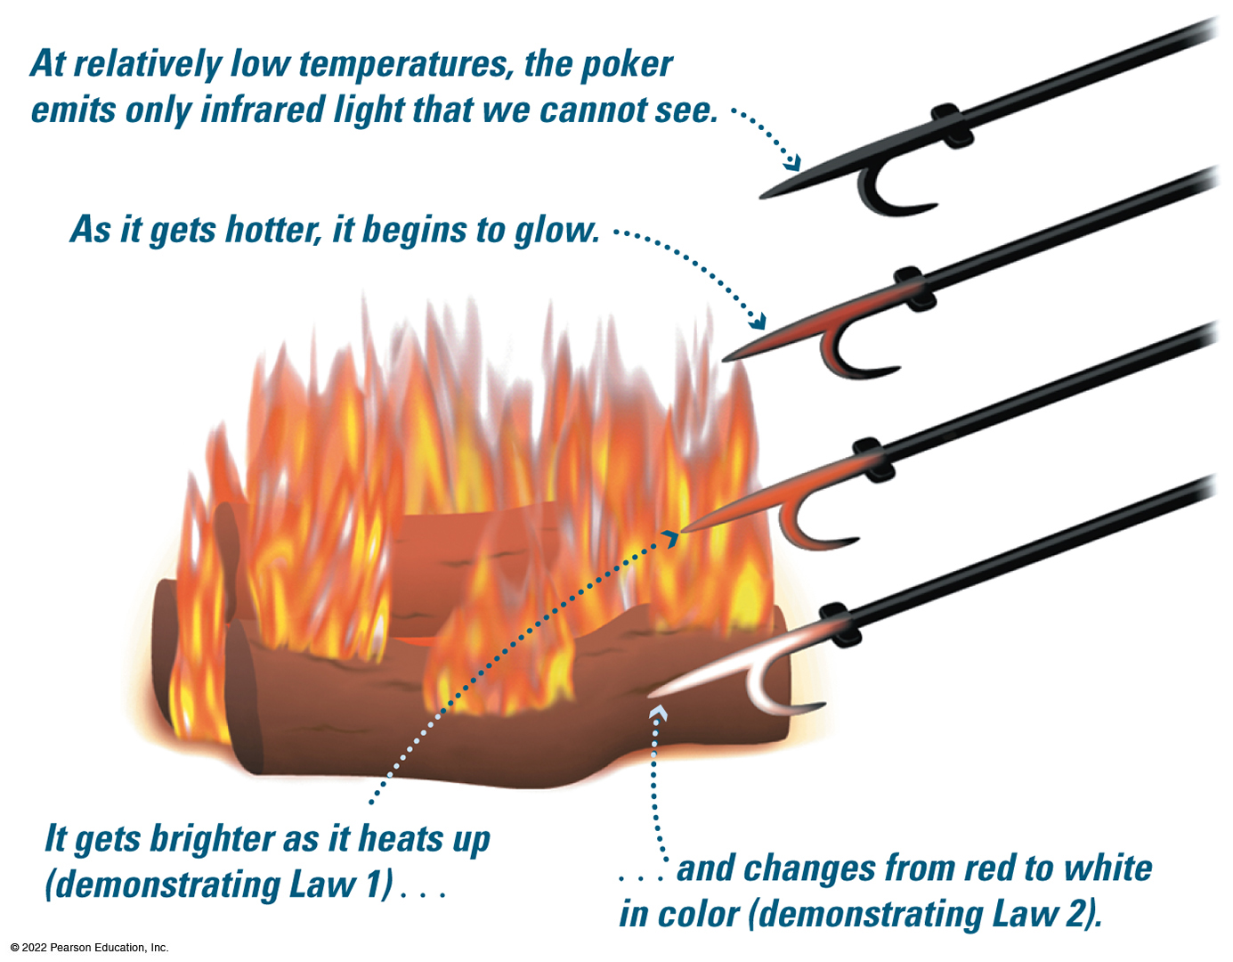
How Does Light Tell Temperature?
Notes:
• Top poker, far from the fire, black. At relatively low temperatures, the poker emits only infrared light that we cannot see.
• Second poker from the top, closer to the fire, dark orange. As it gets hotter, it begins to glow.
• Third poker from the top, in the flames, glowing red. It gets brighter as it heats up, demonstrating Law 1.
Bottom poker, at the base of the fire, glowing white changes from red to white in color, demonstrating Law 2.

Slide 20
Thermal Radiation
Nearly all large or dense objects emit thermal radiation, including stars, planets, and you.
An object's thermal radiation spectrum depends on only one property: its temperature.

Slide 21
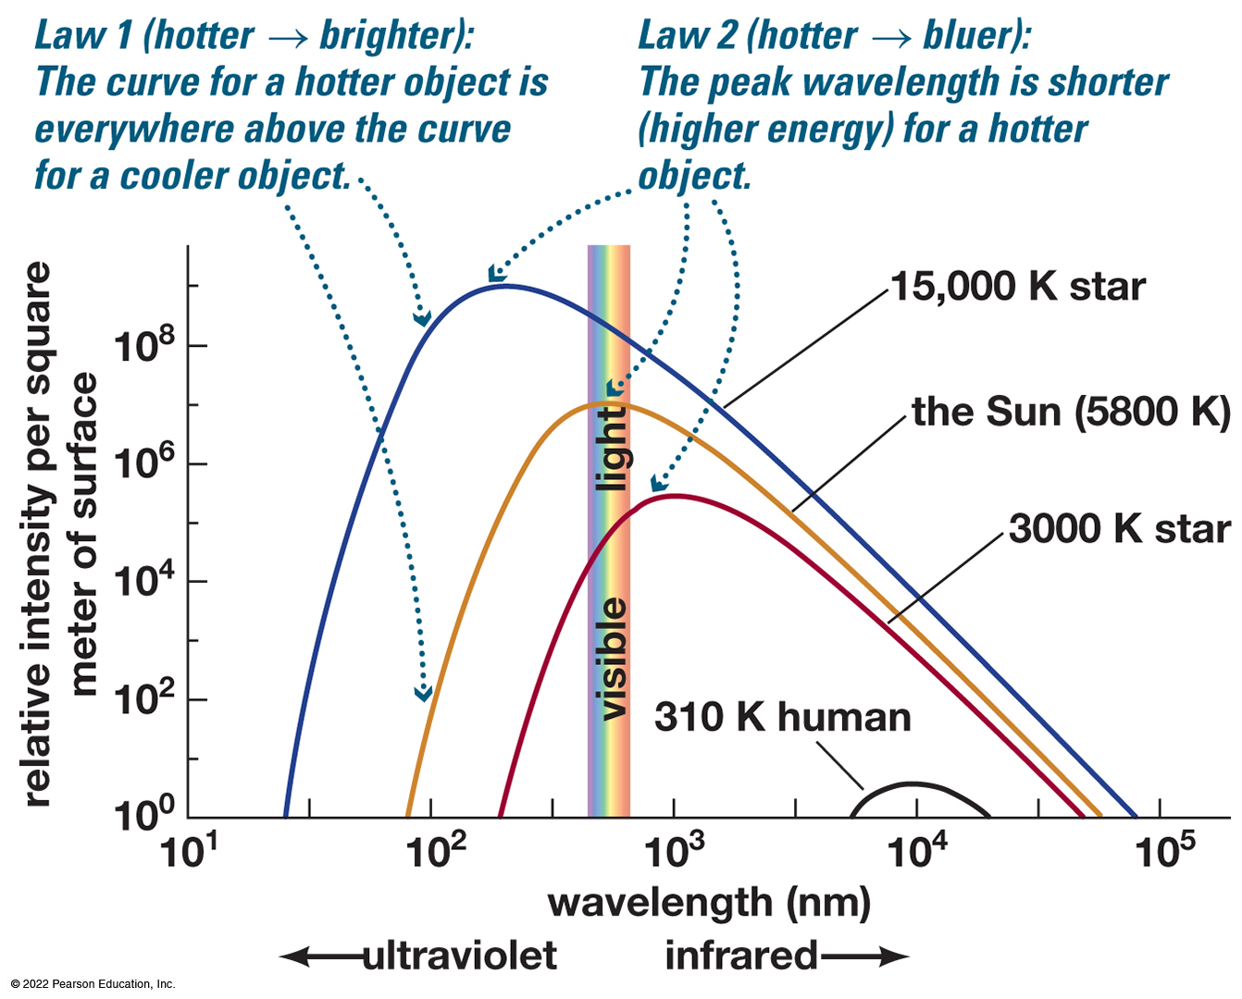
Properties of Thermal Radiation
Hotter objects emit more light at all frequencies per unit area.
Hotter objects emit photons with a higher average energy.
Notes:
Remind students that the intensity is per area; larger objects can emit more total light even if they are cooler.
The vertical axis plots relative intensity per square meter of surface, from 10 to the zeroth power up to 10 to the ninth power. A vertical band with rainbow colors, labeled, visible light, stands just to the left of 10 to the third power nanometers on the horizontal axis. To the left of this band is ultraviolet wavelengths and to the right of this band is infrared wavelengths. The graph plots There are four curves, all with a similar shape, with their vertical point of the curve leaning left toward the vertical axis. The curves are as follows.
• 15,000 Kelvin star curve. The curve rises from the horizontal axis almost halfway between 10 to the first power and 10 to the second power nanometers. The curve rises steeply to a rounded peak slightly to the right of 10 to the second power nanometers, with a relative intensity of about 10 to the ninth power. Then the curve gently falls to the horizontal axis, reaching it at almost 10 to the fifth power nanometers.
• The Sun curve, 5800 Kelvins. The curve rises from the horizontal axis at almost 10 to the second power nanometers, rises steeply to a rounded peak in the visible light band at a relative intensity of about 10 to the seventh power, then gently falls to the horizontal axis slightly to the left of the curve for a 15,000 Kelvin star.
• 3,000 Kelvin star. The curve rises from the horizontal axis about a third of the way from 10 to the second and 10 to the third power nanometers. It rises steeply to a rounded peak around 10 to the third power nanometers at a relative intensity of about 10 to the fifth power, then descends gently to the horizontal axis just slightly to the left of the preceding two curves.
• The Human curve, 310 Kelvin. The curve appears around 10 to the fourth power nanometers with a peak relative intensity per square meter of surface of about 10 to the first power and declines to a point on the horizontal axis at 10 to the 4.25 power nanometers.
The two laws of thermal radiation are as follows.
• Law 1. The curve for a hotter object is everywhere above the curve for a cooler object, showing that hotter objects emit more radiation per unit surface area at every wavelength.
Law 2. The peak wavelength is further to the left for hotter objects, showing that hotter objects emit more of their light at shorter wavelengths, high energy.

Slide 22
Thought Question
Which is hottest?
A. A blue star
B. A red star
C. A planet that emits only infrared light

Slide 23
Thought Question
Which is hottest?
A. A blue star
B. A red star
C. A planet that emits only infrared light

Slide 24
Thought Question
Why don't we glow in the dark?
A. People do not emit any kind of light.
B. People only emit light that is invisible to our eyes.
C. People are too small to emit enough light for us to see.
D. People do not contain enough radioactive material.

