Slide 1
Light
Most of our information from Space
Notes:
This lecture takes lots of demonstration apparatus:
Transmission overhead projector with
Diffraction grating after focusing lens
Slit mask
Square mask
CMY filters
RGB filters
RGB filter wheels
Vertical-slit lamp and variac
Class set of diffraction gratings
R, G, B projectors

Slide 2
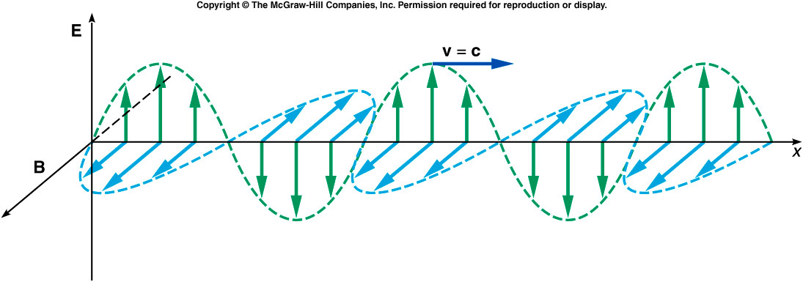
Classical model
Coupled electric and magnetic fields that are perpendicular:
to each other, and
to the direction of propagation (transverse).

Slide 3
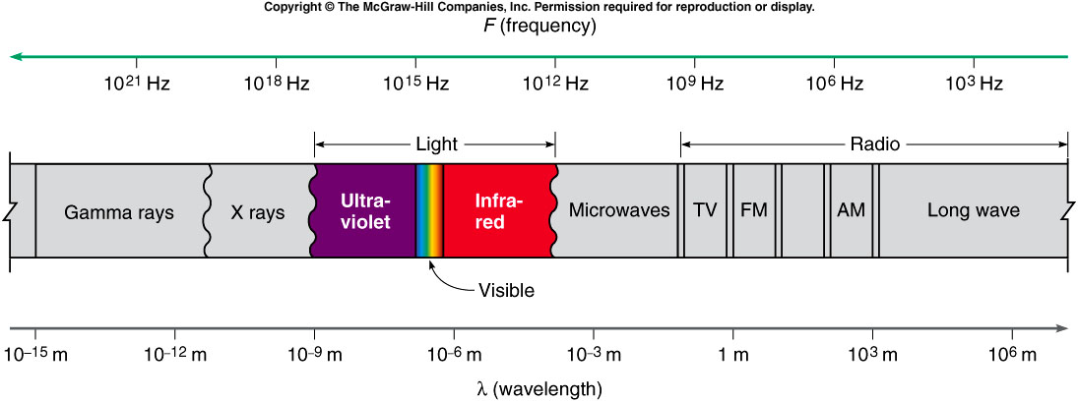
Electromagnetic Spectrum
Notes:
Demonstrate
Overhead projector with grating over focusing lens. Light from slit is diffracted into separate colors in both horizontal directions.

Slide 4
Speed of Light
(in vacuum)
c = 2.9979 × 10⁸ m/s

Slide 5
Features of a Wave
Wavelength: repeat distance
Period: repeat time
λ
λ
Notes:
Here we define names for wave features so that we can communicate easily.

Slide 6
Features of a Wave
Frequency f: repeats in a given time
Velocity u: speed of crest motion
u
Notes:
Here we define names for wave features so that we can communicate easily.

Slide 7
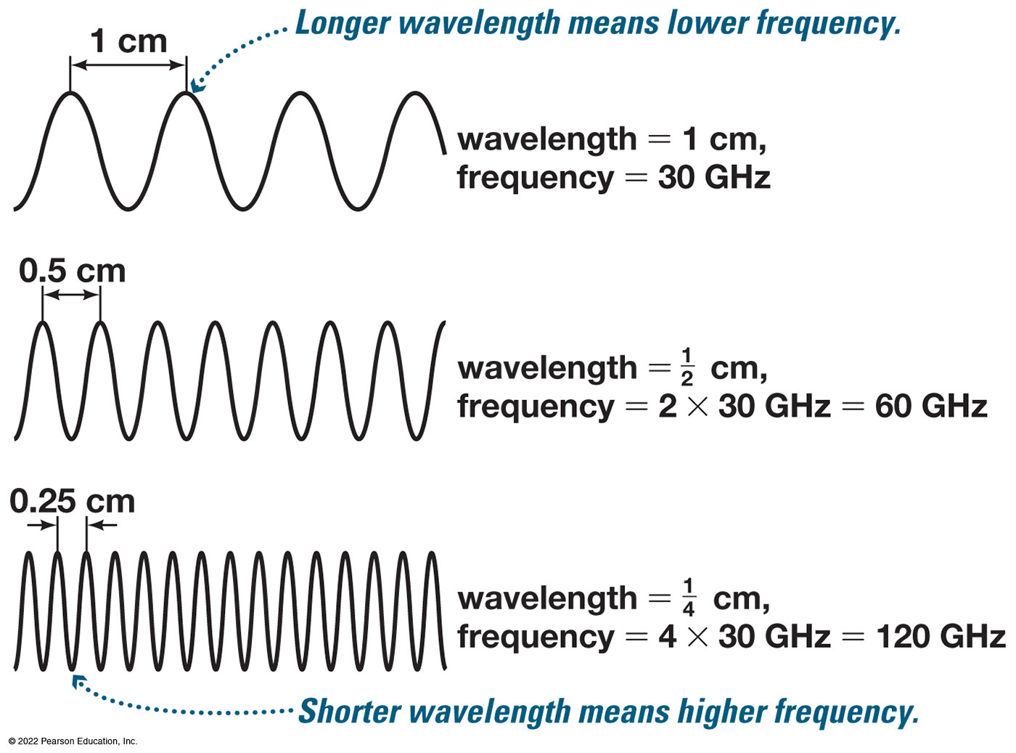
Wavelength and Frequency
Notes:
The waves are as follows
• A wave travels up and back down about 4 times. The distance between the tops of two waves is 1 centimeter. Wavelength equals 1 centimeter. Frequency equals 30 gigahertz. A caption reads, Longer wavelength means lower frequency.
• A wave travels up and down about 8 times. The distance between the tops of two waves is 0.5 centimeter. Wavelength equals one half centimeter. Frequency equals 2 times 30 gigahertz, equals 60 gigahertz.
A wave travels up and down about 16 times. The distance between the tops of two waves is 0.25 centimeter. Wavelength equals, one fourth centimeter. Frequency equals, 4 times 30 gigahertz, equals, 120 gigahertz. Shorter wavelength means higher frequency.

Slide 8
Relations between Features
Period T = 1 / f ; Frequency f = 1 / T
Velocity v = λf
Wavelength λ = v / f
Frequency f = v / λ

Slide 9
Group Question
Doubling the frequency of a wave while keeping its speed constant will cause its wavelength to
increase.
decrease.
stay the same.

Slide 10
Group Question
Doubling the speed of a wave while keeping its wavelength constant will cause its frequency to
increase.
decrease.
stay the same.

Slide 11
Group Question
Doubling the wavelength of a wave while keeping its frequency constant will cause its speed to
increase.
decrease.
stay the same.

Slide 12
Polarization
The electric field vector oscillates in a plane containing the direction of propagation

Slide 13
Plane polarized light
Electric field vectors all in the same direction
Unpolarized light: E field vectors uniformly distributed

Slide 14
So light seems to be a wave. But…

Slide 15
Electromagnetic Wave Energy
Non-classical result:
E = hf
E = energy
f = frequency
h = Planck constant = 6.621 × 10⁻³⁴ J s

Slide 16
Thought Question
The higher the photon energy,
A. the longer its wavelength.
B. the shorter its wavelength.
C. Energy is independent of wavelength.

Slide 17
Light momentum
p = h/λ
= E/c
Light collides elastically with electrons
  just as if they were billiard balls

Slide 18
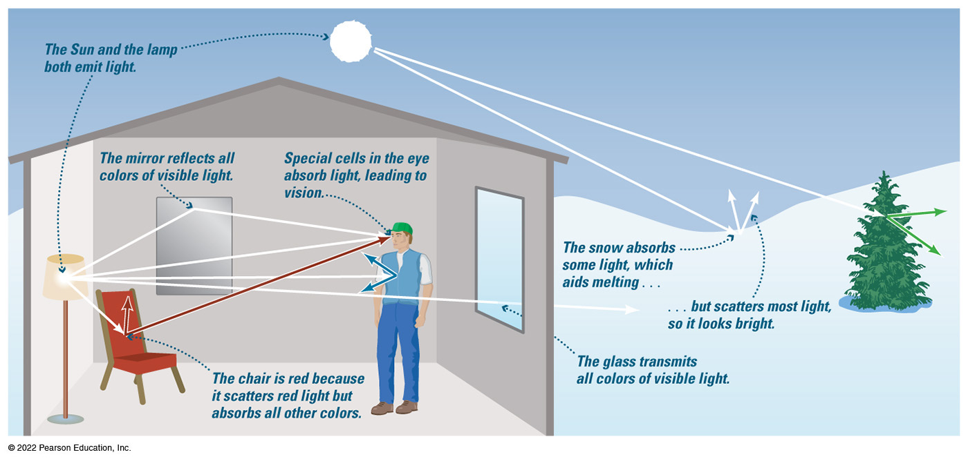
How Do Light and Matter Interact?
Notes:
Inside the house which contains a red chair, mirror, a man, and a window, a lamp emits light. Light from the lamp travels as follows.
• To the mirror. An annotation reads, the mirror reflects all colors of visible light. The light continues from the mirror to the man’s eye. An annotation reads, special cells in the eye absorb light, leading to vision.
• To the man’s eye.
• To the man’s chest. Light also reflects off of the man’s chest.
• Out through the window. An annotation reads, the glass transmits all colors of visible light.
• To the chair. Light continues from the chair and travels away from the chair and toward the man’s eye. An annotation reads, the chair is red because it scatters red light but absorbs all other colors.
Outside the house, the Sun shines in the sky over a snowy landscape containing hills and a tree. The Sun and the lamp both emit light as follows.
• To the tree. Light also passes through the tree.
To the snow. Light also scatters off of the surface of the snow. The annotations read, the snow absorbs some light, which aids melting, but scatters most light, so it looks bright.

Slide 19
Interactions of Light and Matter
Emission
  produces light
Absorption
  consumes light
Transmission
  light passes through
Reflection or scattering
  changes light’s direction

Slide 20
How We Perceive Light

Slide 21
Objectives
Explain how the human eye identifies colors.
Explain how colors are produced by absorption, dispersion, and scattering.

Slide 22
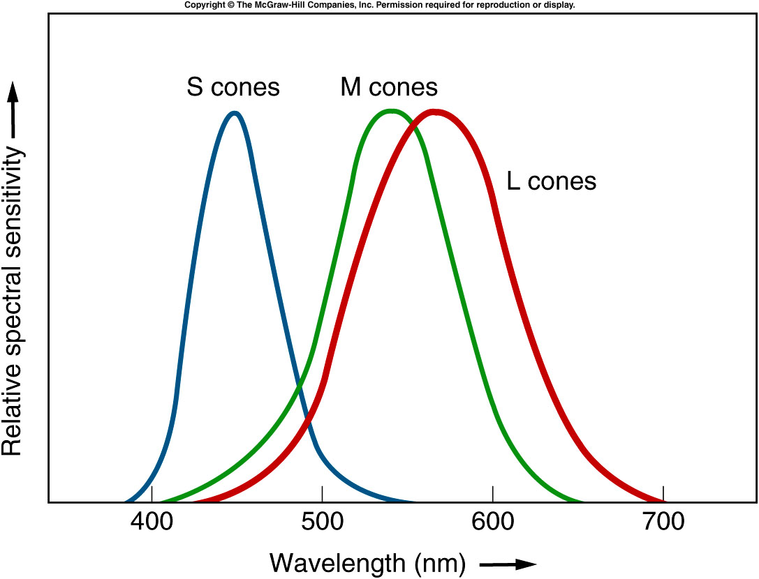
How Human Color Vision Works
424
530
560
Source: Griffith, Physics of Everyday Phenomena
Notes:
Demonstrate
R, G, B slide projectors. Secondary colors formed from primaries, white from combination of all three.

Slide 23
Question
What color do we see when green and red receptors are stimulated equally?
A. Cyan.
B. Blue.
C. Yellow.
D. Magenta.

Slide 24
Question
What color do we see when blue and red receptors are stimulated equally?
A. Cyan.
B. Blue.
C. Yellow.
D. Magenta.

Slide 25
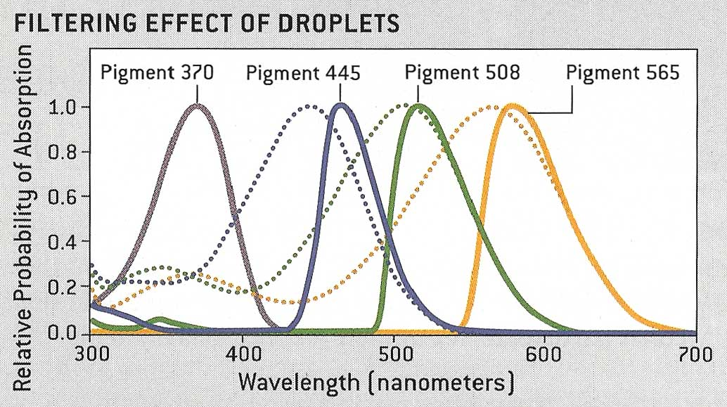
Bird and Reptile Color Vision
Source: Scientific American, July 2006

Slide 26
Reflection and Transmission
(and absorption)
Notes:
Demonstrate
Color filters R, G, B, C, M, Y with overhead projector slit and diffraction grating. Filters Remove colors from light.
Demonstrate
Subtractive primary colors C, M Y with square mask and no diffraction grating on the projector. Combinations create additive primary colors and black.

Slide 27
Question
Why is a rose red?
A. The rose absorbs red light.
B. The rose transmits red light.
C. The rose emits red light.
D. The rose reflects red light.

Slide 28
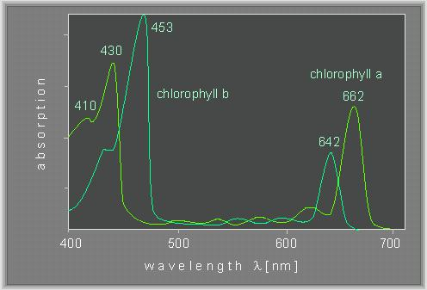
Question
Chlorophyll absorbs blue and red light. What color does it appear?
A. red
B. yellow
C. green
D. violet

Slide 29
Question
In color printing, which two color inks are combined to make the color orange?
Cyan and Magenta.
Cyan and Yellow.
Yellow and Magenta.
Notes:
Demonstrate with CMY color wheel. Removing the C wheel still leaves a position of orange.

Slide 30
Rayleigh Scattering
Why the sky is blue
and sunsets are red

Slide 31
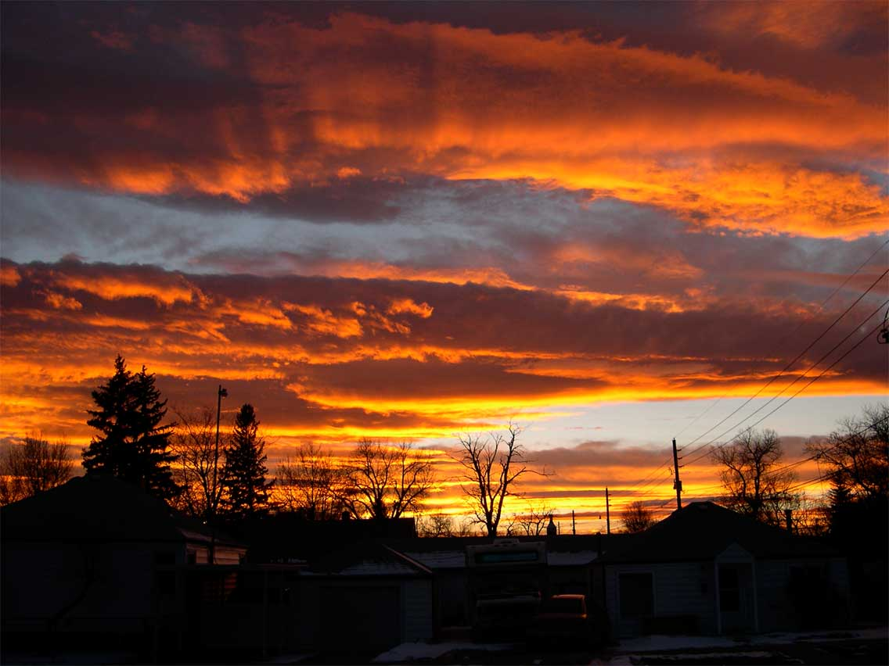
Notes:
There probably isn’t time, but this can be demonstrated nicely with a white light beam shining through dilute milk. The scattered light is bluish and the transmitted light is reddish.

Slide 32
Scattering
Waves scatter best off objects
size ~ wavelength
Air molecules are much smaller than visible wavelengths
Short-wavelength light scatters more than long-wavelength light
Transmitted light is reddened

Slide 33
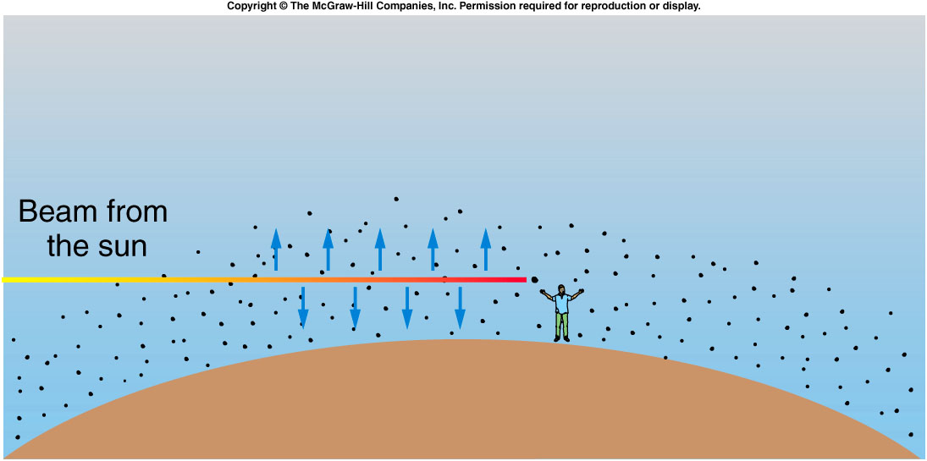
Blue Scatters; Red Passes
Source: Griffith

