Slide 1
Conservation laws, Gravity
The structure of the universe
§4.3

Slide 2
What’s the point?
Nature seems to care about certain quantities—momentum, angular momentum, and energy.
These can be transferred from one object to another, or (in the case of energy) converted to other forms—but never created nor destroyed.

Slide 3
Momentum
The quantity of motion
Nature cares about this

Slide 4
Momentum
Formula
p = mv
m = mass
v = velocity

Slide 5
Force and Momentum
When a net force F is applied to an object of mass m for a time t, its change in momentum is
Ft
= mat
= mΔv
= Δ(mv)
= Δp

Slide 6
Conservation of Momentum
When objects interact:
One applies a force F on the other
  for some time t
The other applies a force –F back
  for the same time t
Their momentum changes are Ft and –Ft
Total momentum change is zero

Slide 7
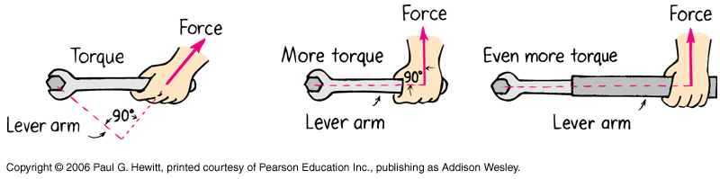
Torque and Angular Momentum
Turning force = torque
= radius × force
= r × F

Slide 8
Angular Momentum
Torque is a rotational force
Angular momentum is rotational momentum
L = r × p
How fast times how far
Direction by right-hand rule

Slide 9
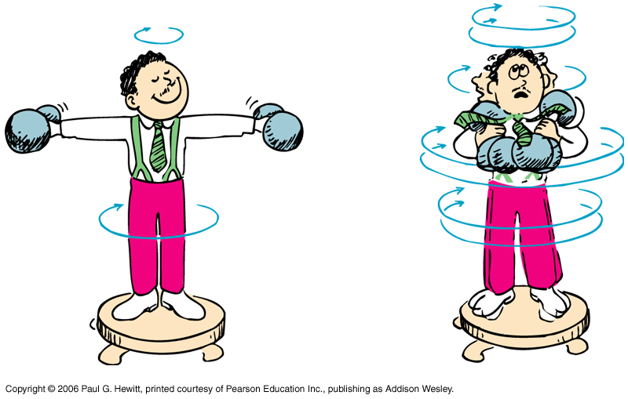
Conservation of
Angular Momentum
If no outside torque, L = r × p is constant.
If r decreases, p increases!

Slide 10
Conservation of
Angular Momentum
Nothing can apply a torque to itself.
Any change in one object’s angular momentum is accompanied by an opposite change in another object.
The angular momentum of the universe never changes.

Slide 11
Energy
Most fundamental form is kinetic energy
  energy of motion
  K = ½ mv²
  similar to momentum but independent of direction
Potential energy is stored in interactions
  gravitational field
  electric or magnetic field

Slide 12
Energy Disguises
Radiative energy is kinetic energy of photons
Thermal energy is kinetic energy of random molecular motions
Chemical energy is potential energy of electric fields in molecules

Slide 13
Work and Energy
Work is the effect of a force acting along a displacement
Work on an object changes its energy
  pushing a cart speeds it up
  sliding surfaces get hot
  lifting a box increases its gravitational potential energy

Slide 14
Orbital Mechanics
Gravity and Energy
§4.3

Slide 15
Simplifying convention
Gravitational potential energy is compared to energy at infinite distance

Slide 16
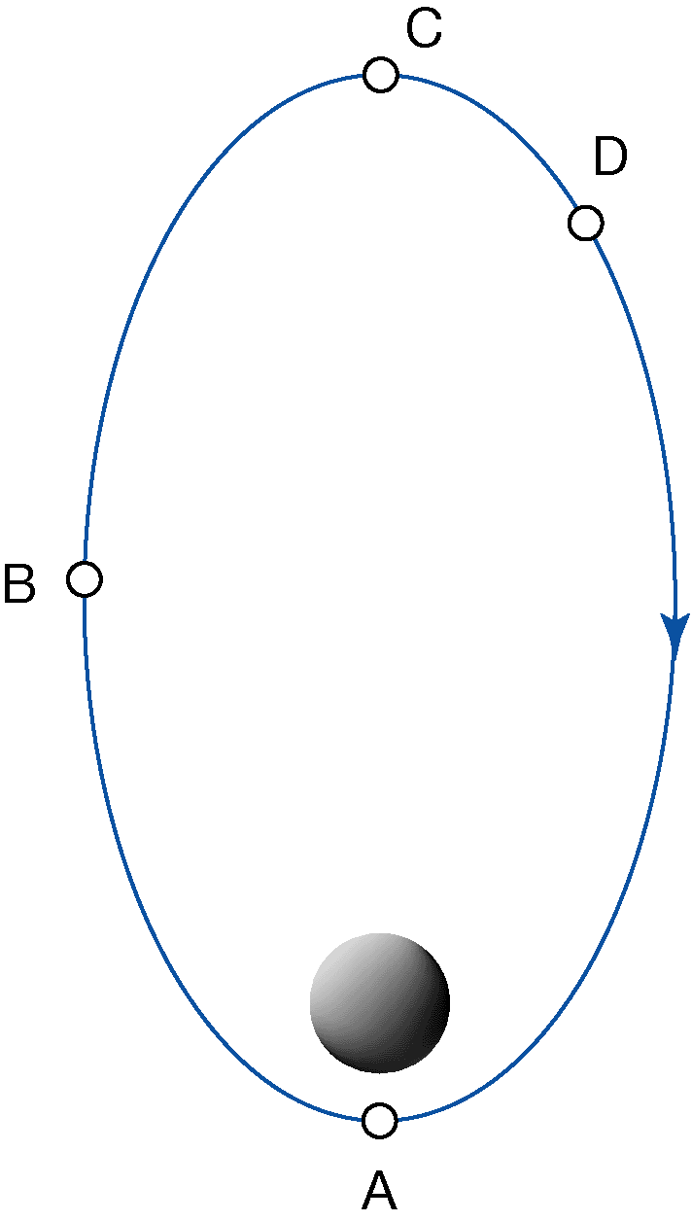
Group Work
Rank the positions in descending order of:
  Force of attraction
  Speed
  Kinetic energy
  Gravitational potential energy

Slide 17
Newton’s laws explain
Kepler’s laws
Elliptical orbits—inverse-square attraction
T² = a³—inverse-square attraction
Equal areas—conservation of angular momentum

Slide 18
Question
The planet Saturn is about 10 times farther from the Sun than Earth. Its mass is about 100 times that of earth. How does its gravitational attraction to the Sun compare to Earth’s?
100 times weaker.
10 times weaker.
About the same.
10 times stronger.
100 times stronger.

Slide 19
Question
The planet Saturn is about 10 times farther from the Sun than Earth. Its mass is about 100 times that of earth. How does its gravitational acceleration toward the Sun compare to Earth’s?
100 times smaller.
10 times smaller.
About the same.
10 times larger.
100 times larger.

Slide 20
Orbits
E > 0: Open
  hyperbola
E = 0: Escape speed
  parabola
E < 0: Closed
  ellipse

Slide 21
Escape Speed
if an object’s U_{g} + K_{tr} ≥ 0, it can “escape” from a gravitational field.

Slide 22
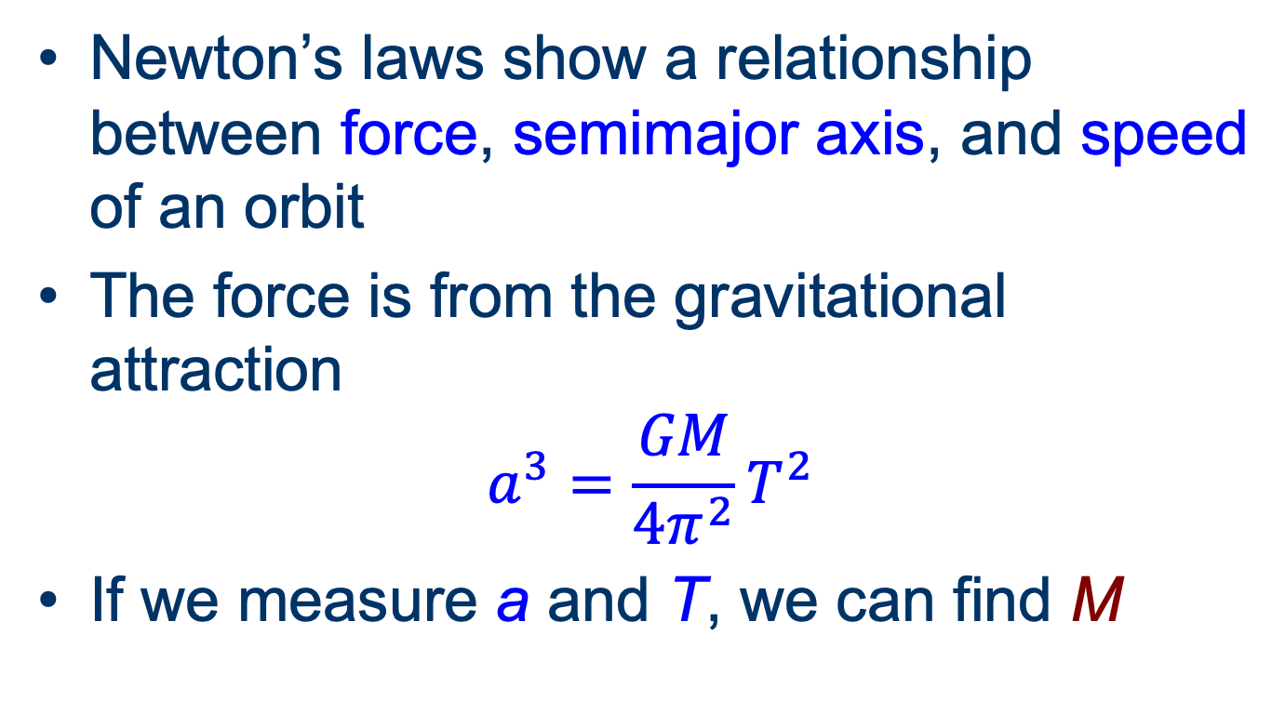
Measuring Mass
Newton’s laws show a relationship between force, semimajor axis, and speed of an orbit
The force is from the gravitational attraction
$$a^{3}=\frac{GM}{4π^{2}}T^{2}$$
If we measure a and T, we can find M

Slide 23
Tides
Force of gravity decreases with distance
  1/r²
Near side pulled more than far side
Creates tidal bulges

Slide 24
Tidal locking
The Earth’s gravity causes lunar tides
Distorts the Moon into an oblong shape
Internal drag resists distortion
  slows Moon’s spin
Moon now rotates synchronously
Many other moons rotate synchronously

