Slide 1
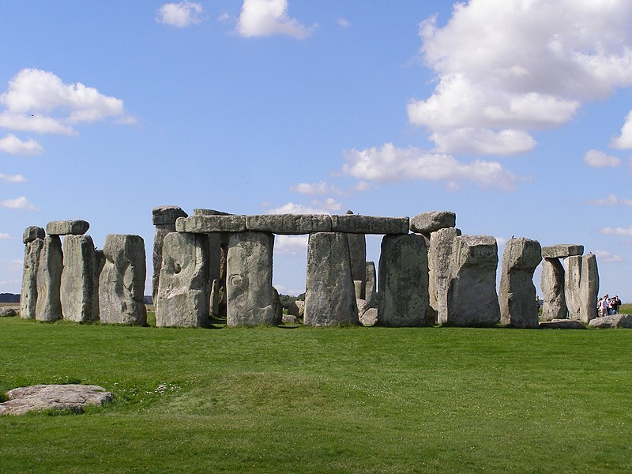
History of Astronomy
(very, very abridged)
Chapter 3
Image: Gareth Wiscombe

Slide 2
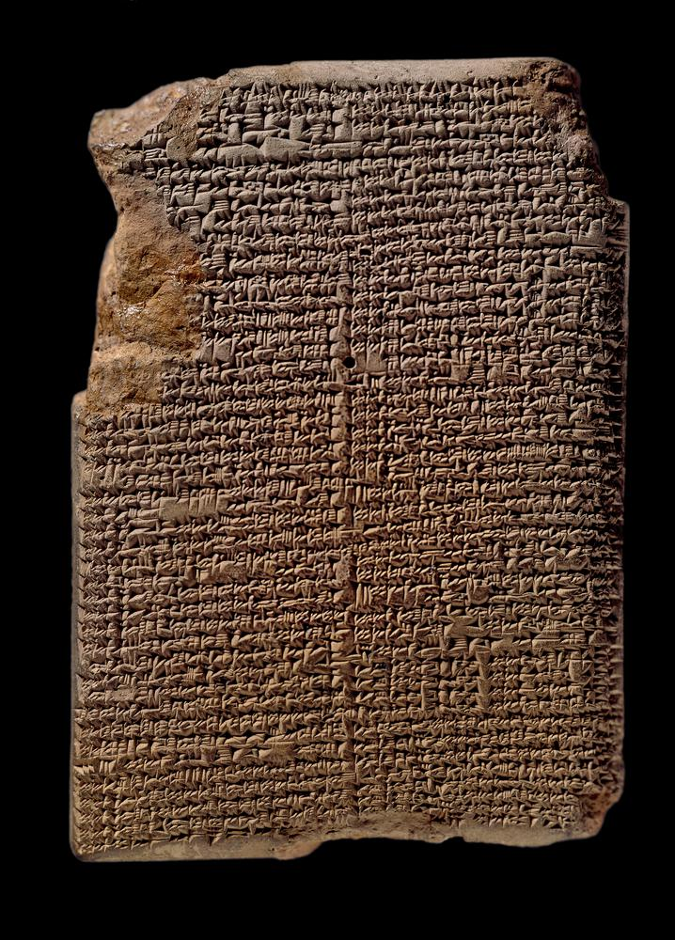
Babylonians
Recorded star positions
Began systematic geometry
Modeled celestial motions with formulas
Mul-Apin tablet Image: British Museum

Slide 3
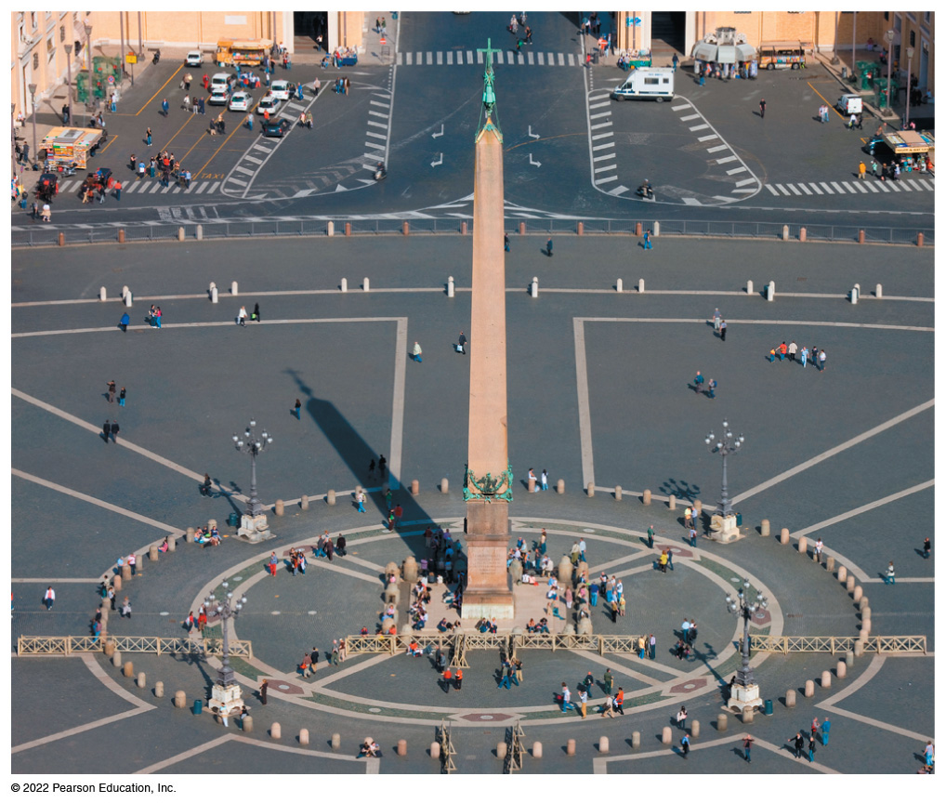
Egyptians
24-hour day
Aligned pyramids with stars
Stellar calendar (Flooding of the Nile)
Bennett et a.l, Fig 3.2

Slide 4
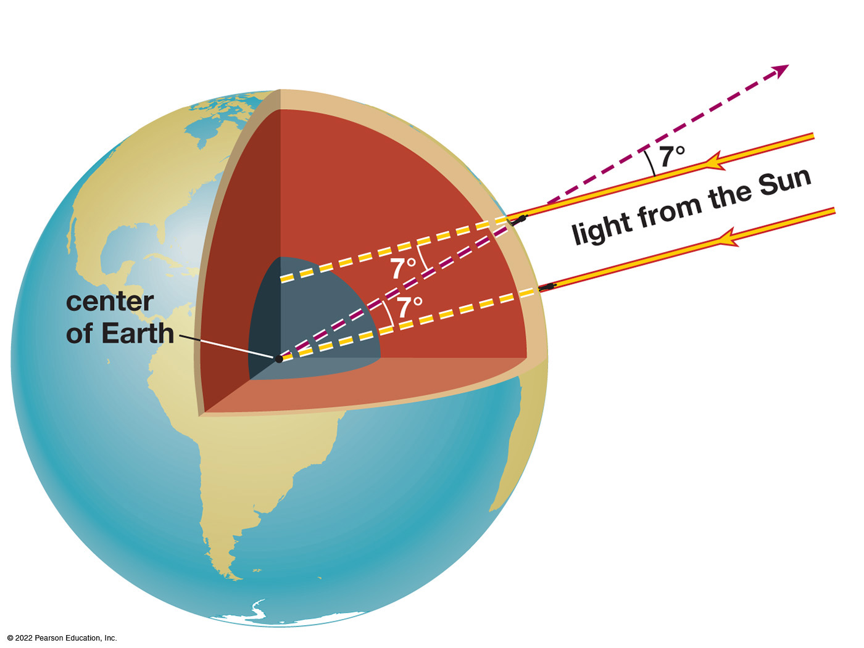
Eratosthenes (~276–194 BCE)
Found the size of the Earth
Syene was subsolar at solstice
At Alexandria, Sun altitude was 83°
Syene was 5000 stadia south of Alexandria

Slide 5
Hipparchus (?–127 BCE)
Catalogued visible stars
Ranked stars by brightness (magnitude scale)
Estimated Moon’s orbital distance
Recognized precession of the axis

Slide 6
Aristotle
Theoretician (not observer)
Heavens are perfect and unchanging

Slide 7
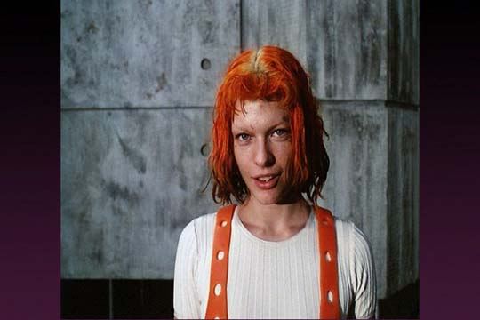
The Ancients observed
Some things fall down
solids, liquids
Some things blow around
air
Some things rise
fire
Some things circle
the fifth element?

Slide 8
Sky things move
Stars
circle the sky once per sidereal day
Moon
circles the ecliptic once per month
Sun
circles the ecliptic annually, varying speed
Planets
Near the ecliptic, paths halting and loopy

Slide 9
Mars Retrograde
Images: Comins, Fig. 2.2

Slide 10
What’s happening?
No evidence the Earth moved
Celestial motions based on circles?
Ptolemy’s (~100–170 CE) elegant epicycle model
Deferent: circle around Earth
Epicycle orbits along the deferent
planet orbits along the epicycle
Accepted for over 1000 years

Slide 11
Epicyclic Planetary Motion
Images: Comins, Fig. GD2-1

Slide 12
Epicyclic Planetary Motion
Images: Comins, Fig. GD2-1

Slide 13
Ptolemaic Model
Decent fit to observations
No explanatory basis other than perfection of circles
Eventually deviated from reality beyond rescue

Slide 14
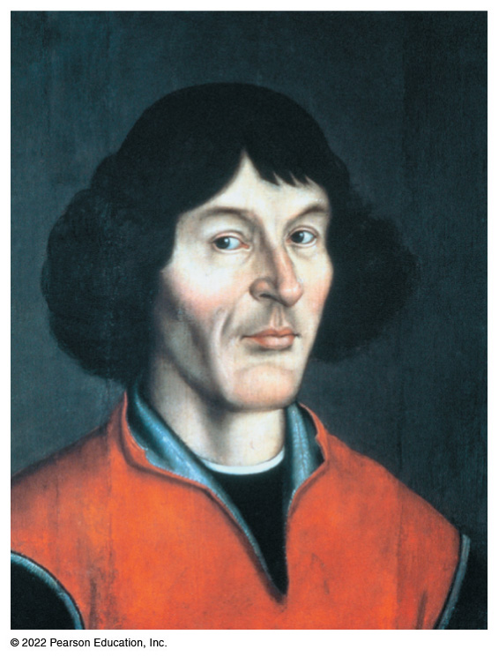
Nicolaus Copernicus
Revived heliocentric model
Assumed circular orbits
Explained retrograde planetary motion
Poor predictions of planetary positions

Slide 15
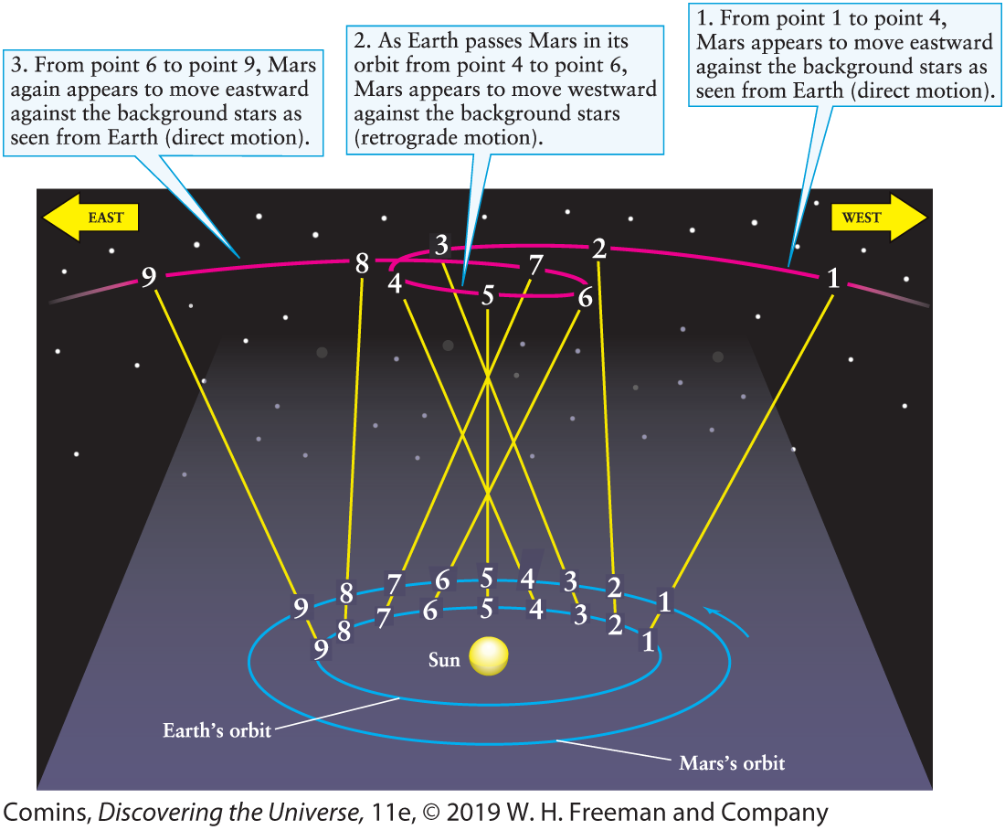
Heliocentric Explanation

Slide 16
“Retrograde” Motion
ScienceWorld video (YouTube)
Simple animation

Slide 17
Tycho Brahe
Last of the great pre-telescope observers
Decades of precise observations of planetary positions

Slide 18
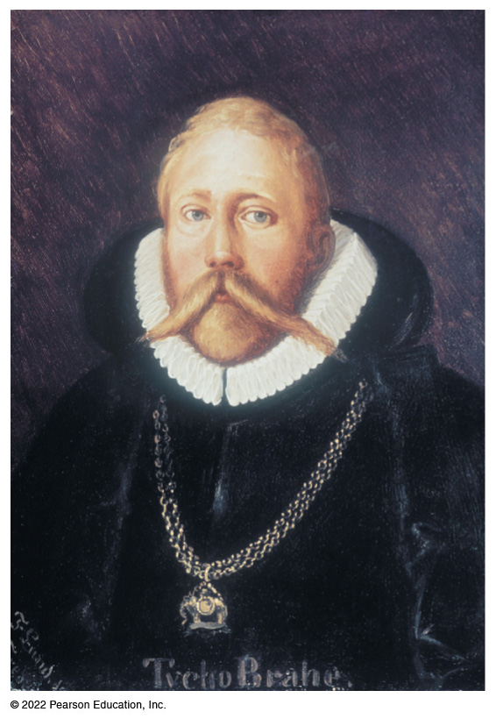
Tycho Brahe (1546–1601)
Last of the great pre-telescope observers
Decades of precise observations of planetary positions

Slide 19
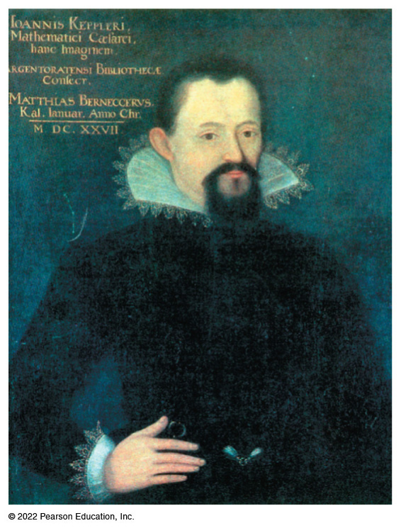
Johannes Kepler (1571–1630)
Brahe’s assistant
Took Brahe’s data after his death
Strove to develop a model to calculate the data

Slide 20
Kepler’s Laws
Completely empirical
Planets orbit the sun in elliptical paths, with the Sun at one focus
Duration (period) of the orbit T is related to the semi-major axis a of the orbit as
T² = a³
The orbit sweeps out equal areas in equal times

Slide 21
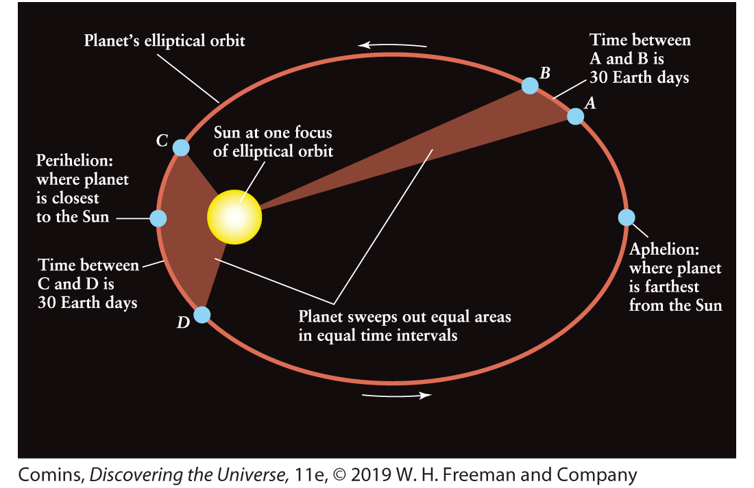
Elliptical Orbits

Slide 22
Keplerian Orbits
Planets orbit the Sun, but the orbits are not centered on the Sun
Planets move fastest at perihelion, slowest at aphelion
Planets closer to the Sun have faster speeds and shorter orbital periods

Slide 23
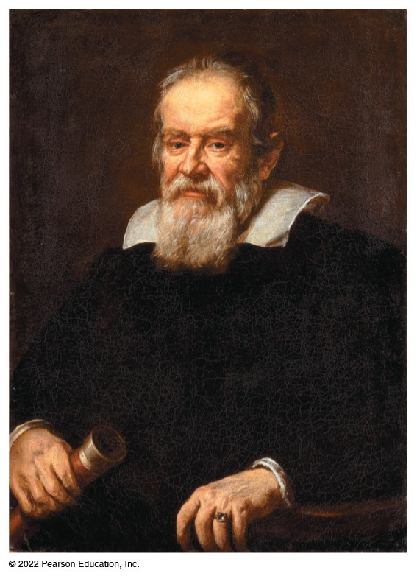
Galileo Galilei (1564–1642)
Used a telescope
Saw Moons of Jupiter
Saw Mountains on the Moon
Phases of Venus
Saw Stars in the Milky Way

Slide 24
Galileo Galilei
Formulated the law of inertia
Regularity of relative motion

Slide 25
Isaac Newton
Improved telescope design
Used a reflecting telescope
Advanced science of optics
Formulated laws of force and motion
Determined formulas for gravity
Theoretical foundation for Kepler’s laws

