Slide 1
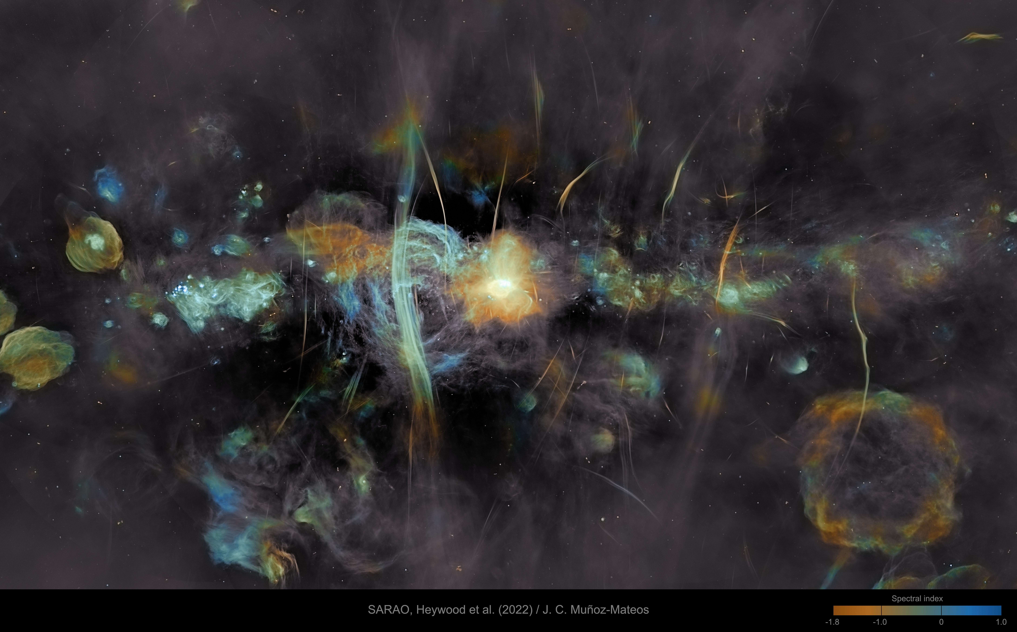
Stellar Coordinates

Slide 2
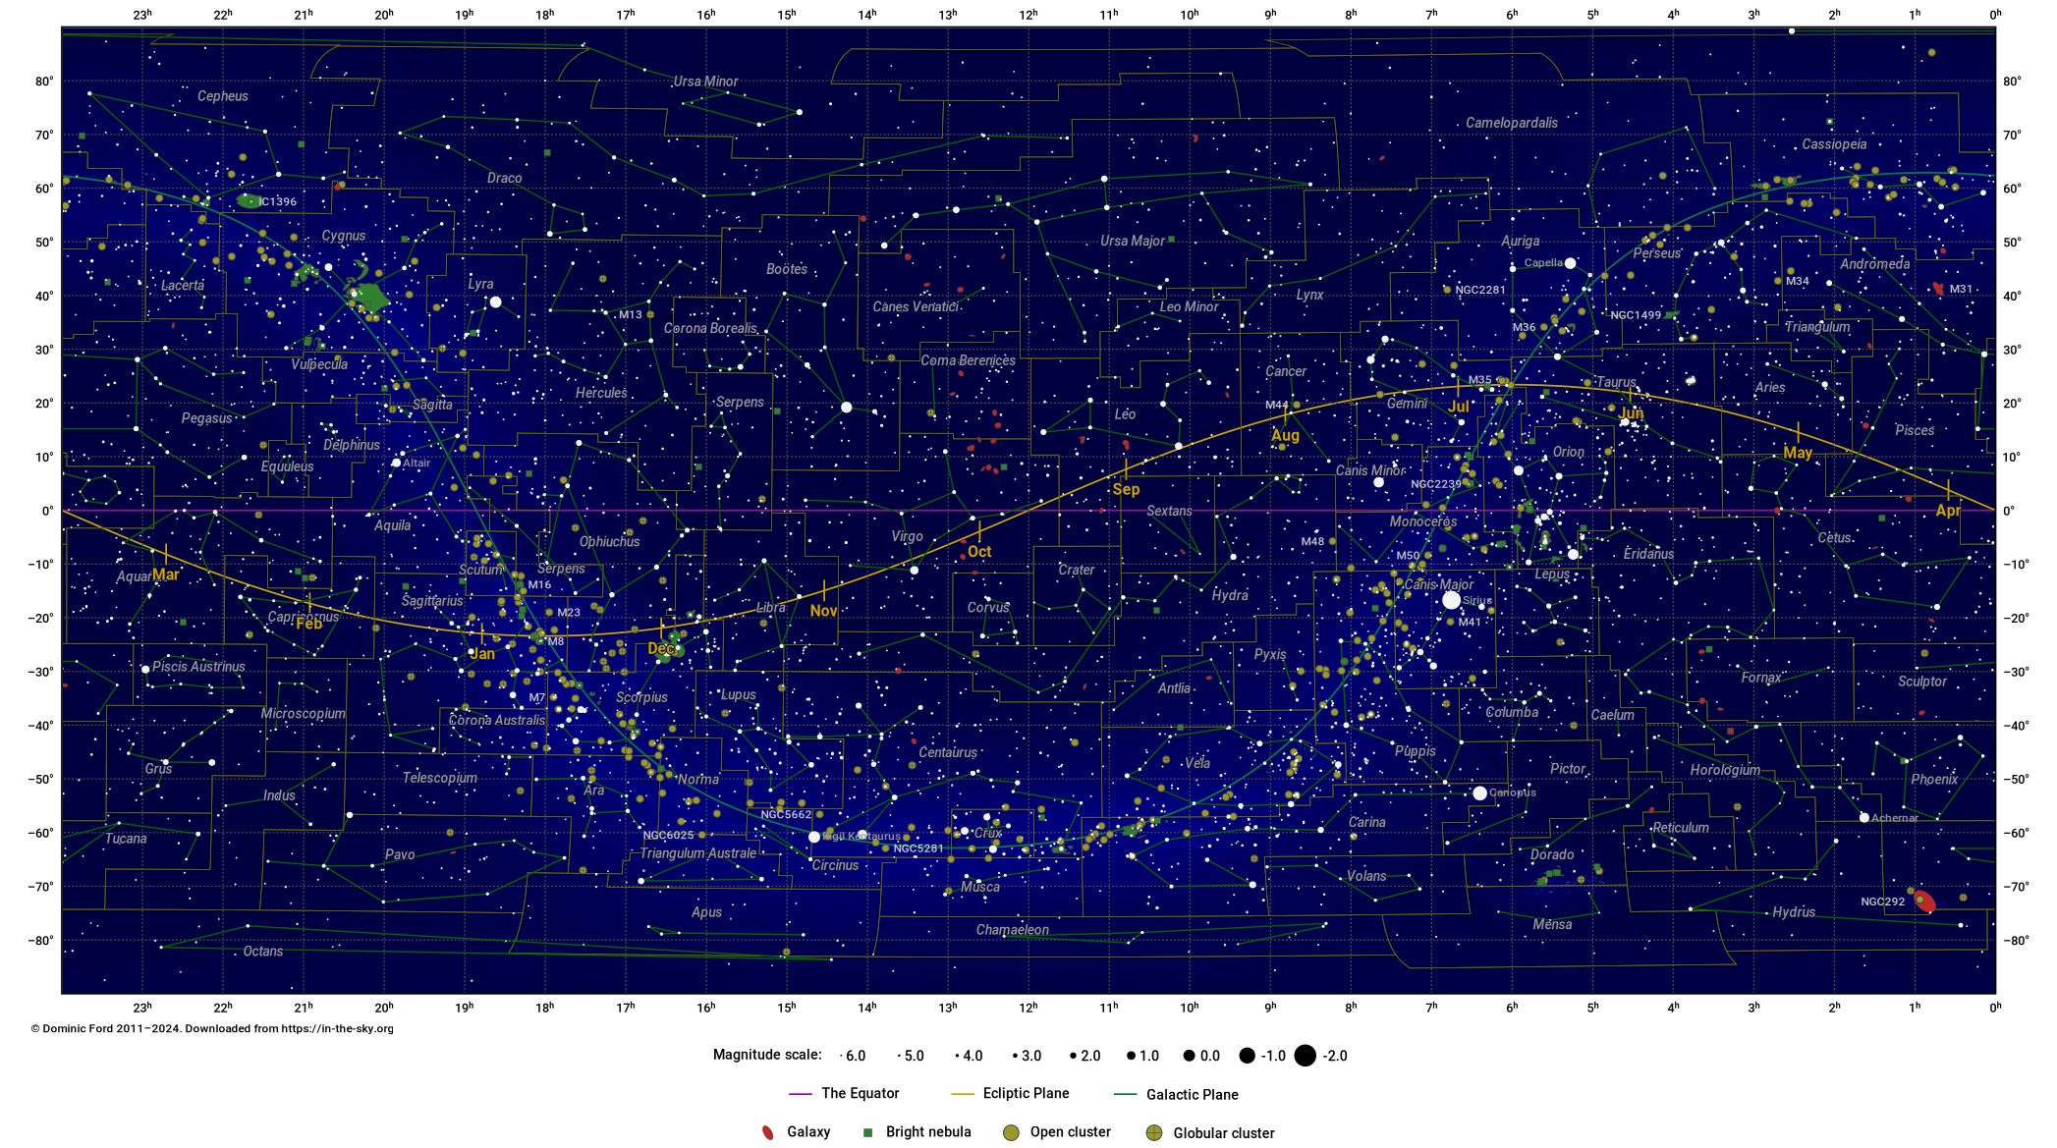
Constellations

Slide 3
Coordinates
How should we specify where something is in the sky?

Slide 4
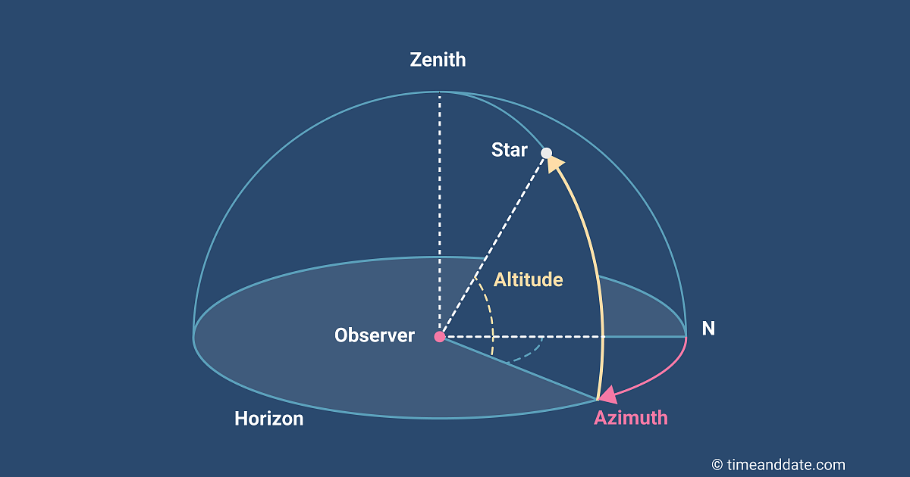
Alt-Azimiuth
Altitude: degrees above the horizon
Azimuth: degrees cw of North (heading)

Slide 5
Alt-Azimuth Coordinates
Advantages
  Easy to use
  Intuitive
Disadvantages
  System moves relative to the sky
  Zenith is different everywhere on Earth
  Must specify time, location to be useful

Slide 6
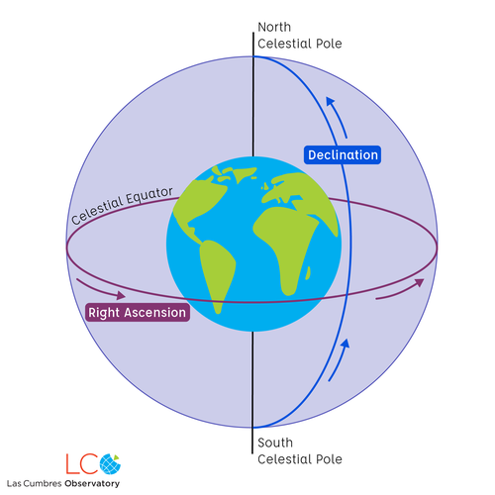
Equatorial Coordinates

Slide 7
Equatorial Coordinates
Declination (like latitude)
  0° at equator
  +90°at north celestial pole
  –90° at south celestial pole

Slide 8
Equatorial Coordinates
Right ascension (like longitude)
  0 at March equinox (first point of Aries)
  Progresses eastward around the celestial equator to 24 h
  Reported in hh:mm:ss
  strictly, sidereal time

Slide 9
Equatorial Coordinates
Advantages
  Referenced to the sky, not the Earth
  Tracking RA is easy using (sidereal) time
Disadvantages
  No obvious landmarks for zero
  The celestial equatorial plane moves
  The First Point of Aries moves
  Must specify an epoch to know the axes

Slide 10
Ecliptic Coordinates
Latitude 0° at the ecliptic plane, ±90° at the ecliptic poles
Longitude 0° at the First Point of Aries, increases eastward to 360°

Slide 11
Ecliptic Coordinates
Advantages
  The ecliptic plane doesn’t move
    one axis is steady
  Uses degrees for both coordinates
Disadvantages
  The March equinox does move

Slide 12
Galactic coordinates
Image: NASA/Caltech-JPL, Spitzer data

Slide 13
Galactic Coordinates
Latitude 0° is the plane containing the Sun parallel to the plane of the Milky Way galaxy
Longitude 0° in the direction to the galactic center
Longitude increases ccw looking down north galactic pole

Slide 14
Galactic Coordinates
Advantages
  Stabler than Earth orbit parameters
Disadvantages
  Galactic plane hard to define exactly
  Galactic plane isn’t exactly planar

Slide 15
ICRS
International Celestial Reference System
Defined by 303 distant radio sources (mostly quasars)
Equivalent to equatorial coordinates at January 1, 2000

Slide 16
Constellation Boundaries
Celestial sphere is officially partitioned between 88 constellations
  Adopted in 1930
Boundaries between constellations are line segments of constant right ascension or declination
  B1875.0 coordinates

Slide 17
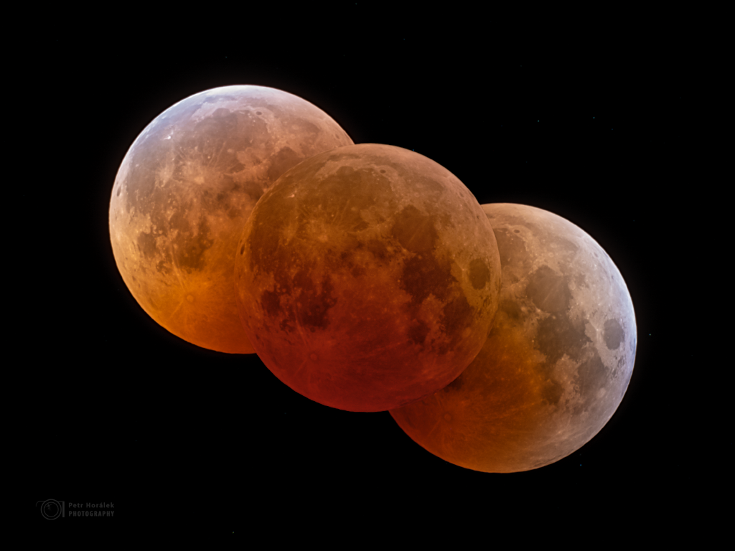
Eclipses, Transits, and Occultations
Getting in the way

Slide 18
Solar Eclipses
Moon blocks the Sun
What phase?
Why not every month?

Slide 19
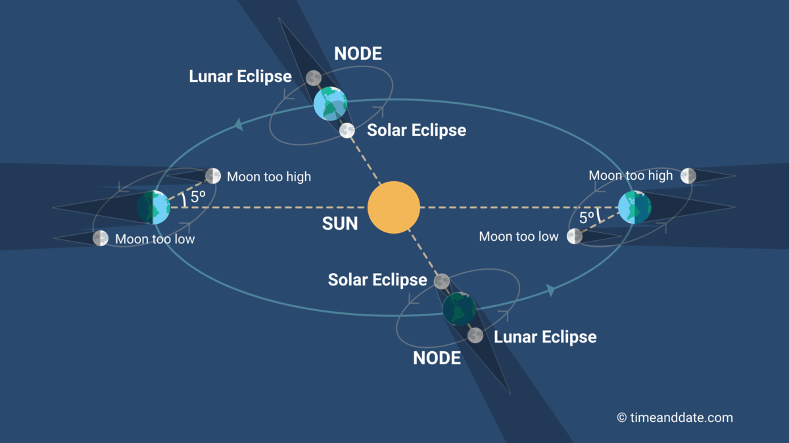
Eclipses

Slide 20
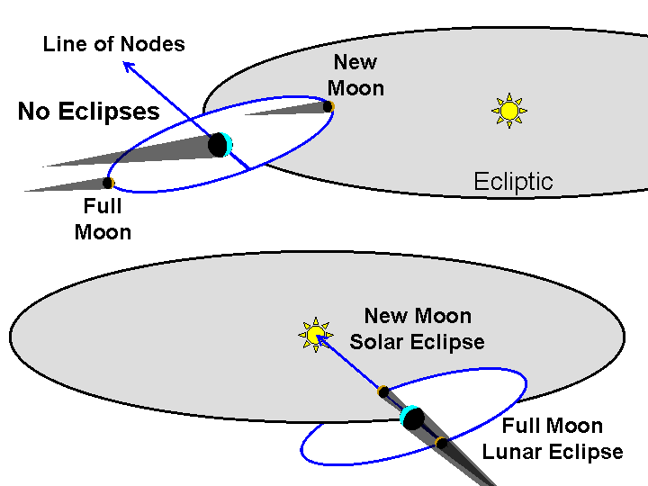
Lunar inclination
Image credit: Richard Pogge, Ohio State U

Slide 21
Line of sight
Node: where an orbit crosses the ecliptic
Nodal line: where orbital plane intersects the ecliptic

Slide 22
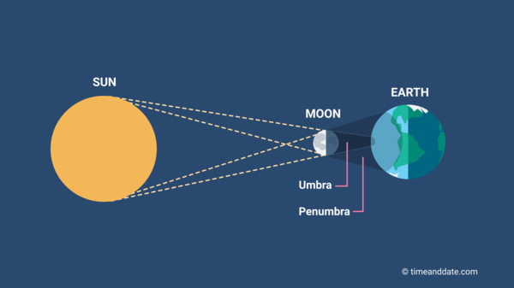
Parts of the shadow

Slide 23
Earth and Moon
Photo: NavCam 1 of the OSIRIS-REx probe, Sep 25, 2017
Approximately equidistant from Earth and Moon
Credit: NASA

Slide 24
They’re so close
Sun and Moon each subtend ½ degree
Sun is 400 times the diameter of Moon
Sun is 400 times farther than Moon

Slide 25
Disk matching
Sun: diameter 1.393 ×10⁶ km
Position | Distance (km) | Angle (ʹ)
average | 150 ×10⁶ | 32.3
perihelion | 147 ×10⁶ | 32.8
aphelion | 152 ×10⁶ | 31.7
Moon: diameter 3475 km
Position | Distance (km) | Angle (ʹ)
average | 384,399 | 31.1
perigee | 356,870 | 33.5
apogee | 406,079 | 29.4
The Sun usually looks bigger than the Moon

Slide 26
Types of Solar Eclipse
Total
  Part of Earth’s surface passes through Moon’s umbra
Partial
  Moon’s penumbra lands on Earth’s surface, but umbra misses
Annular
  Earth’s surface is beyond the Moon’s umbra

Slide 27
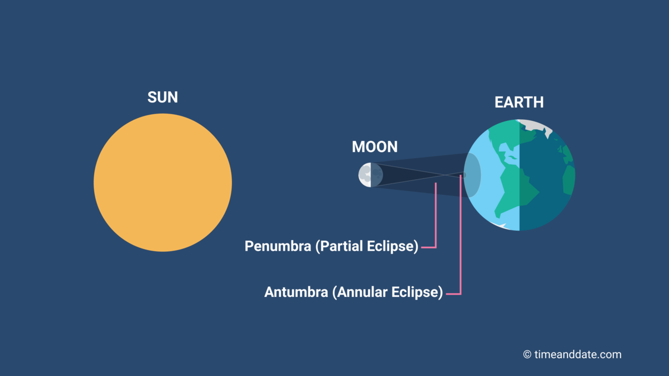
Annular eclipse

Slide 28
View a Solar Eclipse
More likely in summer
  More time facing the Sun
Totality more likely at aphelion
  Northern hemisphere summer
Narrow path of totality
Brief totality at best

Slide 29
What is an eclipse like?
GOES time lapse
Veritasium

Slide 30


Slide 31
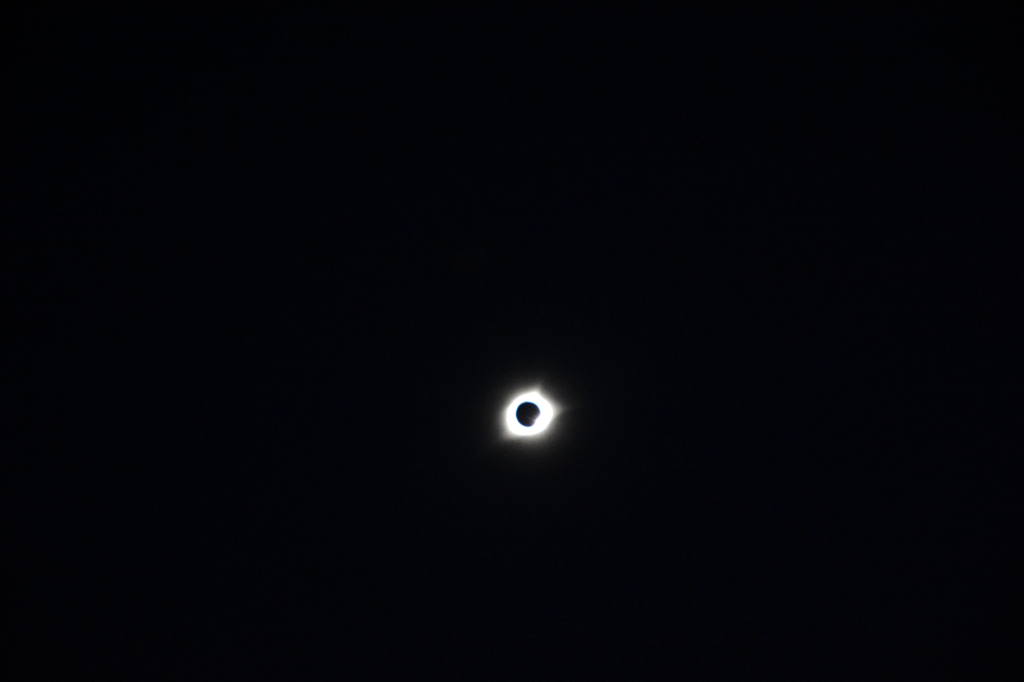

Slide 32
Lunar eclipses
Earth shades the Moon
What phase?
Why not every month?

Slide 33
Types of Lunar eclipse
Total
  Entire Moon passes into Earth’s umbra
Partial
  Some of the Moon inside Umbra, some in penumbra
Penumbral
  Moon passes into penumbra, misses umbra

Slide 34
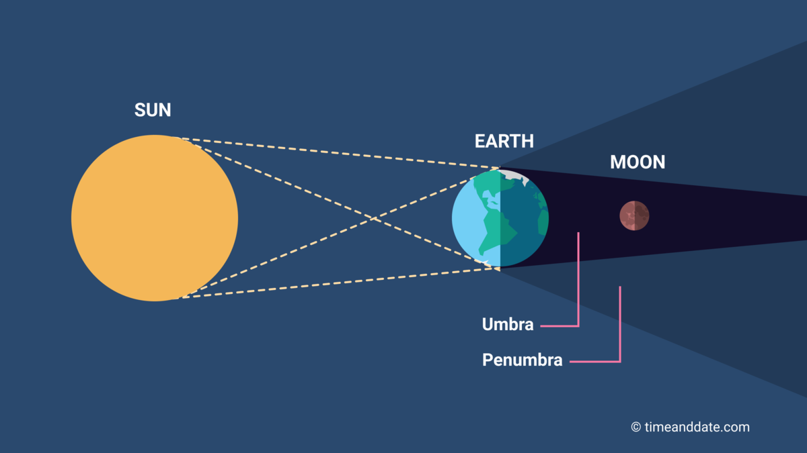
Total lunar eclipse

Slide 35
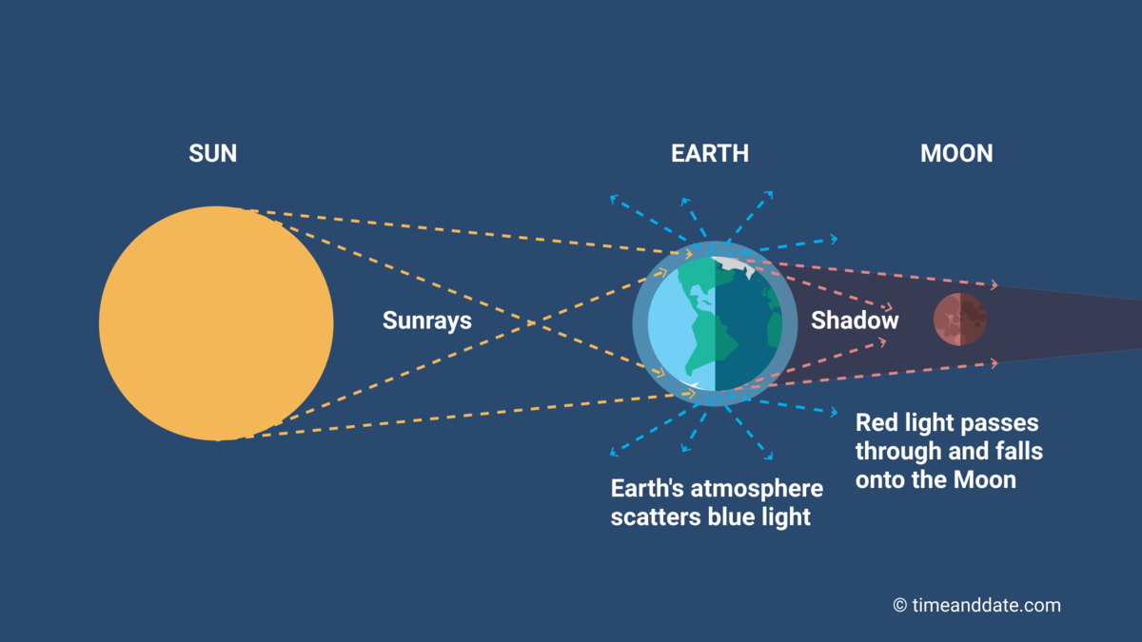
Blood Moon
Why is the umbra red?

Slide 36
View a Lunar Eclipse
Only visible at night
Visible everywhere the Moon is visible
Long period of totality

Slide 37
Earth’s umbral diameter
at distance of Moon
Position | Umbra, km | Umbra/Moon
average, average | 9177 | 2.64
aphelion, perigee | 9487 | 2.73
perihelion, apogee | 8912 | 2.56
As long as they line up, the eclipse is total.

Slide 38
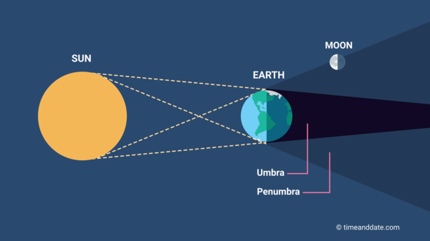
Penumbral lunar eclipse

Slide 39
Upcoming Eclipses
Total lunar eclipse Mar 14–15, 2025
  total 12:26–1:31 AM; max 12:58
Total lunar eclipse Sep 7, 2025
  not visible in Americas
Total lunar eclipse Mar 3, 2026

Slide 40
Upcoming Eclipses
World’s next total solar eclipse 8/12/2026
  visible in Arctic, Spain
After that, total solar eclipse 8/2/2027
  visible in north Africa, Arabian peninsula
Laramie’s next total solar eclipse 5/3/2106

Slide 41
Planetary Transits
Inner planet between Sun and Earth
  Inferior conjunction
Very little obscuration
  Mercury 10"–12"
  Venus 58"
Nodal alignment required
  Mercury’s orbital inclination 7°
  Venus’s orbital inclination 3.4°

Slide 42
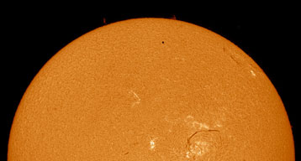
Transits are Rare
Next transits of Mercury:
  Nov 13, 2032 not visible in N. America
  Nov 7, 2039 not visible in N. America
  May 7, 2049 visible in western N. Am.
  Nov 8, 2052 visible in Americas
Image: Howard Brown-Greaves

Slide 43
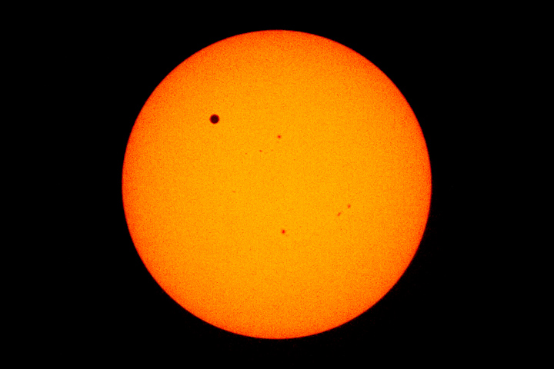
Transits are Rare
Transits of Venus:
  Jun 8, 2004
  Jun 6, 2012
  Dec 11, 2117
  Dec 18, 2125
  June 11, 2247
  June 9, 2255
Image: NASA

Slide 44
Exoplanet Transits
Sensitive way to detect exoplanets
Gives information about
  atmosphere of star
  atmosphere of planet
  diameter of planet
Low probability of alignment
Difficult to detect planets much smaller than their stars

Slide 45
Occultations
Closer object blocks a more distant object
E.g. planet, moon, or asteroid blocks a star
Gives information about
  atmosphere of blocker
  size and shape of near object
  size and shape of distant object

Slide 46
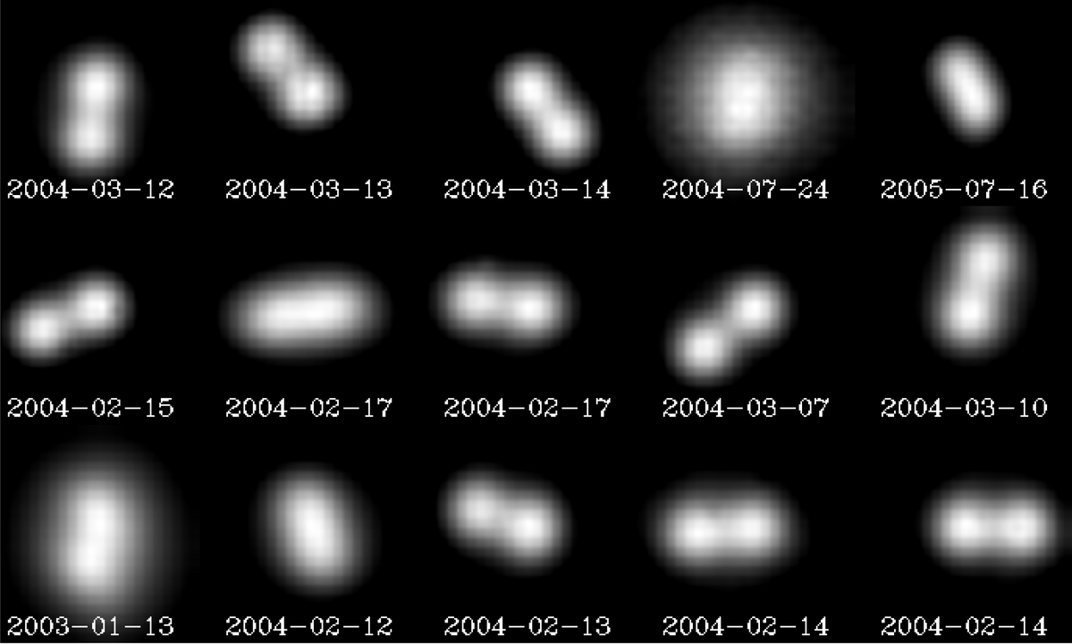
Asteroid (90) Antiope
Best telescopic view, VLT/adaptive optics
By European Southern Observatory

Slide 47
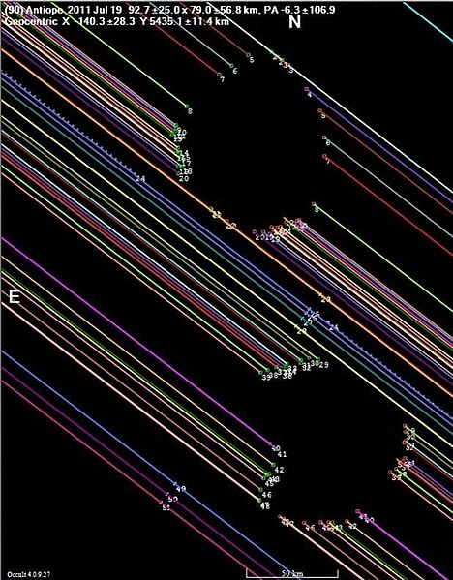
Asteroid (90) Antiope
Occultation of LQ Aquarii, 7/19/2011
Timings from multiple stations in western US
Credit: David Dunham, International Occultation Timing Association

Slide 48
Eclipse and occultation
APOD 11 Nov 2022

