Slide 1
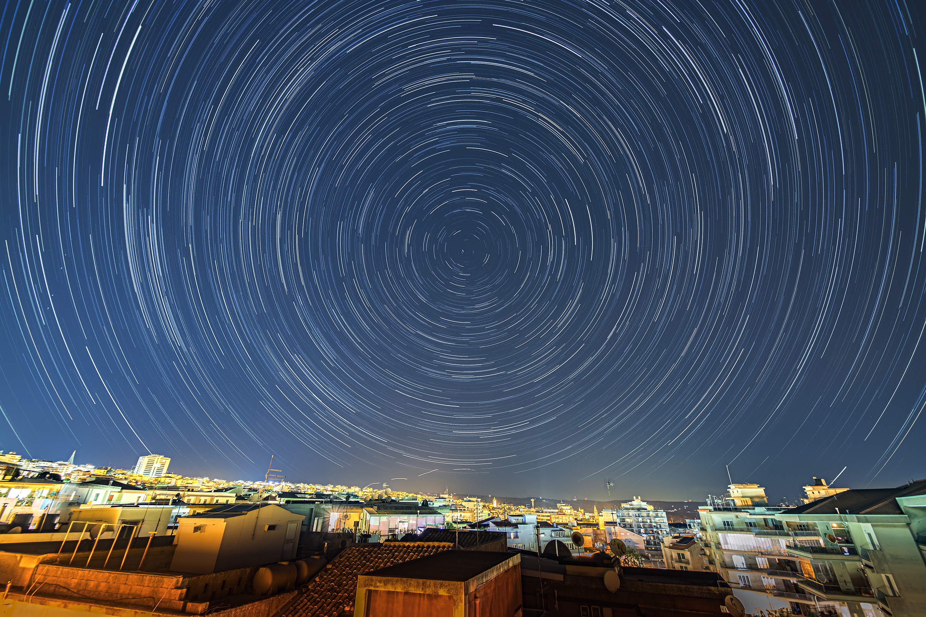
Days, Months, Years
The sky tells time
Image credit: Gianni Tumino

Slide 2
The Heavens move
Celestial objects move across the sky
That’s what we see
Regularly-repeating patterns in the sky have set our concept of time

Slide 3
Daily motion
Celestial objects travel east to west
Circle around an axis
counterclockwise around North Star in northern hemisphere
clockwise around nothing prominent in southern hemisphere
From this we can deduce which way Earth spins

Slide 4
Daily motion
We see different objects
at different times of the night
at different times of the year
from different parts of the Earth

Slide 5
Polaris
Close to North Celestial Pole
20th brightest star
0.75° from pole (1.5 times diameter of full Moon)
Does not move throughout the night
Does not move throughout the year
Moves slightly over the millennia

Slide 6
We can observe
Half the sky at a time
above the horizon
90° around our zenith
Some stars never set (circumpolar)
Some stars never rise (always below the horizon)

Slide 7
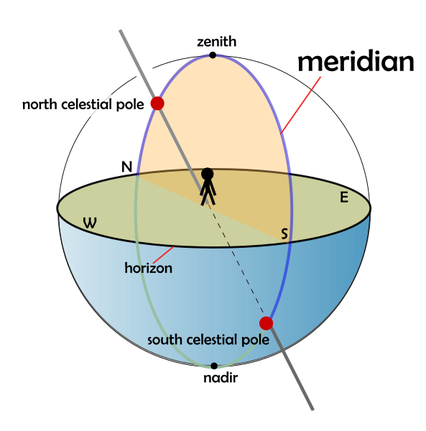
What we see
Credit: Wikimedia commons, creator AMitchell125

Slide 8
Announcement
I won’t be at my 7–8 office hour this evening

Slide 9
Latitude matters
The farther we are from the equator:
more of the sky is circumpolar
more of the sky is always below the horizon
At the poles
half the sky is circumpolar
At the equator
poles are at the horizon
everything else is visible some time

Slide 10
Wandering Sun
The Sun travels through the fixed stars
Moves about 1° per day along the circular path of the Ecliptic
Inclined 23.5° from the Celestial Equator
Passes through Zodiac constellations
Crosses the equator at equinoxes
Farthest north and south at solstices
Completes one cycle in a year

Slide 11
Repeating patterns
Regularly-repeating patterns in the sky have set our concept of time
Days
12- and 24-hour days and nights
Egyptians favored base 12
Standard hours only really caught on after mechanical clocks became commonplace
Minutes and seconds

Slide 12
Days
The Sun rises and sets day after day
Daylight length varies annually
Time between high noon also varies annually

Slide 13
Days
Solar Day: high noon to high noon
(when the Sun is highest in the sky)
varies throughout the year
Mean solar day = 24 hours
Sidereal Day: fixed star to fixed star
Period = 23 h 56 min 4.1 s
One year holds one more sidereal day than Solar days

Slide 14
Group work
A Solar day is longer than a sidereal day. Which way does the Earth orbit the Sun? (The same way the Earth spins, or opposite?)

Slide 15
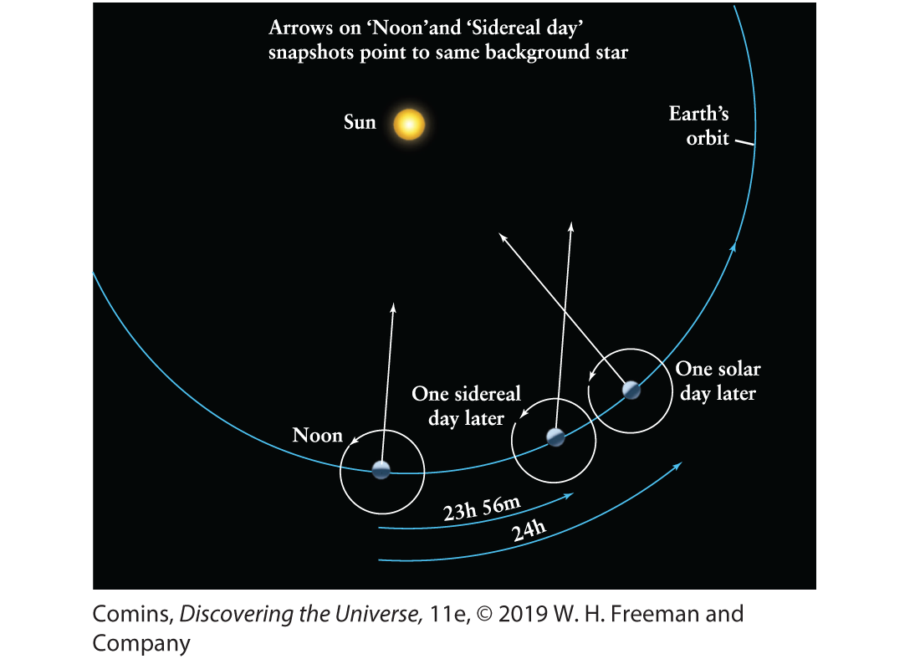
Days
Figure 1.10, Page 17

Slide 16
Week days
Seven days of the week
Seven visible wanderers in the sky
English | French | Spanish
Sunday | dimanche | domingo
Monday | lundi | lunes
Tuesday | mardi | martes
Wednesday | mercredi | miércoles
Thursday | jeudi | jueves
Friday | vendredi | viernes
Saturday | samedi | sabado

Slide 17
Wandering Moon
The Moon travels along the ecliptic
Rises, sets about an hour later each day
Circles through the fixed stars in 27.322 d
sidereal month
Phases repeat in 29.5 d
synodic month or lunation

Slide 18
Group work
The Moon rises and sets later each day. Which way does the Moon orbit the Earth? (The same way the Earth spins, or opposite?)
A lunation is longer than a sidereal month. How do the Earth’s and the Moon’s orbits require this?

Slide 19
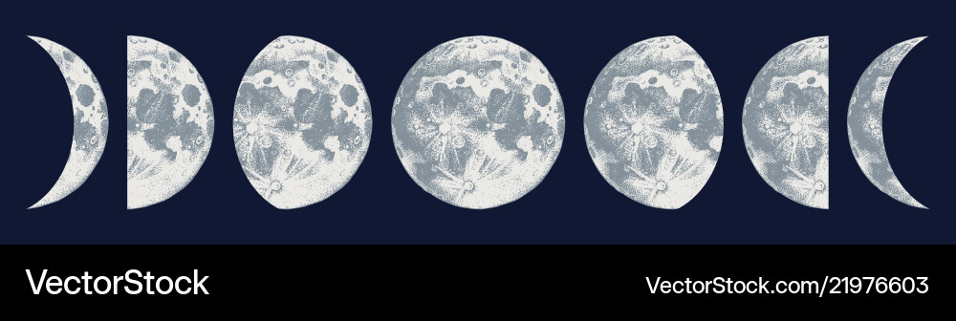
Phases of the Moon
New
Waxing crescent
First quarter
Waxing Gibbous
Full
Waning Gibbous
Last quarter
Waning crescent

Slide 20
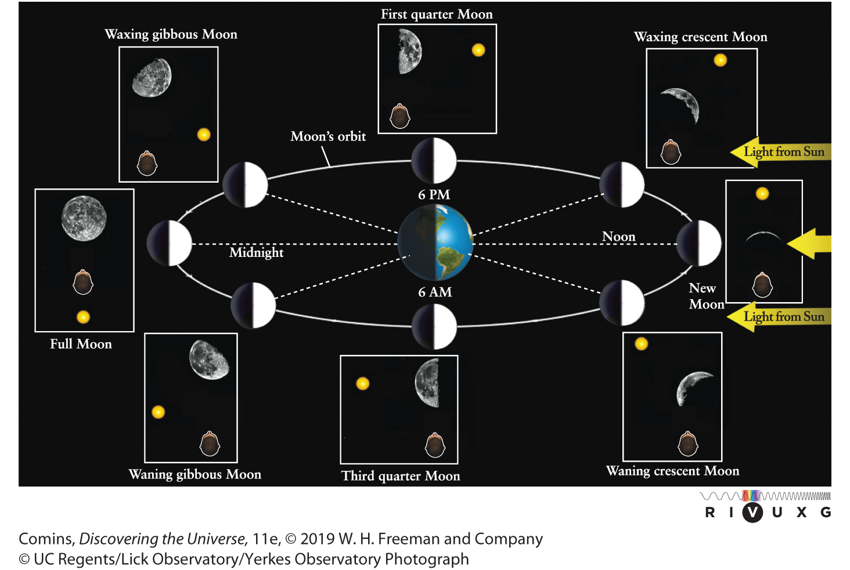
Phases of the Moon
Figure 1.23, Page 27

Slide 21
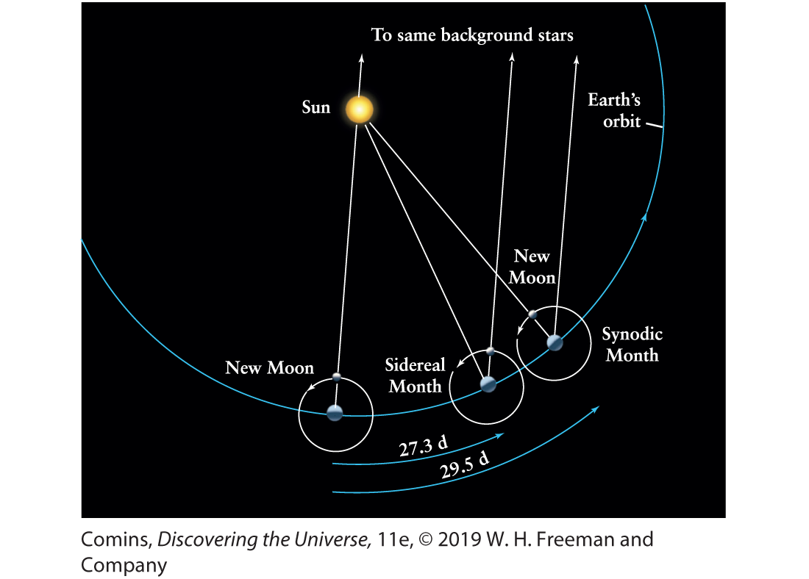
Months
Figure 1.25, Page 29

Slide 22
Months
Our calendar months are contrived to synchronize with the year

Slide 23
Annual Motion
Orbit of Earth around the Sun
Appears the other way around
Sidereal year
fixed star to fixed star
Period 365.256 days

Slide 24
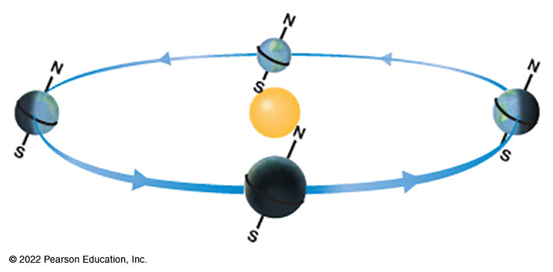
The Seasons
Astronomically begin at equinoxes and solstices
Yearly temperature cycles result from 23.5° axial tilt
March equinox
June solstice
December solstice
September equinox

Slide 25
The Seasons
More daylight hours during Spring and Summer
Sun closer to zenith in Spring and Summer
March equinox
June solstice
December solstice
September equinox

Slide 26
The Seasons
Temperature lags solar input
It takes time to heat up and cool down
Season beginnings vary culturally
USA: astronomical seasons
Europe: first of the month
Ancient Celts: cross-quarter days
Laramie: June is Spring, July is Summer, August is Fall

Slide 27
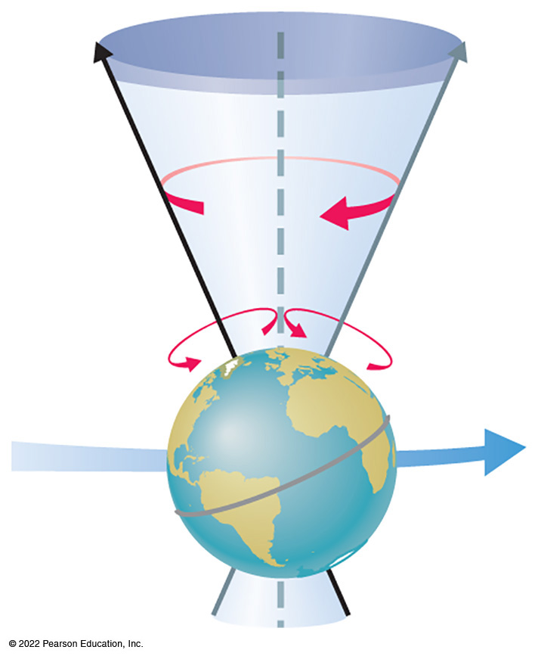
Precession
Earth’s axis slowly precesses
about the axis of the ecliptic

Slide 28
Precession
Period about 26,000 years
Equinoxes precess about the ecliptic
The Sun is in different constellations at the change of the seasons than it was in the past

Slide 29
Tropical Year
Tropical year
equinox to equinox
Period 365.24219 days
The calendar year is the tropical year to match the cycle of the seasons

Slide 30
The Tropics
Gr. tropos, “turning”
Latitudes ± 23°26’
Sun “turns around” at the tropics
formerly in Cancer and Capricornus
now in Sagittarius and Gemini
Between the tropics, the Sun is directly overhead at solar noon twice per year

Slide 31
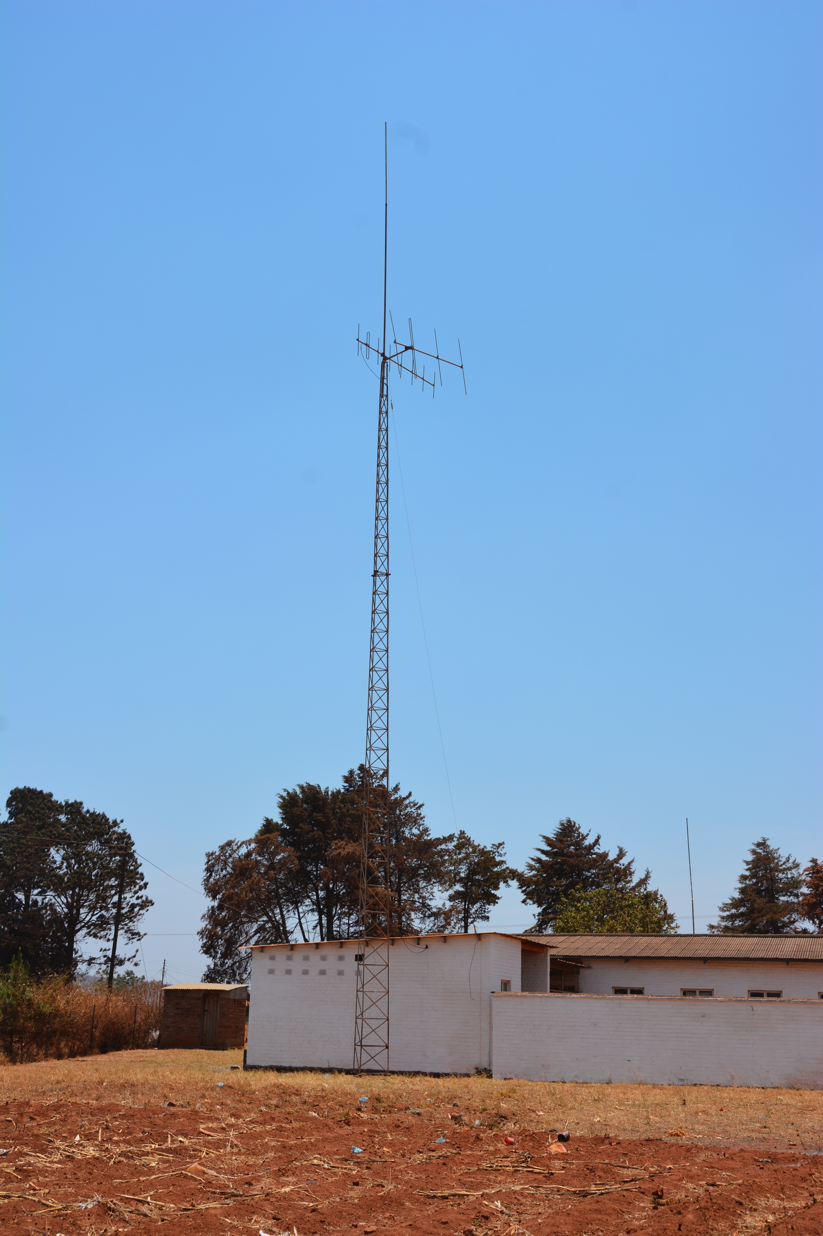
Champhira, Malawi
About 12°south latitude
Subsolar day, 2016
Do you see the shadow?

Slide 32
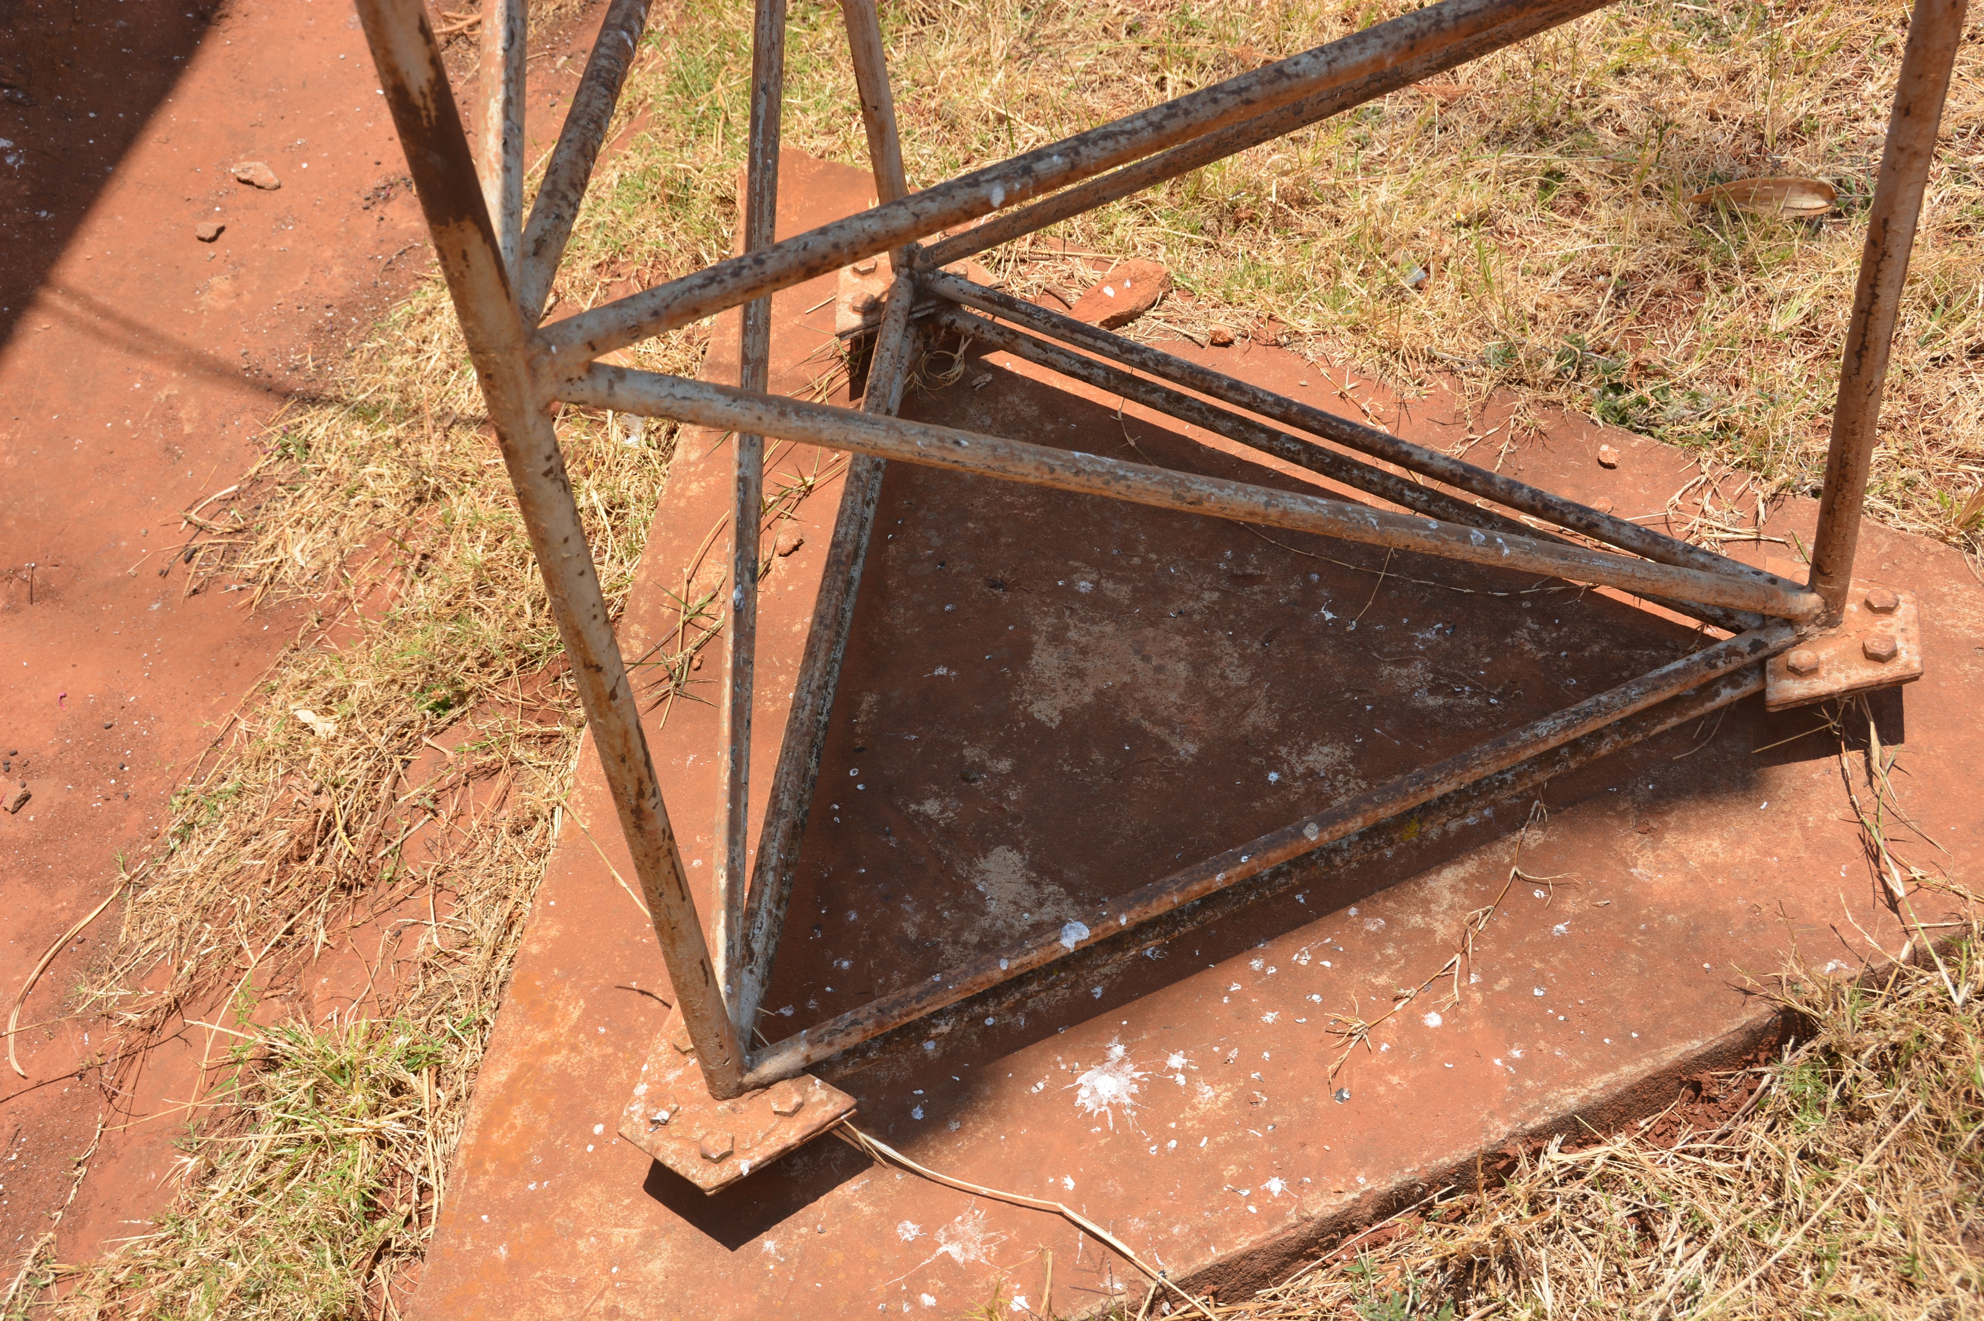

Slide 33
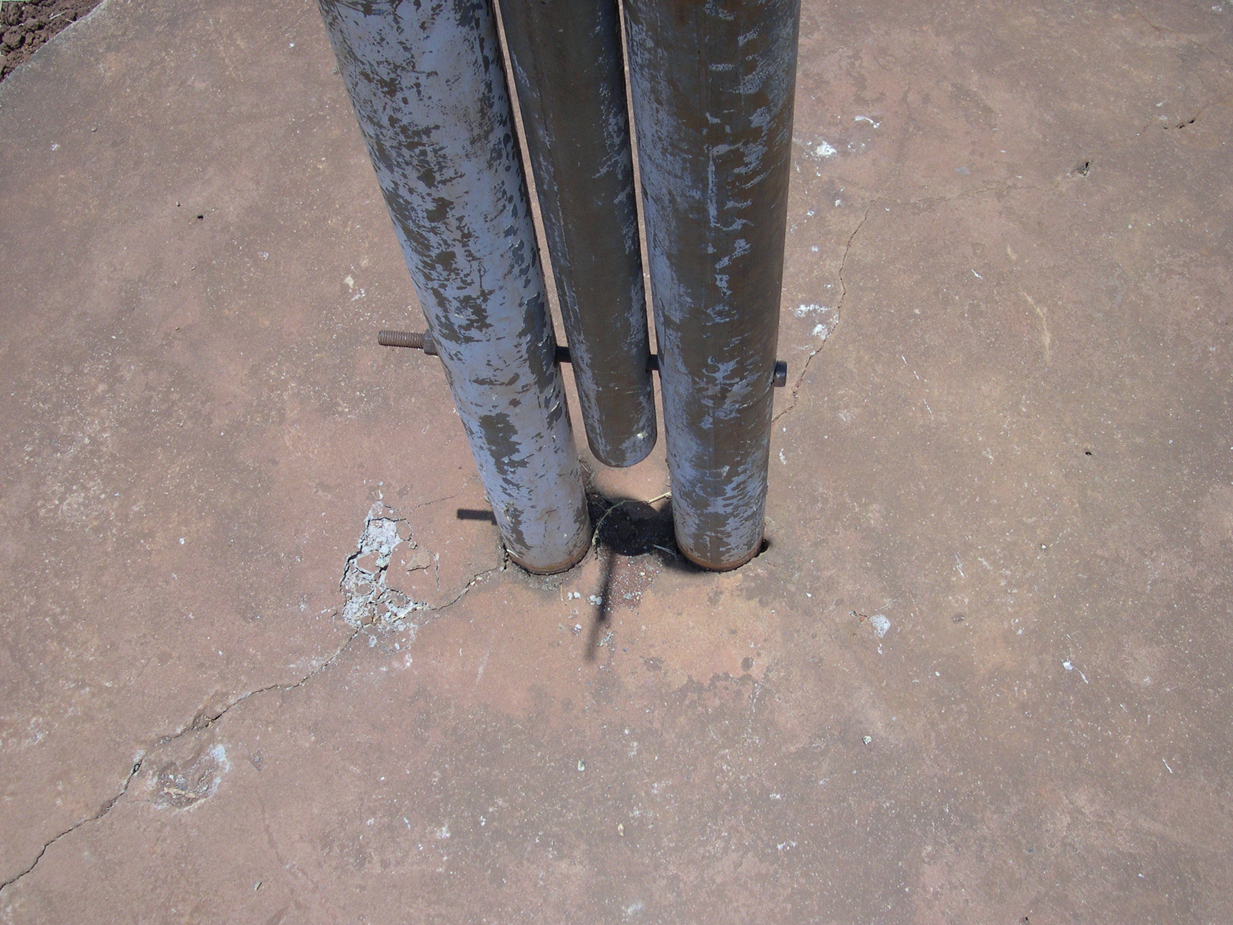

Slide 34
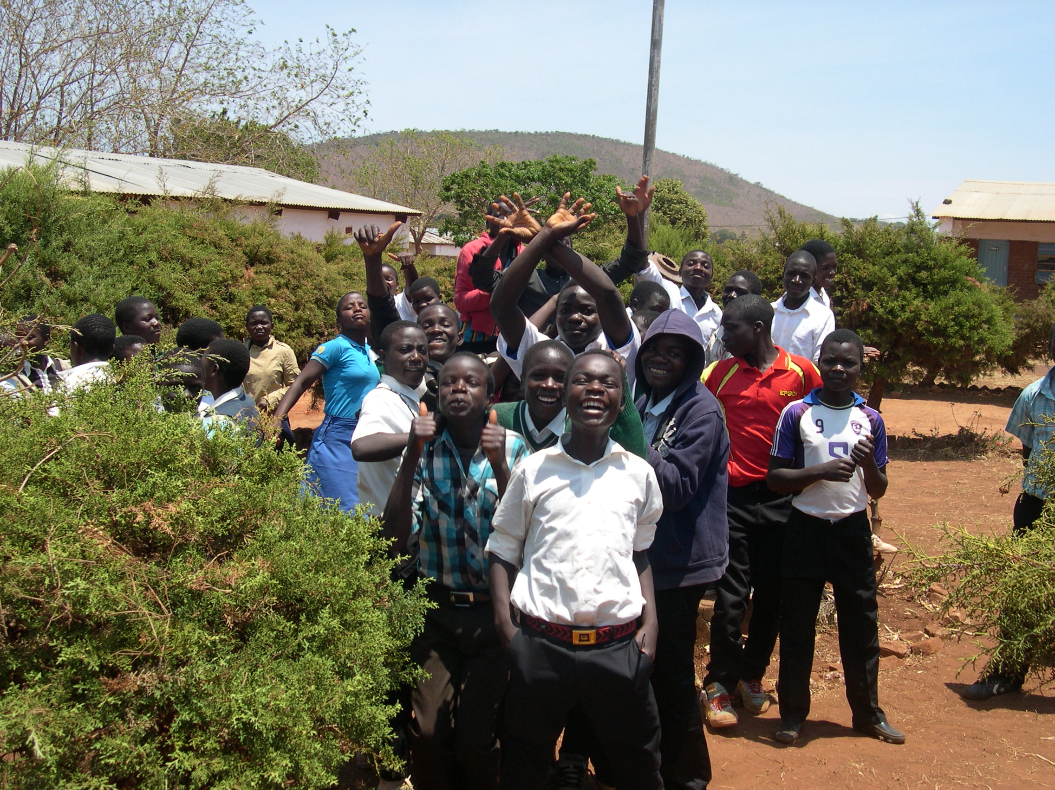

Slide 35
Perihelion and Aphelion
Currently perihelion in January, aphelion in July
More orbital time far from Sun
Orbit precesses from planetary influence and general relativity

Slide 36
Exit Ticket
Write on an index card one thing that now makes more sense
or
One question you have about today’s topic

