Slide 1
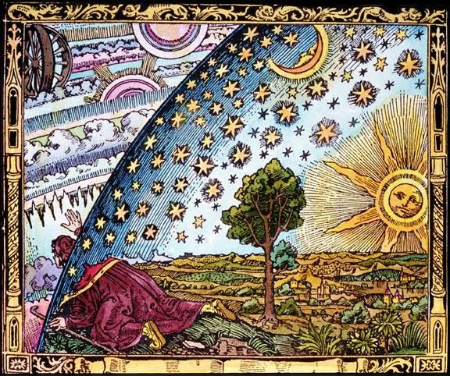
What’s out there
What the universe is made of

Slide 2
Pair Exercise
Think of as many celestial objects as you can.
  can be individual items (e.g. stars)
  can be structures (e.g. star clusters)

Slide 3
Structural levels
Objects (stars, asteroids, planets)
Solar system
Galaxy
Galaxy clusters
Galaxy superclusters
Cosmic web
  walls, filaments, voids

Slide 4
Other levels of structure
Many stars are in clusters
  some long-lived
  most non-dwarf stars are binaries
Galaxies have structure
  arms, disk, bulge of spiral galaxies

Slide 5
Cosmic Distances
Measuring distance is of critical importance to understanding the universe (the distance problem)
It’s fairly easy to find an object’s direction
Measuring distance is very difficult
Astronomy research depends on the unglamorous work of developing and testing ways to measure distance

Slide 6
Cosmic Directions
Specified in terms of two angles
  celestial latitude and longitude
Coordinates need to specify
  an origin
  a plane containing the origin
    (the plane and origin define an axis)
  another point in the plane
    (or a line in the plane containing the origin)
  a direction around the plane

Slide 7
Cosmic Directions
Coordinates need to specify
  an origin
  a plane containing the origin
    (the plane and origin define an axis)
  another point in the plane
    (or a line in the plane containing the origin)
  a direction around the plane
What are these quantities for latitude and longitude coordinates?

Slide 8
Pair Exercise
How might astronomers measure or estimate distances to celestial objects?

Slide 9
Useful Distance Units
kilometer
Astronomical unit
light year
parsec

Slide 10
Speed, time, and distance
speed = distance / time
so
distance = speed×time
time = distance / speed

Slide 11
Speed of Light
c = 299,792,458 meters per second
This is a definition
The second is defined by the period of the hyperfine transition of cesium-133
  9,192,631,770 repeats = 1 s

Slide 12
Light·year
Distance light travels in one year
ly = (light speed)(1 year)
  this is a distance
ly = c·(1 y)

Slide 13
Exercise
How big is a ly in terms of familiar units?

Slide 14
Distances are Immense
Light from the nearest stars takes years to reach us
Our Galaxy is about 100 kly across
Nearest large galaxy is 2.5 Mly away
HST and Webb have imaged galaxies ~12 Gly distant
Observable Universe ends ~14 Gly away

Slide 15
Look-back time
Light from the stars takes time to reach us
The farther an object is from us, the longer ago light must have left the object to be arriving now
The time it takes light to reach us is the lookback time
We see celestial objects as they were in the past

Slide 16
Solar System Distances
Sun diameter D⊙ is 1.40×10⁶ km (106 D⊕)
Body Diameter (km) Orbital distance (km)
Mercury 4,879 5.80×10⁷
Venus 12,104 1.08×10⁸
Earth 12,756 1.50×10⁸
Moon 3,475 3.84×10⁵
Mars 6,779 2.28×10⁸
Jupiter 139,820 7.78×10⁸
Saturn 120,000 1.43×10⁹
Uranus 50,724 2.88×10⁹
Neptune 49,244 4.51×10⁹

