Slide 1
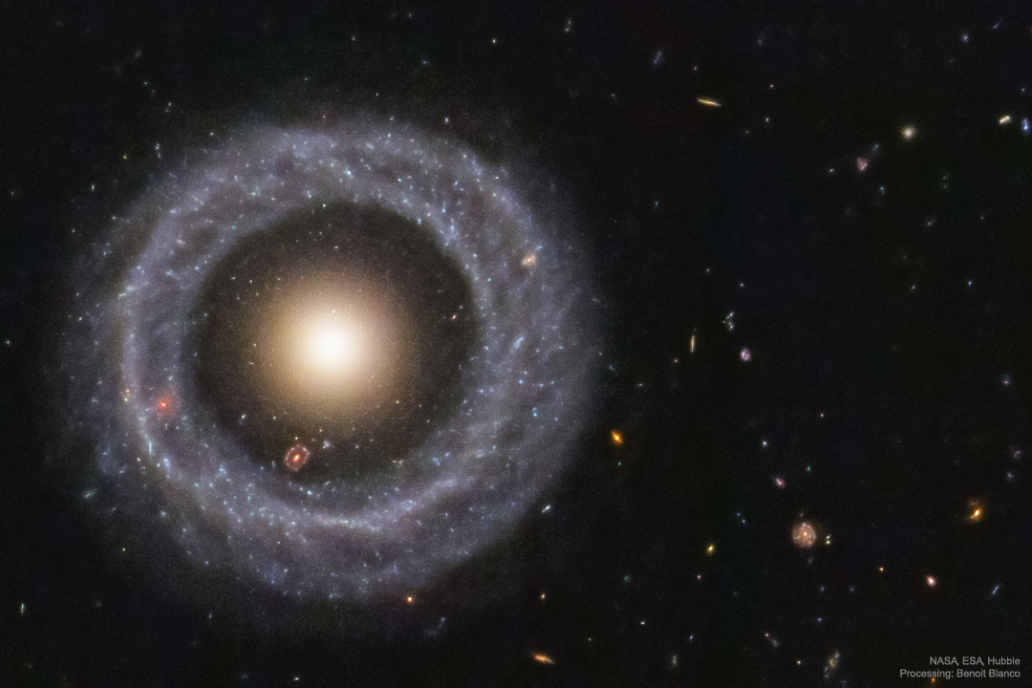
Welcome to
ASTR 1000: Descriptive Astronomy

Slide 2
Subject Matter
The whole Universe

Slide 3
What’s the Point?
The universe is everything
Astronomy puts things in perspective
Understanding the universe helps us understand where we are

Slide 4
Who are You?
Please clearly write your first and last name
and pronouns on both sides of the tent card
Your Name
Your Name
Please bring your tent card to every class
First Last

Slide 5
Group Work
Introduce yourself to your neighbors.
Tell them something boring about
  yourself
  your home town
  your family
  your name
  or anything else associated with you
Tell your group and write it down.

Slide 6
Index cards
Your name
The boring thing you told your neighbors
Anything you’d like me to know

Slide 7
Who am I?
Born and raised in Baltimore
Ph.D. Caltech
M.Ed. John Carroll U
Physics teacher since 2005

Slide 8
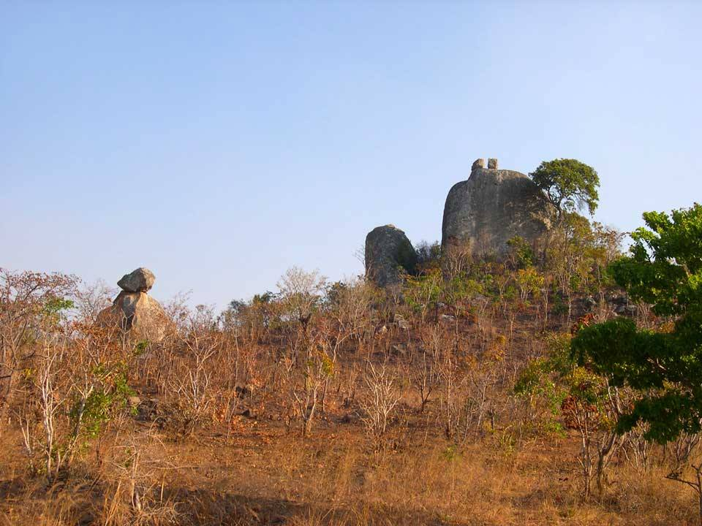
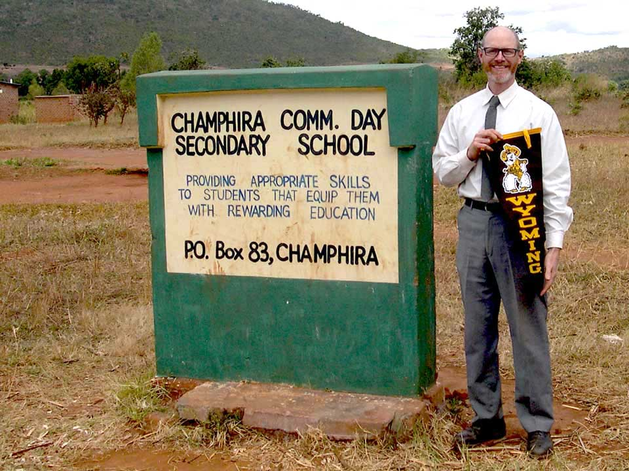
Where I’ve taught
University of Wyoming
Newman University
Champhira Community Day Secondary School
Maine School of Science and Mathematics

Slide 9
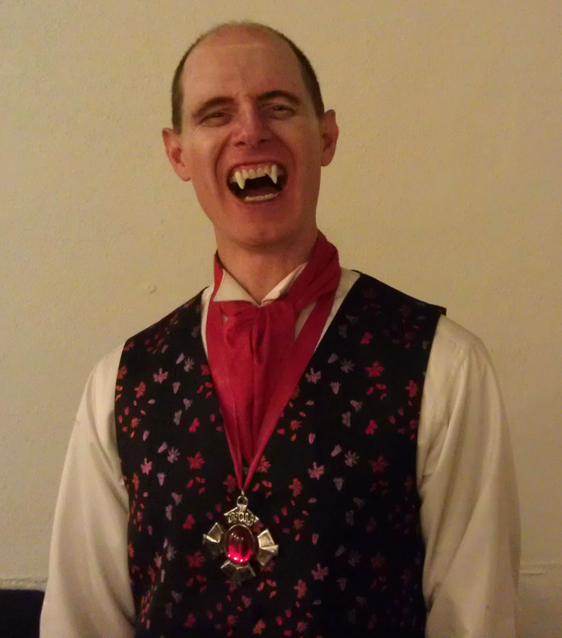
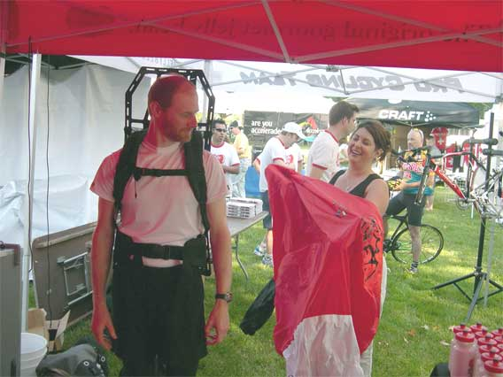
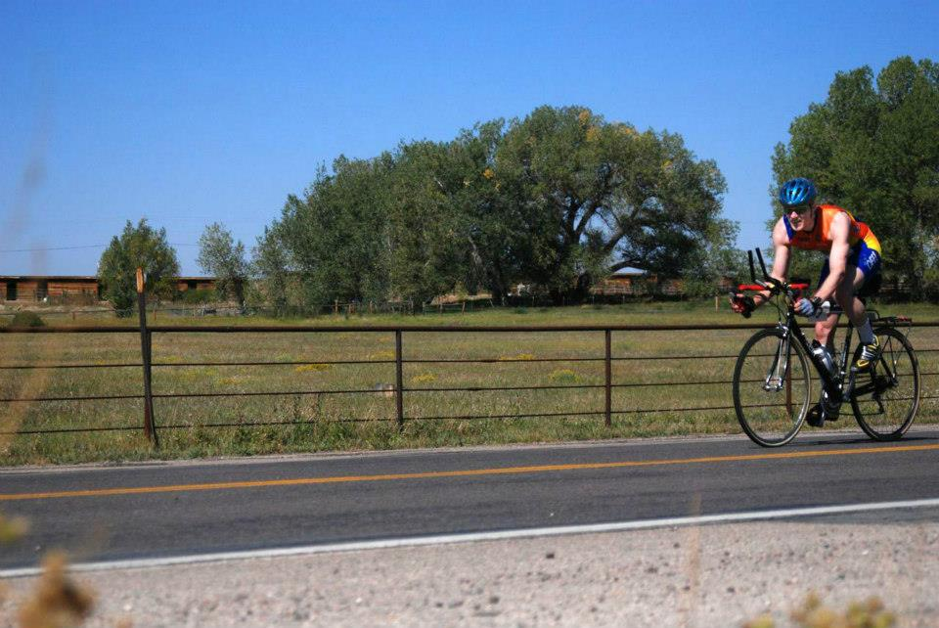
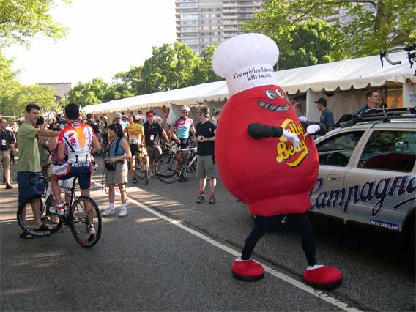
Interests
Cycling
Baking

Slide 10
Subjects
Universe
  What is in it?
  How is it arranged?
  How did it get like this?
Solar system
  How did it form?
  What does it contain?
  How do the pieces interact?

Slide 11
Subjects
The Sun
  What is it made of?
  What is its structure?
  How does it work?
  How will it change?

Slide 12
Subjects
Stars
  How are they alike?
  In what ways are they different?
  How do they shine?
  How do they change over time?

Slide 13
Subjects
Stellar remnants
  How do they form?
  How do they evolve?
  How do they interact with other bodies?

Slide 14
Subjects
Galaxies
  How do they form?
  How do they evolve?
  What is their structure?
  How do they interact with each other?

Slide 15
Subjects
The Universe
  How did it form?
  What is in it?
  Why is it as it is?
  What will happen to it?

Slide 16
Discussion question
Consider silently for 1 minute:
  Why do we suppose the Earth is round?
Discuss with near neighbors

Slide 17
Mechanics of the Course

Slide 18
Grading
In-class activities 5%
Online homework 10%
“Part” projects 50%
À la carte activities 20%
Final exam 15%

Slide 19
Homework
Mostly for practice (10% of course grade)
On MasteringAstronomy
  hope it’s bundled with your textbook
Accessed through WyoCourses shell

Slide 20
“Part” Projects
Textbook is categorized into 5 parts (+1)
Do something to demonstrate mastery of learning objectives within each part, e.g.
  concept map
  model
  game
  quiz questions

Slide 21
“Part” Projects
Draft
  To demonstrate progress
Draft feedback
  Will classmates’ projects cover the learning objectives?
Project
Project feedback
  What do classmates’ projects say?

Slide 22
À la Carte Activities
Read a book and tell the class
Rooftop observing
3D Constellation model
Planetarium show

Slide 23
Final Exam
Only exam in the class
15% of course grade

Slide 24
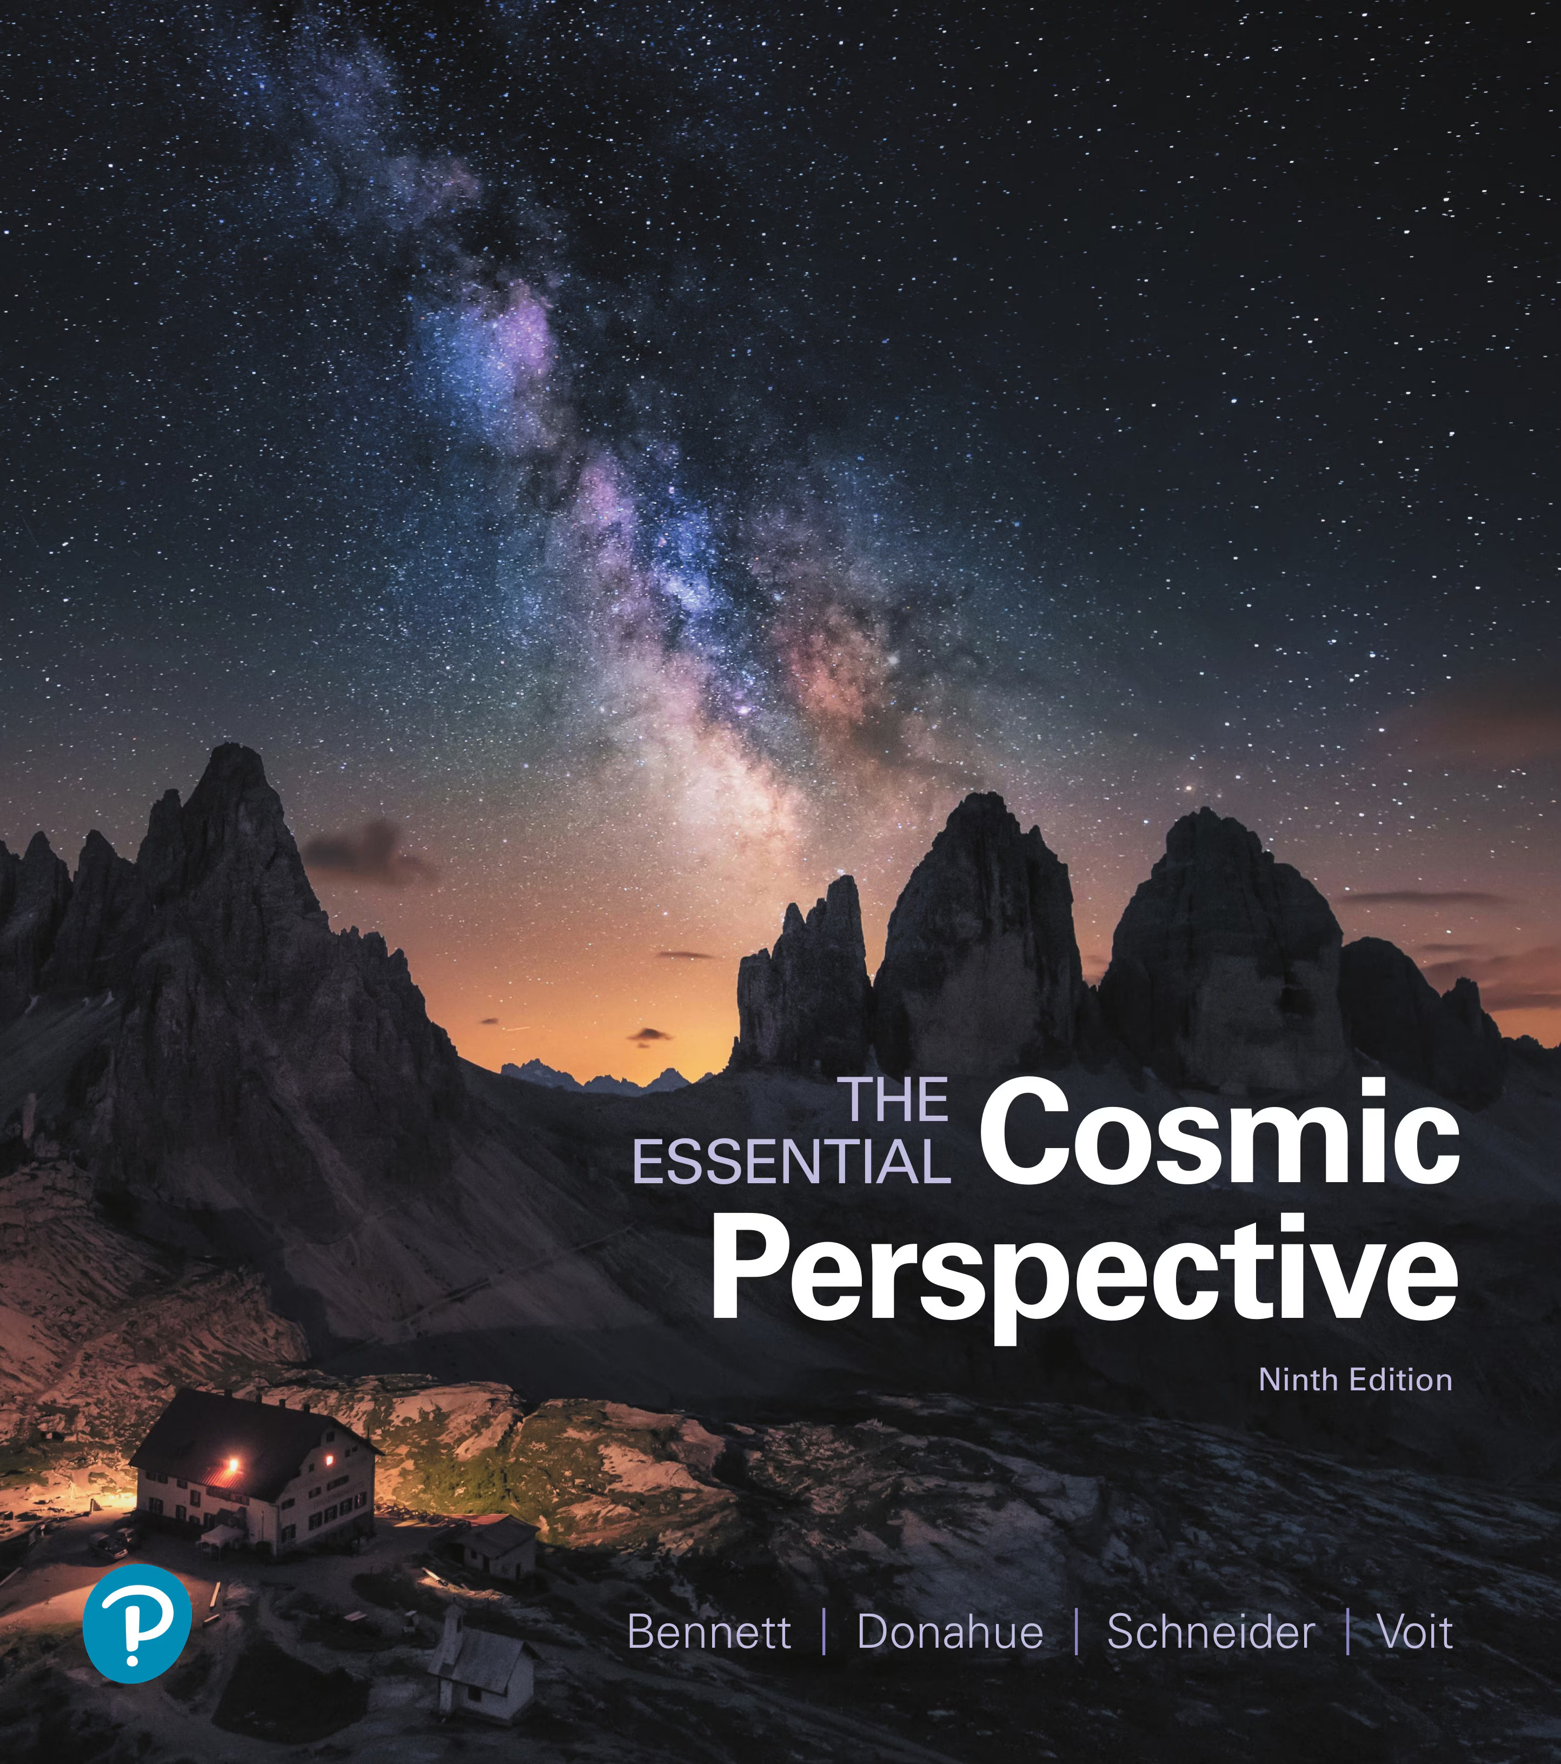
Textbook
Textbook: Bennett et al., The Essential Cosmic Perspective, 9th ed. (req.)

Slide 25
Visit Me
Physical Science building room 116
Hours:
M 3:10–4:10 PM
T 1–2 PM
W 7–8 PM PS 234
F 10–11 AM
or by appointment
or come in if my door is open

Slide 26
The Science of Astronomy
What we’re dealing with

Slide 27
Space is really big
Cosmic Voyage
  6:14–11:24

Slide 28
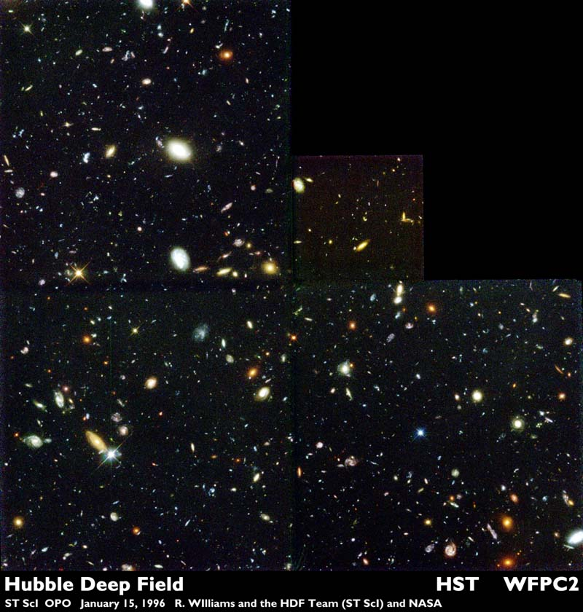
Space is really empty

Slide 29
Really big and empty
Hubble Ultra-Deep Field

Slide 30
Reading for Next Time
Overview of the universe
What’s out there, and how is it arranged?

Slide 31
Right away
Find the course on WyoCourses.
  Try the sample assignment.
Complete the recommended reading.

Slide 32
Exit ticket
(On the back of your index card)
Why did you register for this class?

