Slide 1
River Landscapes
And how they vary

Slide 2
Headwater valleys
What is the shape of a stream valley?
What determines the shape?
Notes:
Shape: trick question. V shape or flat. The V can be at different angles

Slide 3
Active agents
How does a stream affect its surroundings?

Slide 4
Headwater processes

Slide 5
Drainage Divide
Ridge dividing stream flow by ultimate destination
Ridges erode

Slide 6
Stream Piracy
Headward erosion

Slide 7
Stream Piracy
Headward erosion

Slide 8
Stream Piracy
Headward erosion

Slide 9
Stream Piracy
Stream capture
Abandoned bed

Slide 10
Desert Streams

Slide 11
Seasonal Streams
Discharge varies with time
Temperate zone streams usually have greatest discharge in spring
Desert streams often dry most of the year
Permanent stream ≡ flows year-round
Ephemeral stream ≡ flows only after precipitation

Slide 12
Flash floods
https://youtu.be/EZair4Snmko
https://youtu.be/_yCnQuILmsM

Slide 13
Desert stream features
Arroyo
Playa
Evaporite deposits
Alluvial fan
Caliche

Slide 14
Base Level

Slide 15
Delta
Stream without gradient loses competency
Deposits load in the bed
Braided channels become distributaries
Channels fan out

Slide 16
Delta Shapes
Depend on wave and current action at base
Classical (Nile) Delta: wave dominated
Bird’s foot (Mississippi): low-energy base

Slide 17
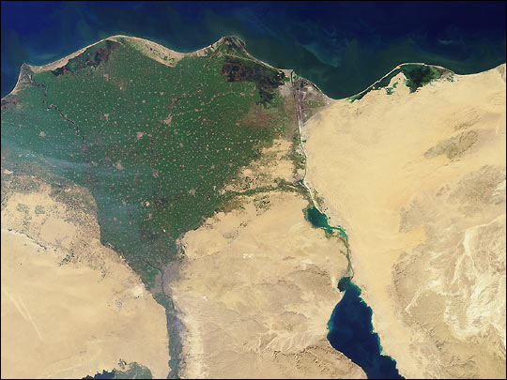
Nile Delta
Source: NASA Earth Observatory

Slide 18
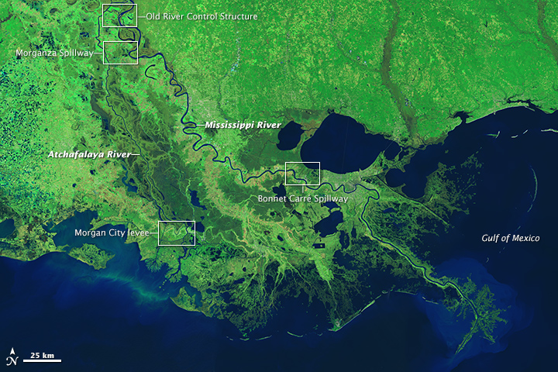
Mississippi Delta
Source: NASA Earth Observatory

Slide 19
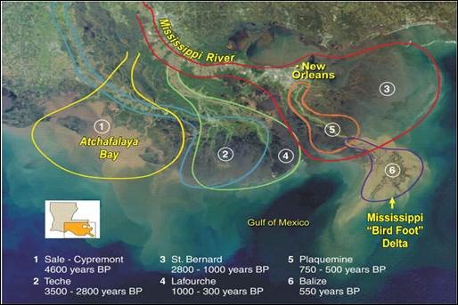
Lobes
Source: mississippiriverdelta.org

Slide 20
Lobe processes
Avulsion
Subsidence

Slide 21
Uplifted Stream Beds

Slide 22
Antecedent Stream
Sometimes a stream flows across a ridge
This can happen when headward erosion breaches the ridge, or
When the ridge was buried under different topography

Slide 23
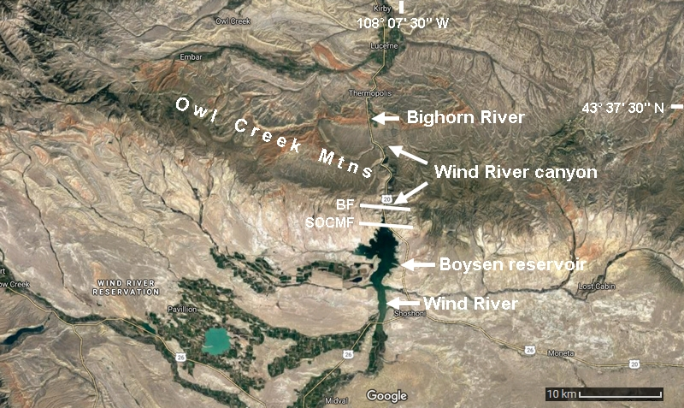
Wind River
Source: US Geology and Geomorphology

Slide 24
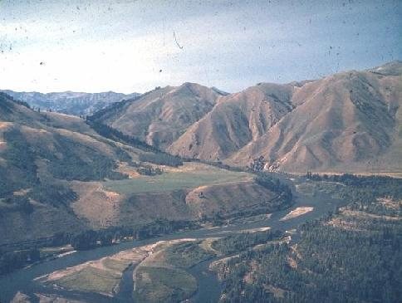
Stream Rejuvenation
A stream will increase competence when its base level lowers
Cuts down into its former flood plain
Source: MIT Physical Geology Tutor

Slide 25
Flooding

Slide 26
Flooding
Discharge is variable
Flood: overtop the banks
Most streams experience bank-full discharge in 50% of years
Higher discharges are less probable
Recurrence interval: average time between events of a given magnitude

Slide 27
Recurrence interval
Discharge
1 y
10 y
100 y
1,000 y
10,000 y
Recurrence interval (log scale)

