Slide 1
Types of Precipitation
Water from the sky
§ 7.4

Slide 2
Rain
Liquid water precipitation
Falls under gravity
Separate drops

Slide 3
Drizzle
Very small droplets, < 0.5 mm
Larger than fog, smaller than normal raindrops
Source cloud must be close to the ground

Slide 4
Freezing rain
Raindrop supercools as it falls through cold air
Freezes upon hitting ground or structures
Coats surfaces with ice

Slide 5
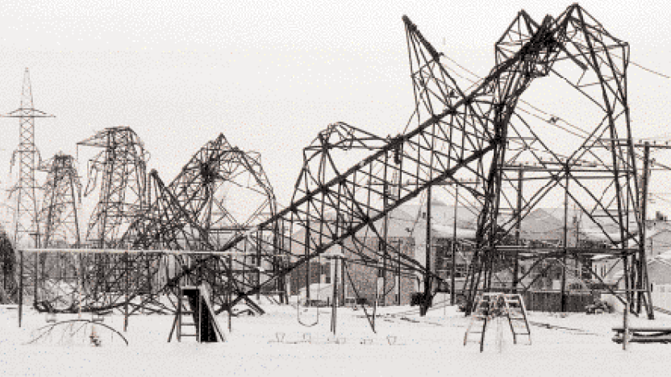
Ice storm
Quebec, 1/10/1998. From INMR.

Slide 6
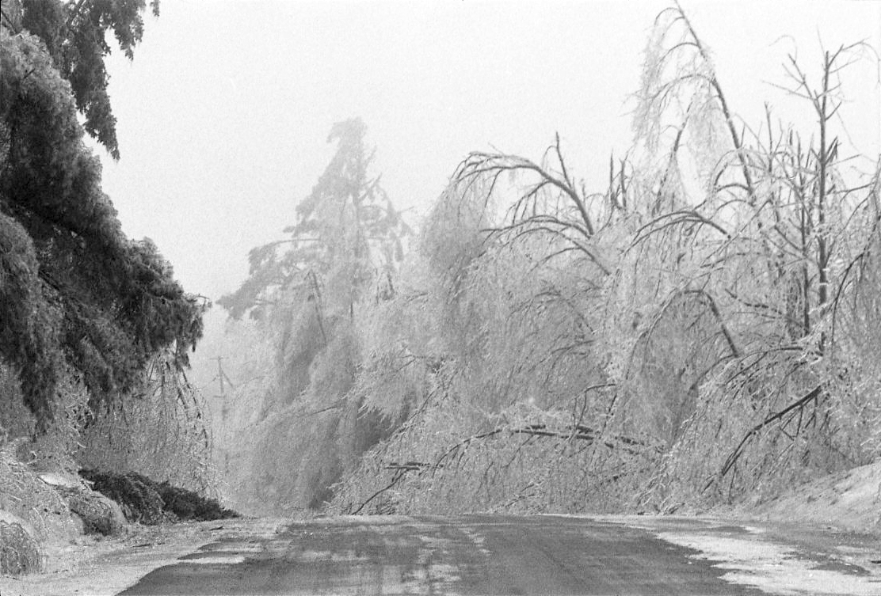
Ice Storm
Mark Kurtz, Saranac Lake, NY, 1998.

Slide 7
Sleet (ice pellets)
Raindrops freeze falling through cold air
Explanatory video from Connecticut Fox 61

Slide 8
Hail
Formed by cycling an icy nucleus through freezing and liquid portions of the cloud
Often layered like an onion
Formerly thought to be vertical cycling; now thought to perhaps also include horizontal transport into up-and downdrafts of differing temperatures

Slide 9
Hail
Requires strong updrafts to keep a hailstone aloft as it grows
The bigger the hailstone, the more energetic the updrafts

Slide 10
Hail Drift
Clayton, NM, 8/13/2004. From Weather Underground.

Slide 11
Hail Storm
Cheyenne flood of 1985

Slide 12
Record hailstones
Cullman, AL, 3/19/2018. From Weather Underground.

Slide 13
Graupel
Grows by riming: supercooled liquid droplets contact an ice srystal
Sometimes called “soft hail”
Forms in both thunderstorms and stratiform storms

Slide 14
Snow
Crystals formed when vapor deposits directly into the solid phase
No intermediate liquid

