Slide 1
Air Pollution
And pollutants
§ 14.1

Slide 2
Carbon Monoxide CO
Source: incomplete combustion of carbon-based fuels
Toxicology: prevents oxygen transport in blood
Vulnerable populations: heart disease
Environmental effects: not significant

Slide 3
Particulates
Source: Dust, dirt, soot, smoke, pollen
Toxicology: PM₁₀: mucosal irritant PM_{2.5}: lung cancer, cardio-respiratory distress, developmental problems
Vulnerable population: asthma, children
PM_{2.5} is considered the largest environmental cause of human mortality

Slide 4
Lead Pb, PbO₂
Source: leaded gasoline
Toxicology: neurotoxin
Vulnerable populations: children
Particularly in economically marginalized groups
Environmental effects: toxic to everything

Slide 5
Volatile Organic Compounds (VOCs)
Source: incomplete combustion of carbon-based fuels
Toxicology: Toxic effects of most concern for indoor exposure. Some VOCs are carcinogenic
Vulnerable populations: children, aged
Environmental effects: promote photochemical smog

Slide 6
Sulfur Dioxide (SO₂)
Source: combustion of sulfur-containing fuels
Toxicology: Respiratory distress
Vulnerable populations: asthma
Environmental effects: Oxidizes to SO₃ Causes aerosols Acid erosion of carbonate rock Acid lakes, kills plants

Slide 7
Acid Rain
Sulfur Dioxide SO₂ formed in combustion
Oxidizes in atmosphere
SO₂ + OH → HOSO₂
HOSO₂ + O₂ → SO₃ + HO₂
Sulfur Trioxide reacts with water
SO₃ + H₂O → H₂SO₄
And rains on fish

Slide 8
Carbonate Buffering
Limestone bedrock absorbs acid
H₂SO₄ + CaCO₃ → CaSO₄ + H₂CO₃
H₂CO₃ → H₂O + CO₂

Slide 9
Nitrogen Monoxide NO, Dioxide NO₂
Source: combining N2 and O2 in internal combustion engines
Toxicology: Respiratory irritant
Vulnerable populations: asthma, aged
Environmental effects: Promotes ozone formation

Slide 10
Ozone O₃
Source: lightning, UV, photochemical smog
Toxicology: Respiratory irritant
Vulnerable populations: asthma, aged
Environmental effects: Promotes ozone formation

Slide 11
Making Ozone
CO + OH → CO₂ + H
H + O₂ → HO₂
HO₂ + NO → NO₂ + OH
NO₂ + hν → NO + O
O + O₂ → O₃

Slide 12
Photochemical Smog
Stew of NOx, VOC’s, sunshine
Primary irritants are O₃ and PANs
Murky brown due to NOx
NOx promote oxidation of VOCs, incidentally making O₃

Slide 13
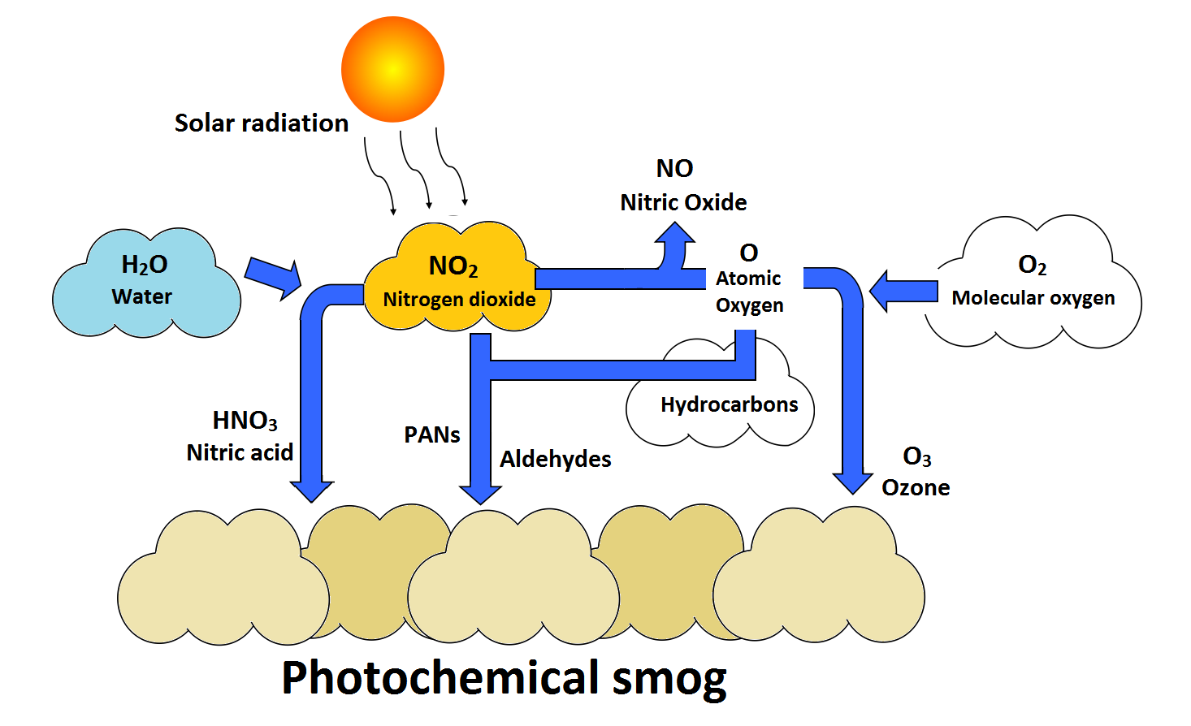
Smog

Slide 14
VOC Example: CH₄
CH₄ + OH → CH₃ + H₂O
CH₃ + O₂ → CH₃O₂
CH₃O₂ + NO → CH₃O + NO₂
CH₃O + O₂ → H₂CO + HO₂
Makes O₃
CO, H₂O, HO₂

Slide 15
Air Quality Index
0–500 Scale
Smaller is better
Below 50 is “good”
One of the good things about living in northern Maine is that AQI is usually good
airnow.gov

Slide 16
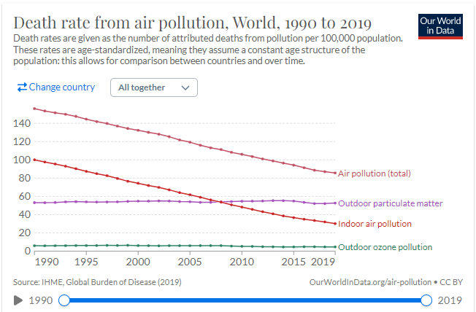
Worldwide Mortality
Source: Our World in Data

