Slide 1
Radiation Energy
To Earth
§ 9.1

Slide 2
Insolation
Incoming Solar Radiation
Greatest at the equator, less at extreme latitudes
Without atmosphere I = I₀ cos (latitude)
Also there’s more air to penetrate at polar latitudes

Slide 3
Energy Budget Varies
Tropics absorb more energy than they radiate
Midlatitudes and polar latitudes radiate more energy than they absorb
How is this possible?

Slide 4
Poleward Heat Transport
Heat carried by movement of fluids
About half by atmosphere
About half by oceans

Slide 5
Seasonal Heating Variations
What causes the seasons?
When is the highest insolation>

Slide 6
Seasonal Temperature Variations
When is it hotter?
When is it colder?

Slide 7
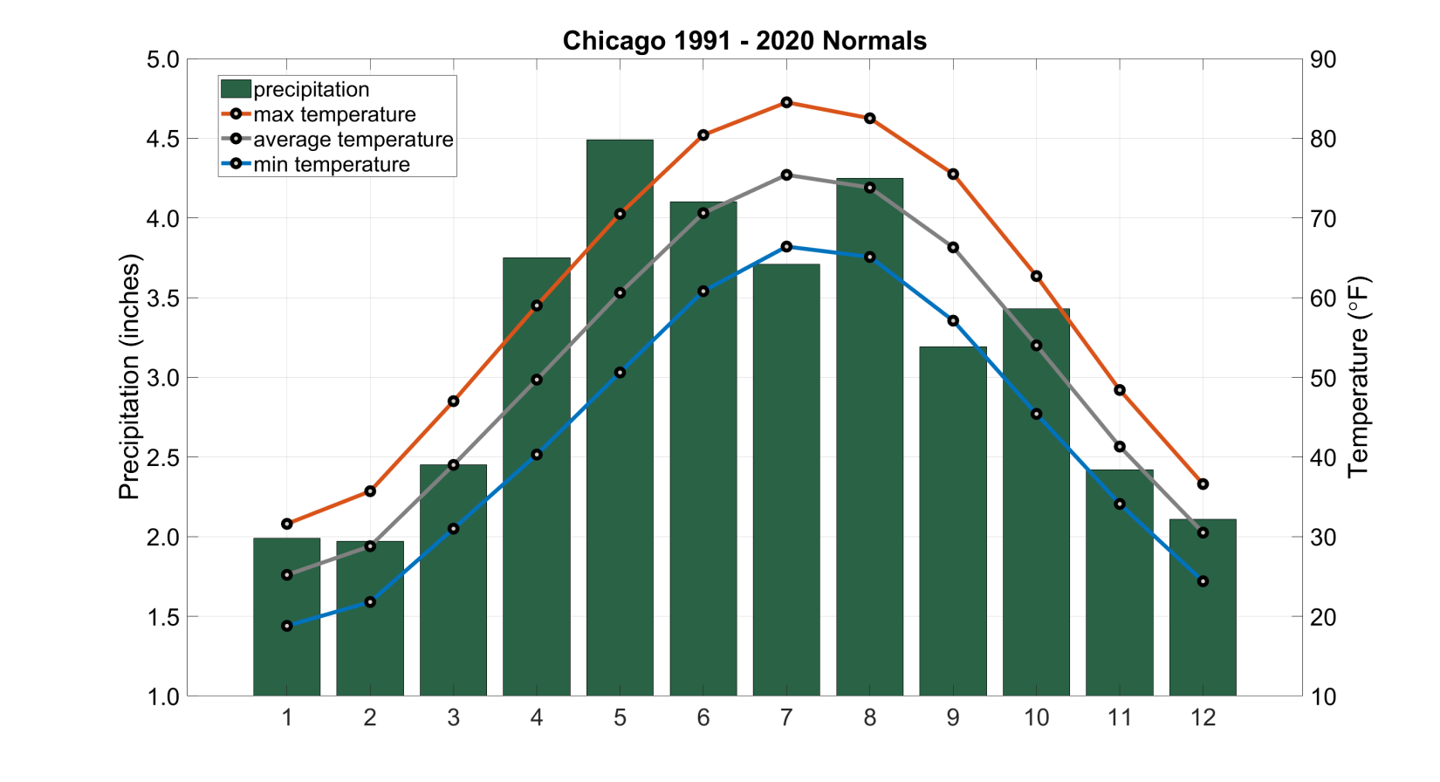
Chicago
Source: Illinois State Climatologist

Slide 8
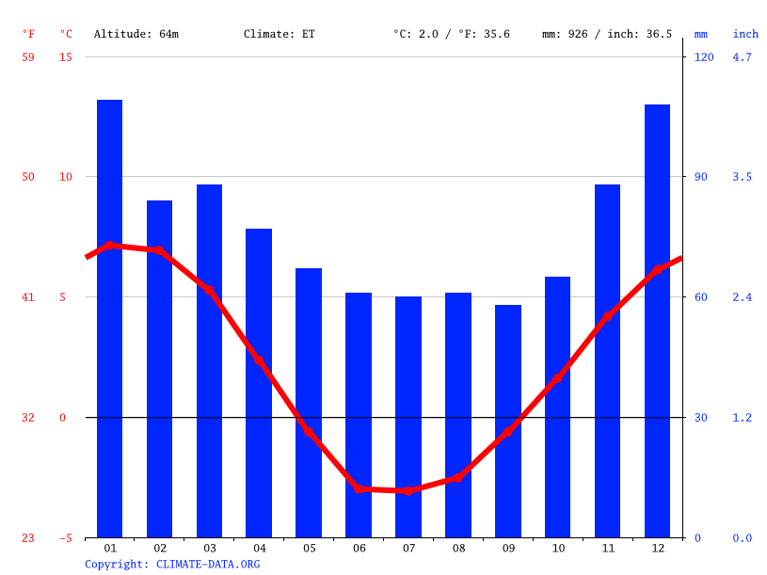
Ushuaia
Source: Climate-data.org

Slide 9
Daily Temperature Variations
When is it hotter?
When is it colder?
By what mechanisms do land and air cool?
“ground inversion”

Slide 10
Marine/Island Effect
Temperature is more constant near water
Water has a higher specific heat capacity than rock

Slide 11
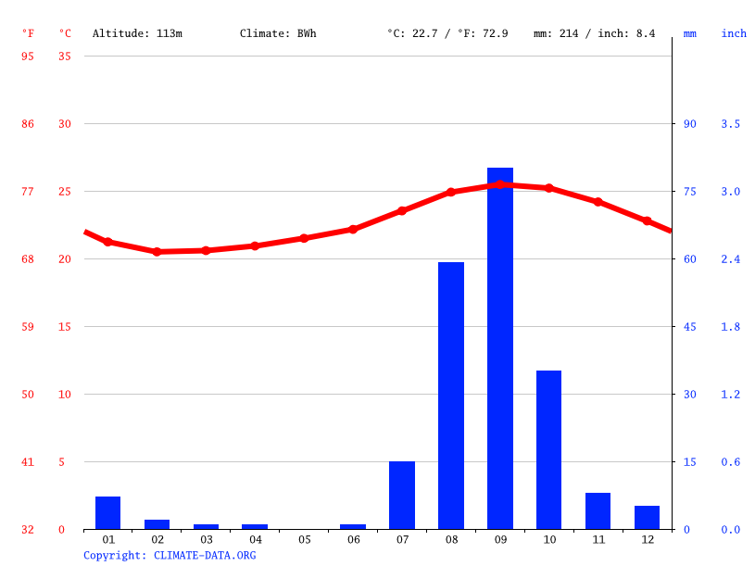
Sao Felipe, Cape Verde Islands
Source: Climate-data.org

Slide 12
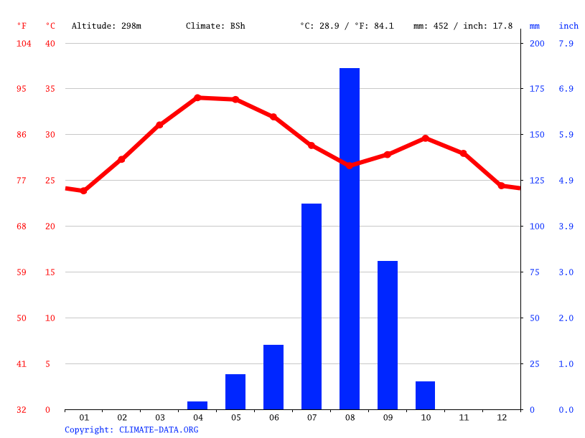
Ndjamena, Chad
Source: Climate-data.org

