Slide 1
Heating Mechanisms
Energy flow in the atmosphere

Slide 2
Heat
Energy transferred in response to a temperature difference
Spontaneous direction: high temperature to low temperature

Slide 3
Temperature
Average kinetic energy per molecule
At the same temperature, lighter molecules travel faster

Slide 4
Heating
Heat is transferred between objects by:
Conduction: collisional transfer of molecular kinetic energy
Convection: buoyancy-driven fluid circulation
Radiation and absorption of electromagnetic waves

Slide 5
Conduction
Conductivity varies with material; solids > liquids > gases

Slide 6
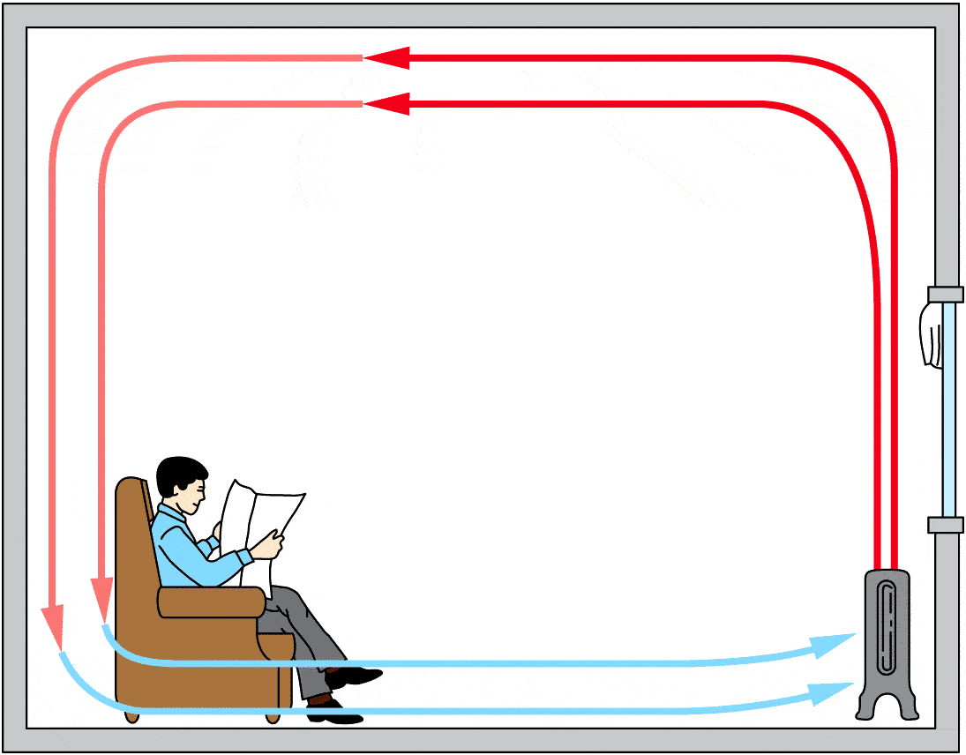
Convection
Warm fluids expand, becoming less dense
Circulation is driven by buoyancy forces
Much faster than conduction

Slide 7
Convection
Convection drives the weather!
Convection drives plate tectonics!

Slide 8
Radiation
Power output increases as T⁴.
Objects are heated by absorbing radiation.
Objects are cooled by emitting radiation.

Slide 9
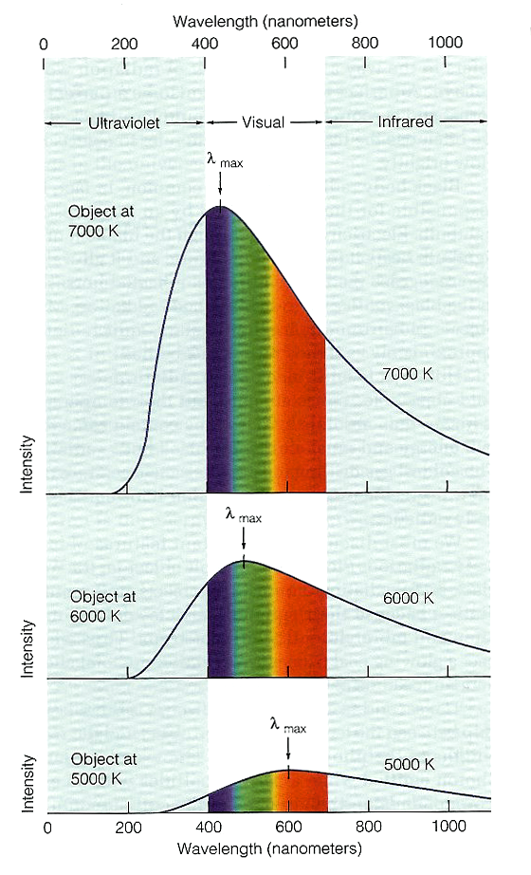
Temp Influences Spectrum
Higher T → greater power
P/A = σT⁴
σ = 5.67×10^{–8} W m^{–2} K^{–4}
Higher T → higher peak frequency
λ_{max} = b/T
b = 2.898 ×10⁶ nm K
Source: M. A. Seeds, Exploring the Universe
Notes:
Demonstrate
Vertical slit with variac, students each have diffraction grating. Show that light is dimmer and redder at lower temperatures.

Slide 10
Question
Hot applesauce takes longer to cool than the same quantity of hot water in the same pot. Why?
Conduction is slower in applesauce.
Convection is slower in applesauce.
Radiation is slower in applesauce.

Slide 11
Question
Solids conduct heat better than gases do. So why does a coat keep you warm in winter?
The coat reduces conduction.
The coat reduces convection.
The coat reduces radiation.

Slide 12
Question
Aluminized Mylar blankets actually can keep you pretty warm. Which heat transfer mechanism(s) do they reduce?
The blanket reduces conduction.
The blanket reduces convection.
The blanket reduces radiation.

Slide 13
Question
A thermos bottle keeps hot things hot, and it keeps cold things cold. But how does it know?
It reduces heat transfer by conduction.
It reduces heat transfer by convection.
It reduces heat transfer by radiation.

