Slide 1
Global Circulation
Large-scale patterns
§9.1–9.3

Slide 2
Tropical (Hadley) Cells
Equatorial air rises
Moisture precipitates
Air travels poleward
Diverted by Coriolis effect
Sinks, warms
Converges to equator

Slide 3
Polar Cells
Polar air sinks
Diverted by Coriolis effect
Warms from ground, rises
Moisture precipitates
Returns to poles

Slide 4
Mid-latitude Cells
Air sinks at the tropics and rises at the polar front
Circulation opposite convection tendency
Mid-latitude heat transfer has another mechanism
Surface winds are poleward, deflected by Coriolis effect to be westerly

Slide 5
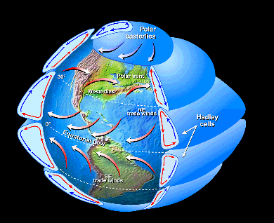
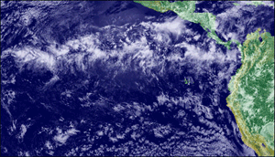
Global-Scale Circulation Cells
Stolen from R.R. Dickerson 2011

Slide 6
Jet Streams
Equatorial air is less dense, polar air is more dense
Air column is highest at the equator
Air aloft has a steep pressure gradient toward the equator at the tropics and polar front
Pressure gradient force pushes air aloft poleward
Wind becomes geostrophic

Slide 7
Latitude Bands per Hemisphere
ITCZ: “doldrums”
Hadley Cells:
Circulate ITCZ to midlatitudes
Surface winds are easterly “trade winds”
Horse latitudes: sinking hot, dry air
Great tropical desert belts
Midlatitudes
Prevailing westerly winds

Slide 8
Latitude Bands per Hemisphere
Midlatitudes
Prevailing westerly winds
Midlatitude cyclones
Polar cells
Air sinks at poles and rises at polar front
Famously bad weather at polar front (“Roaring forties,” “furious fifties,” “screaming sixties”)

Slide 9
Climate Types
Köppen classification

Slide 10
Classes
A–E + H
Poleward from equator + H = highland
A Tropical
B Desert (tropical or temperate)
C Subtropical
D Continental
E Polar

Slide 11
A subtypes
Af Tropical wet (rain forest)
Am Monsoon (seasonal rain)
Aw Tropical wet-dry

Slide 12
B subtypes
BW Desert
BS Steppe (short-grass prairie)
BWh, BSh hot
BWk, BSk cool

Slide 13
C subtypes
Cfa Humid subtropical
Cs Mediterranean (dry summer, rainy winter)
Cfb Marine

Slide 14
D subtypes
Dw Dry winter
Ds Dry summer
Df Wet all year

Slide 15
E subtypes
ET Tundra
EF Ice cap

