Slide 1
Announcement
Bring your computers to lab tomorrow
You’ll be looking at numerical forecasts

Slide 2
Ensemble Methods
Exploring the possibilities
§ 13.2

Slide 3
Why Ensembles?
Any deterministic forecast will have uncertainties
Small variations in initial conditions amplify over time
Difficult to tell what’s certain and what’s not

Slide 4
Ensemble Concept
Vary the initial conditions a little bit
Within measurement uncertainty
Re-run the forecast
Do this several times
Compare the ensemble of forecasts
If predictions agree, certainty is high
WxYz video ECMWF video

Slide 5
Ensemble

Slide 6
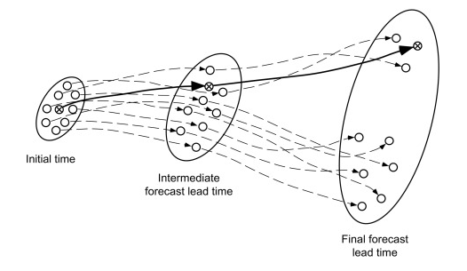
Running an Ensemble
Source: Statistical Methods in the Atmospheric Sciences, Wilks, 2011.

Slide 7
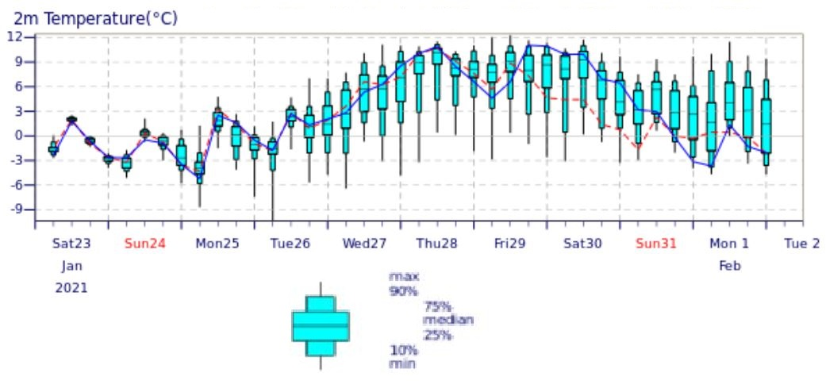
Spread in Predicted Temperature
Source: EMCWF

Slide 8
Trade-offs
Ensemble members must be run at lower resolution than a single deterministic forecast
but
The ensemble average is more reliable than a single deterministic result
The forecast spread reveals the prediction uncertainty

Slide 9
Further refinement
Calibration applies past results of a model to the current prediction
Corrects for known experience

Slide 10
Multi-Model Forecasts
Compare ensembles of different models
Experience: slightly better than either model individually

Slide 11
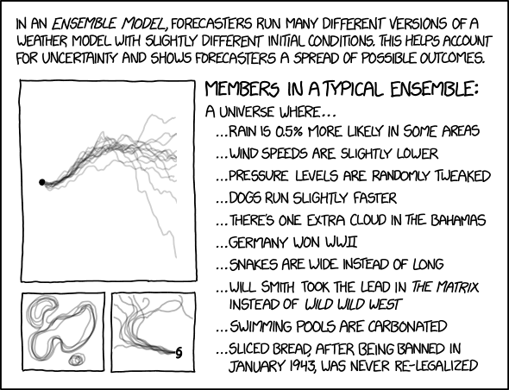
Ensemble Models

