Slide 1
Coriolis Effect
on the spinning Earth
§ 8.4–8.5
Notes:
1

Slide 2
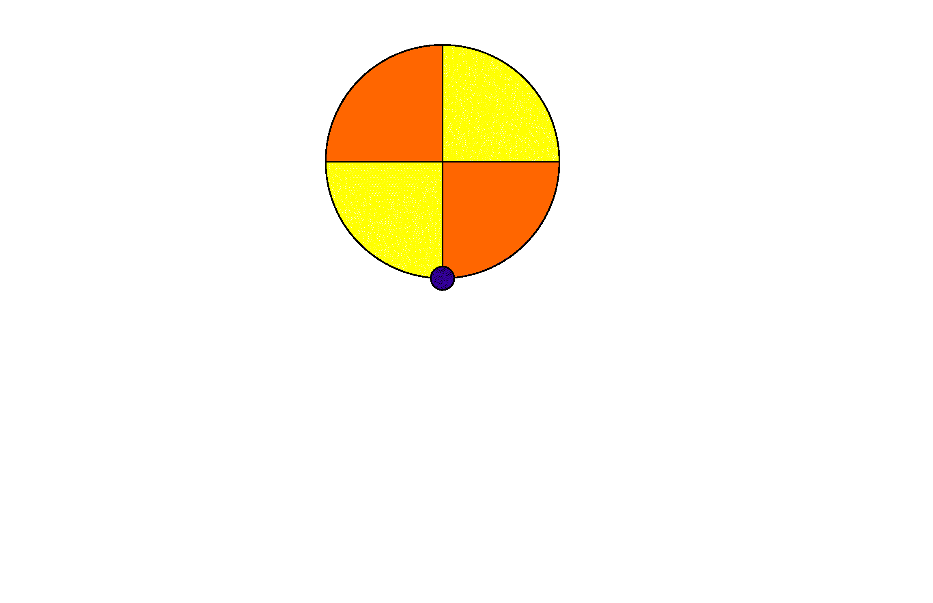
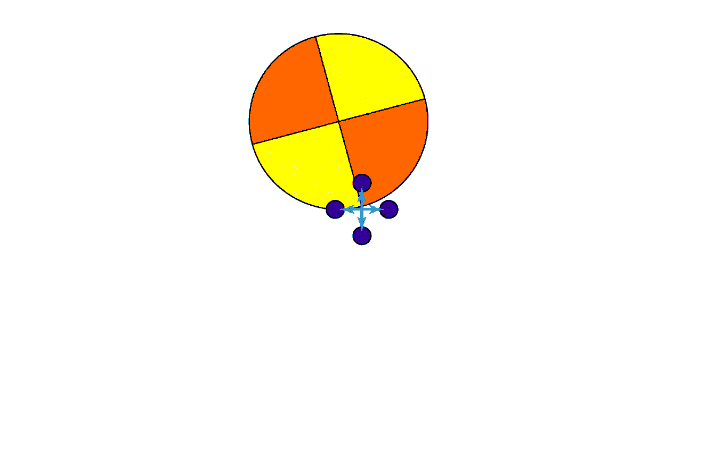
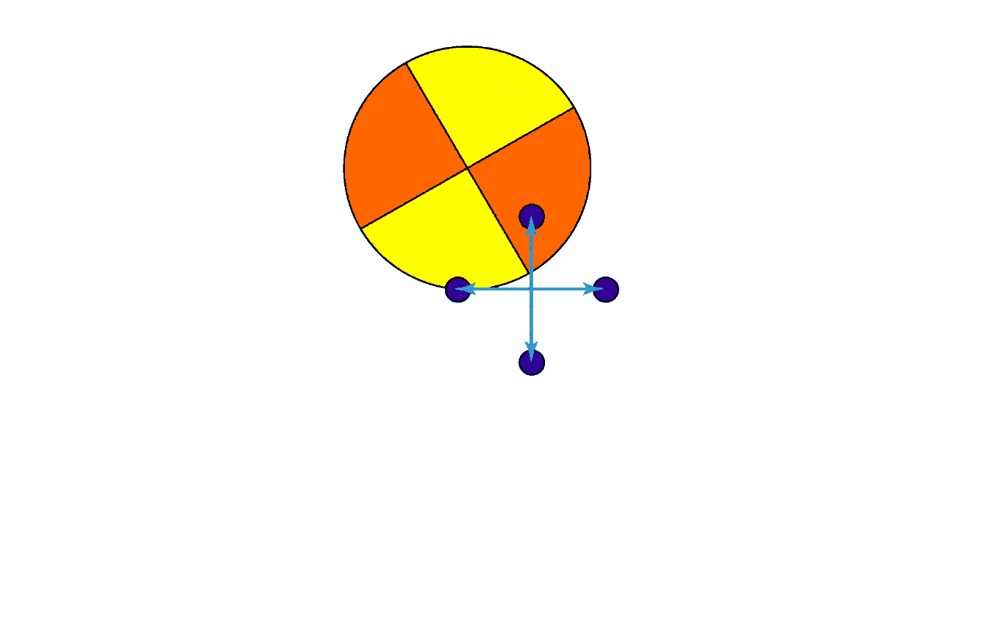
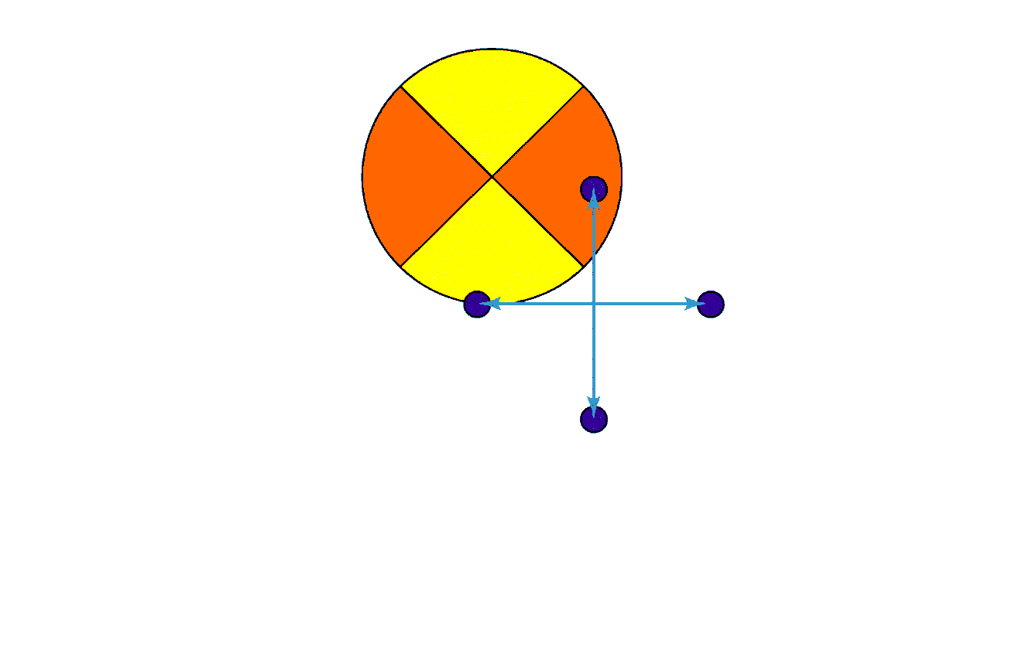
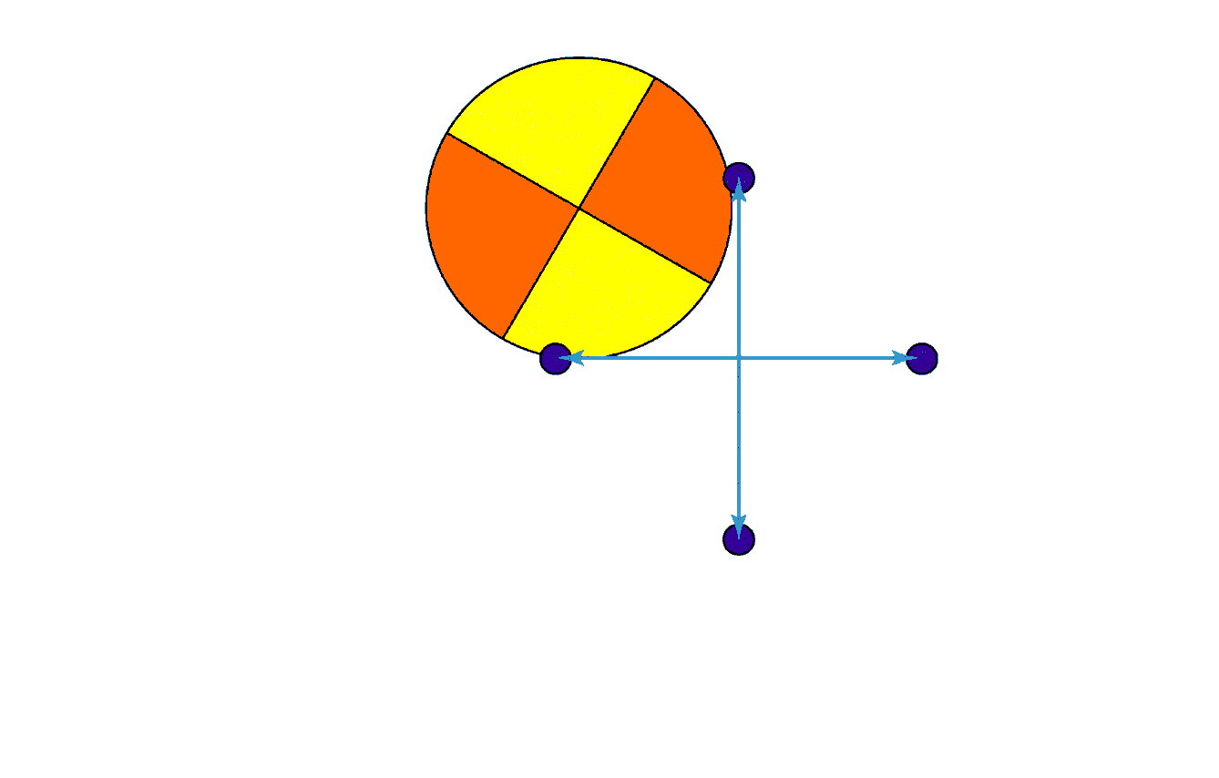
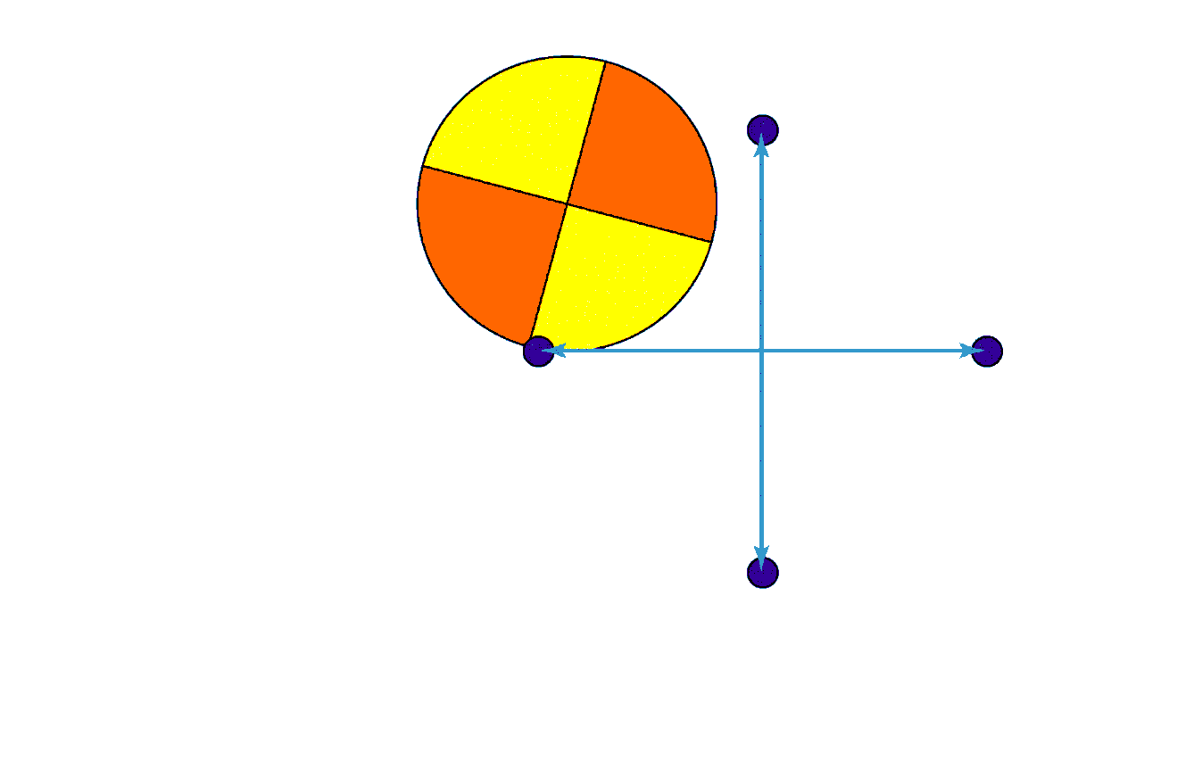
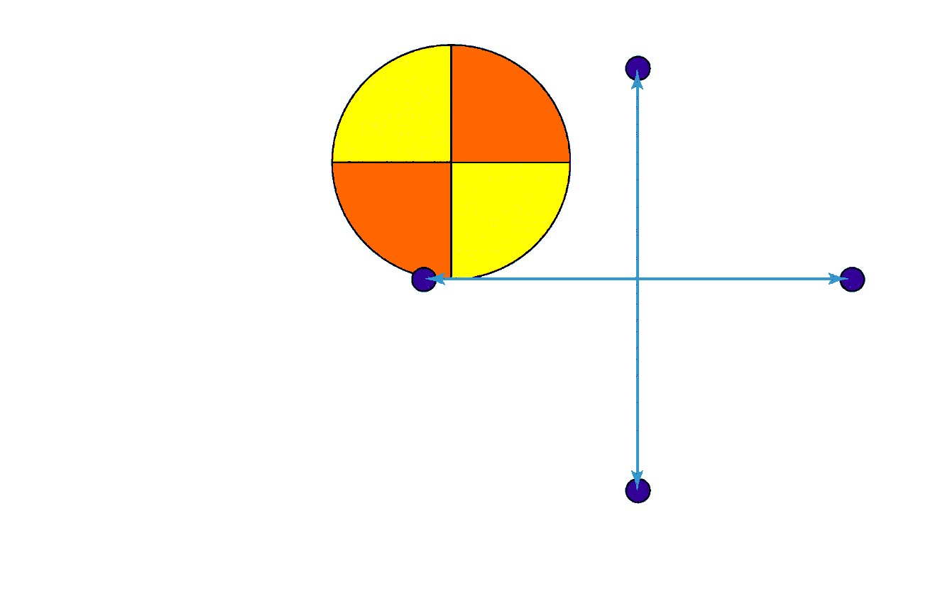
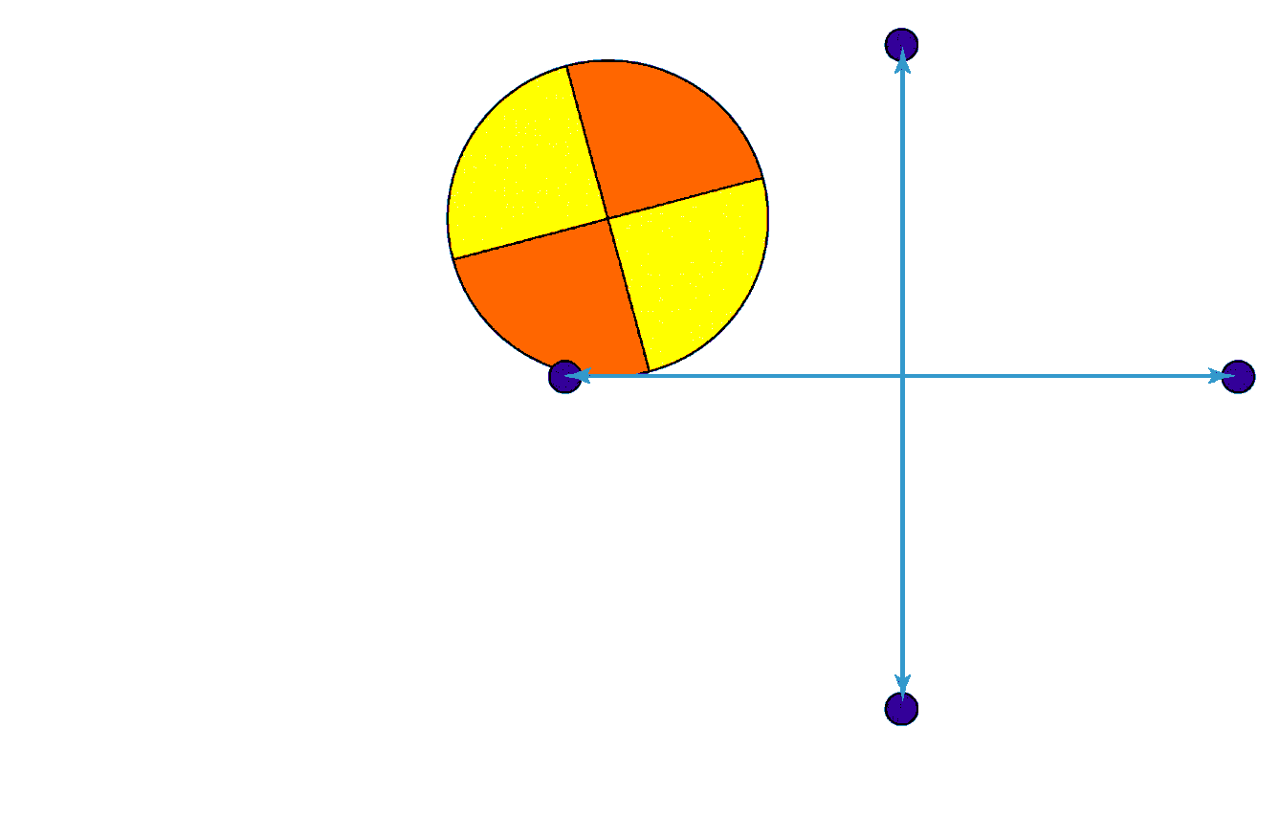
Trajectories
inertial reference frame
Notes:
2

Slide 3
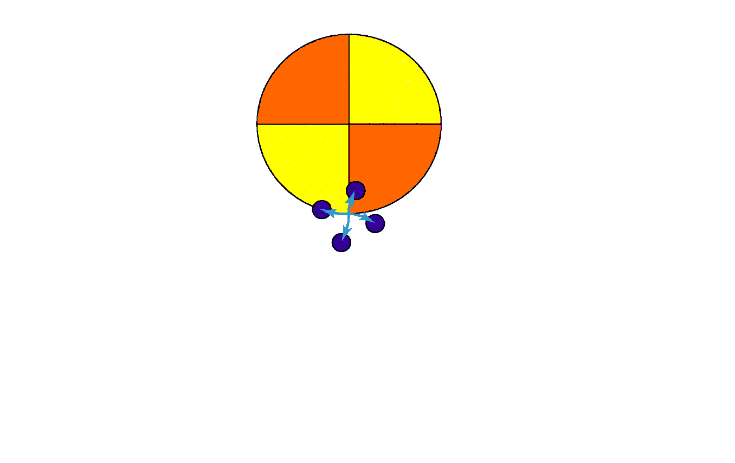
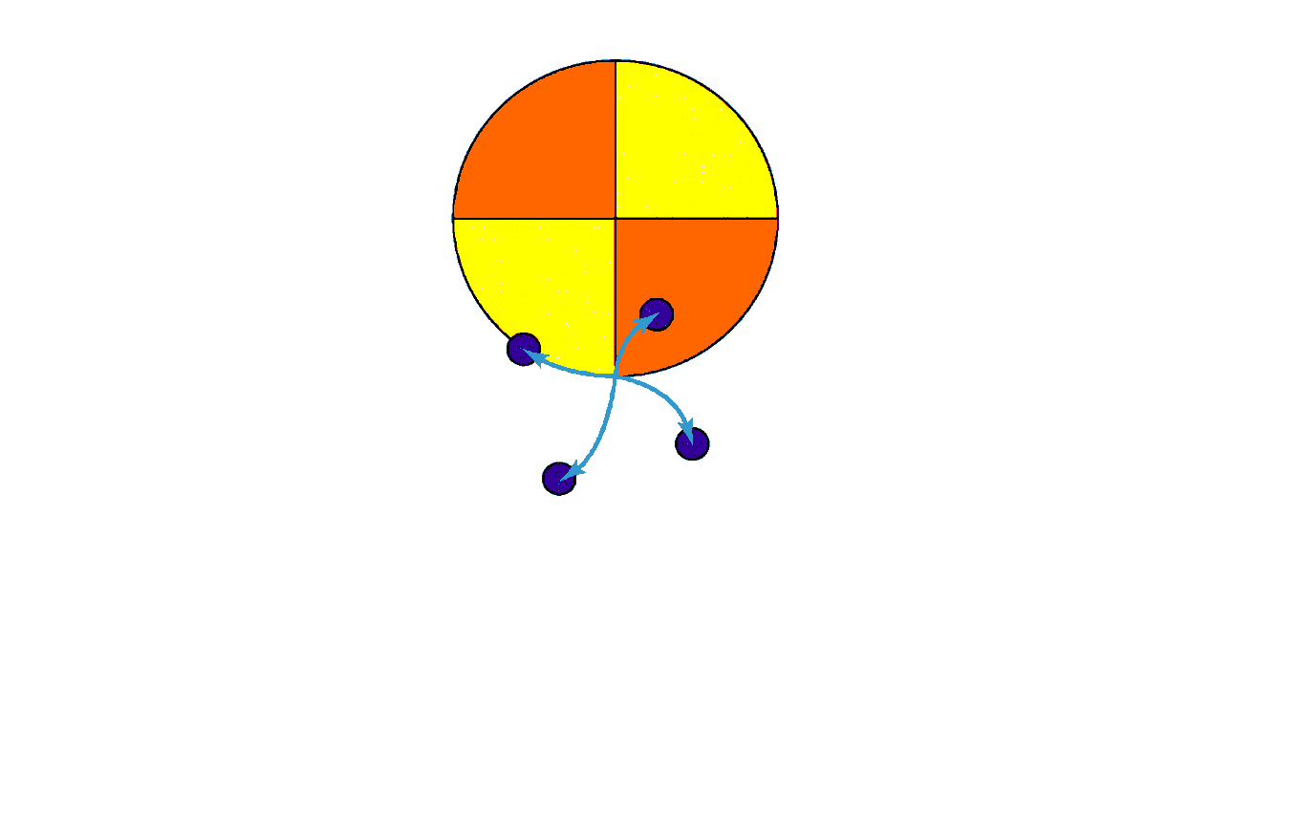
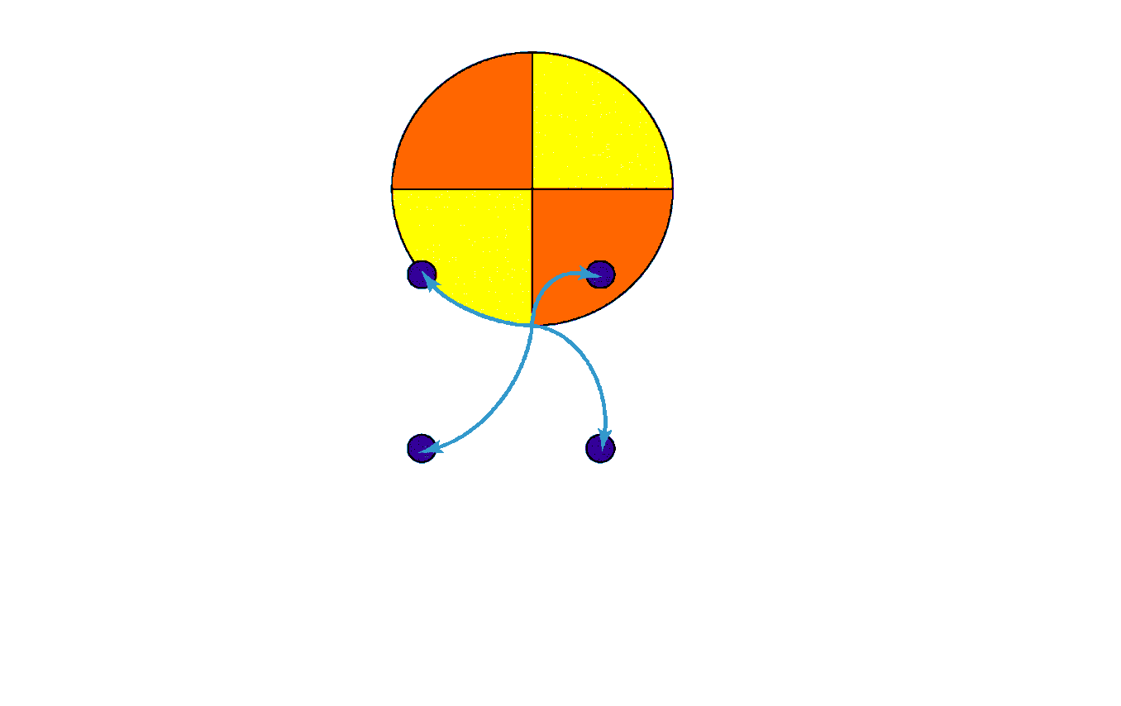
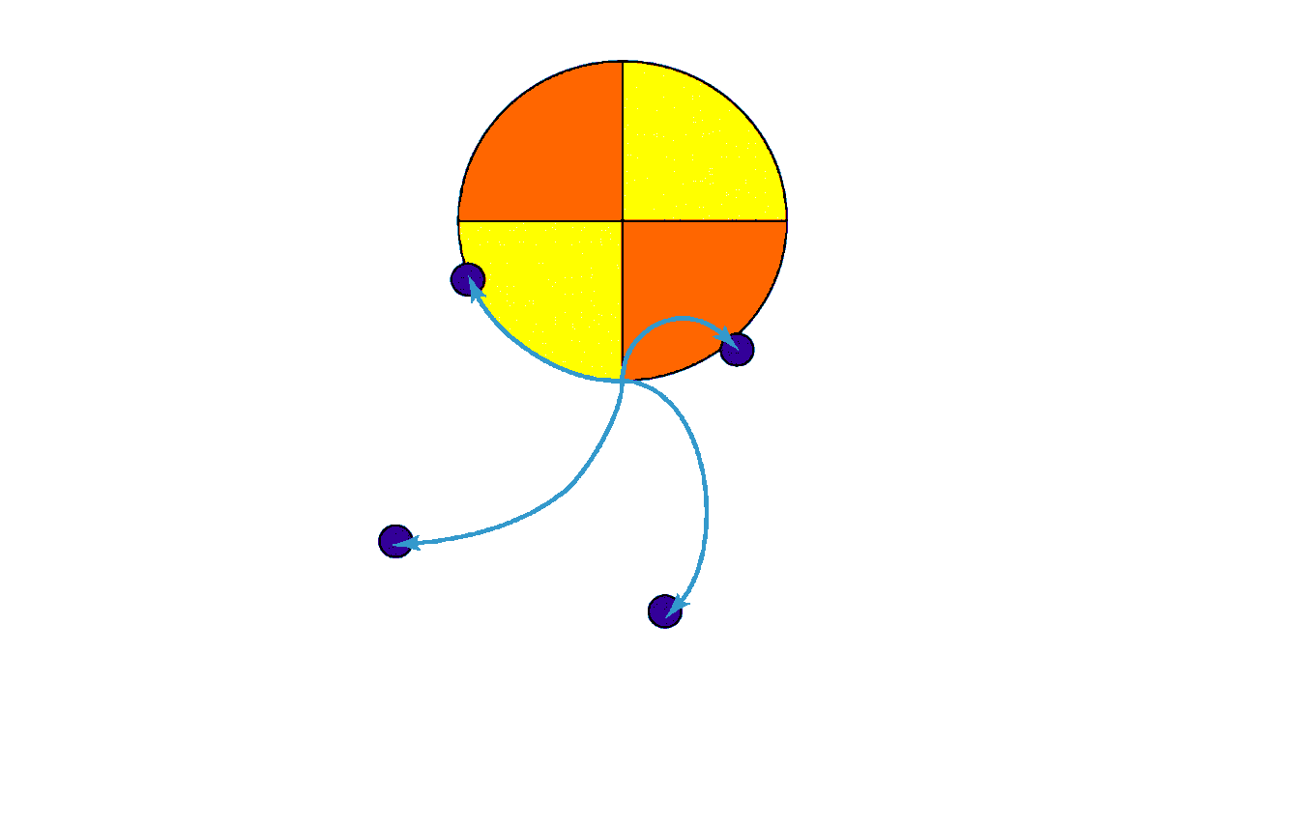
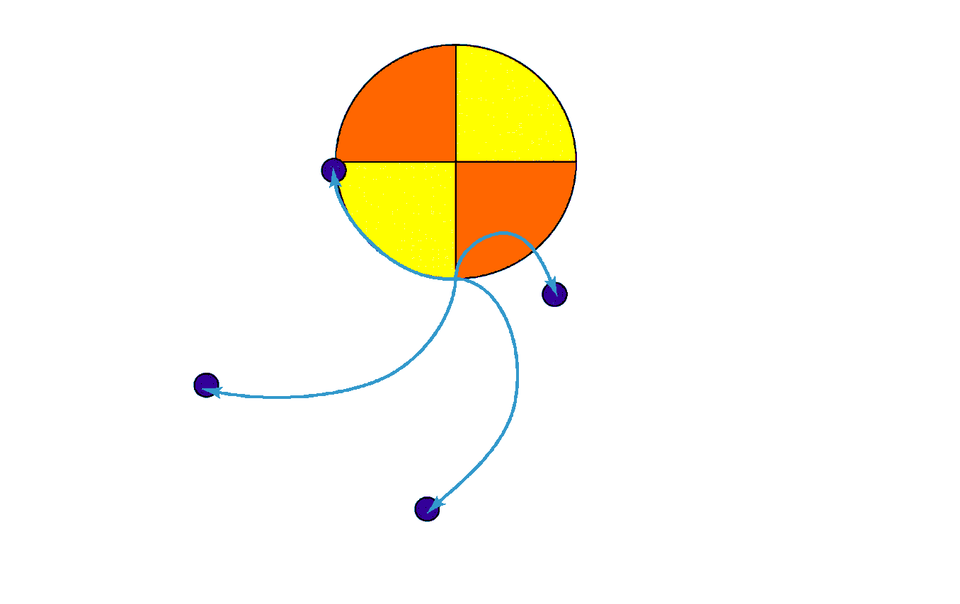
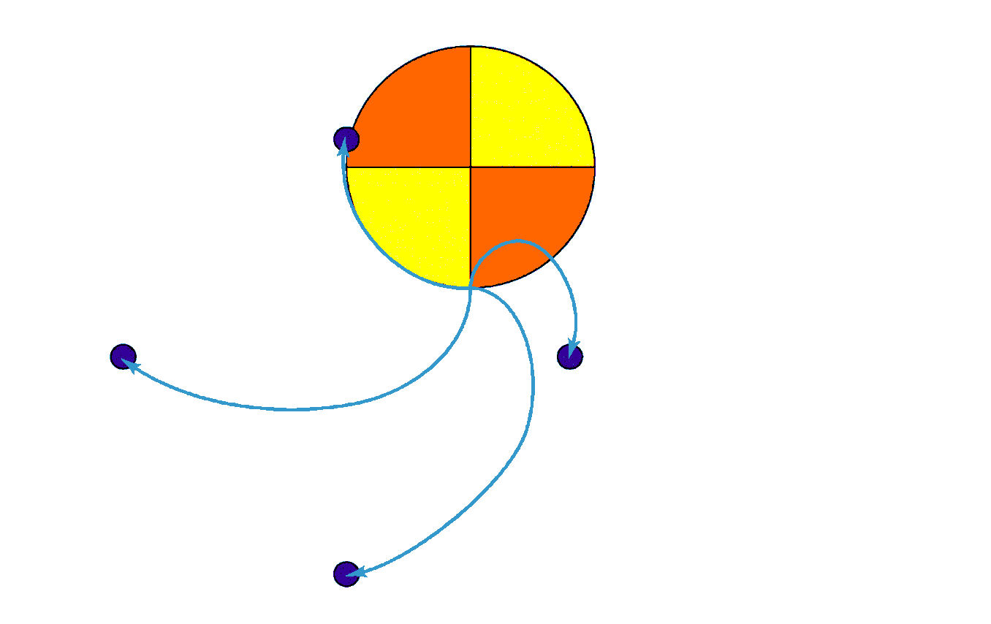
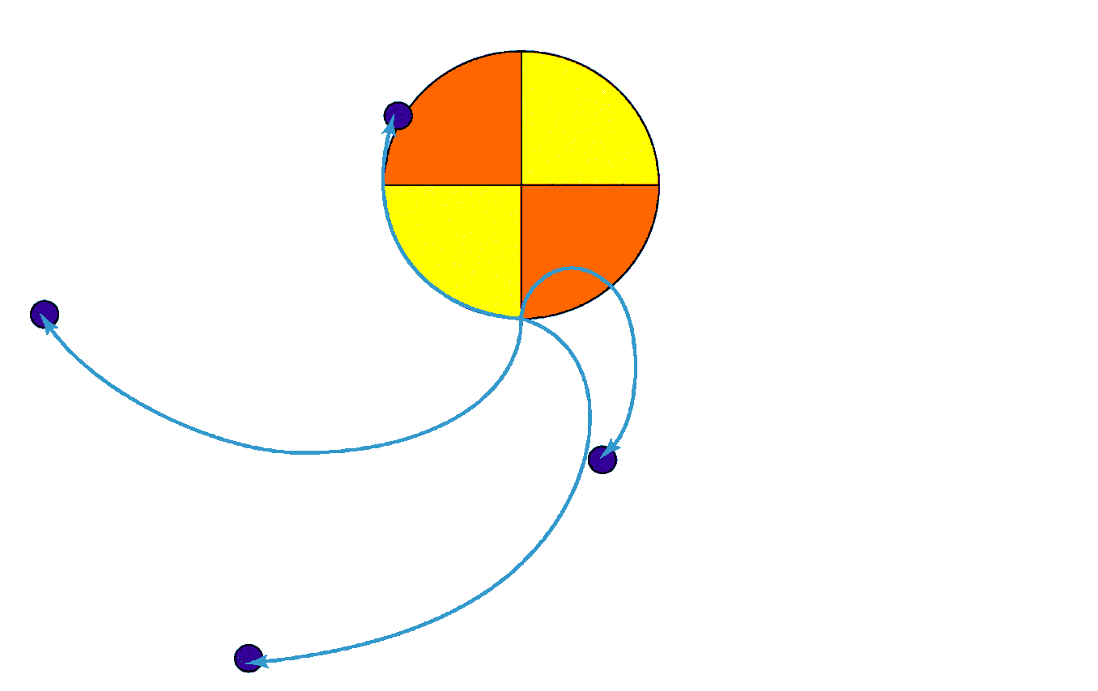
Trajectories
rotating reference frame
Notes:
3

Slide 4
Coriolis Demonstrations
https://youtu.be/BFBGr0GsAPY

Slide 5
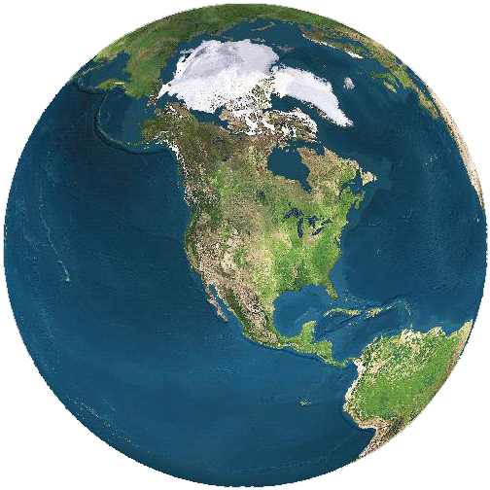
Rotation of the Earth
Rotates West to East (counterclockwise as seen from above North pole)
Poles on axis; equator farthest from axis
Source: Earth and Moon Viewer, Copyright © 1989 by Jef Poskanzer.
Notes:
5

Slide 6
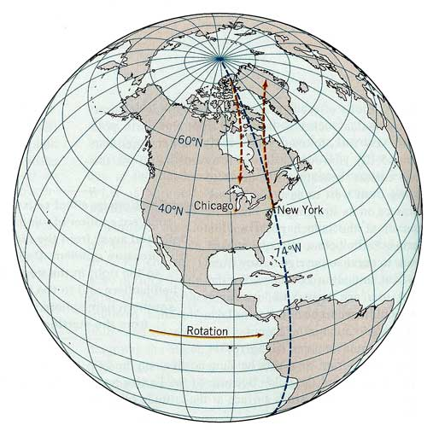
Coriolis Force on Earth
Earth rotates to the East
Trajectories deflect right in N hemisphere
Source: Strahler and Strahler, Introducing Physical Geography, 2005.
Notes:
6

Slide 7
Coriolis Force on Earth
What happens in the Southern Hemisphere?
Trajectories deflect left in S hemisphere
Source: Strahler and Strahler, Introducing Physical Geography, 2005.
Notes:
7

Slide 8
Cyclones
Large rotating storms with central low
Inrushing air diverted by Coriolis effect
L
L
Northern hemisphere
Southern hemisphere

Slide 9
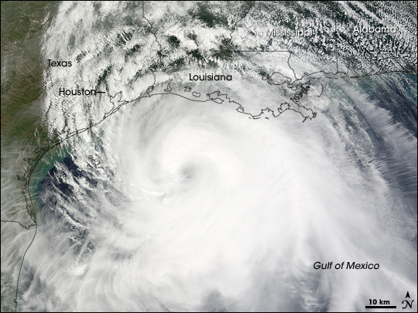
Cyclonic Storms on Earth
Hurricane Ike, September 12, 2008
NASA Earth Observatory
Notes:
9

Slide 10
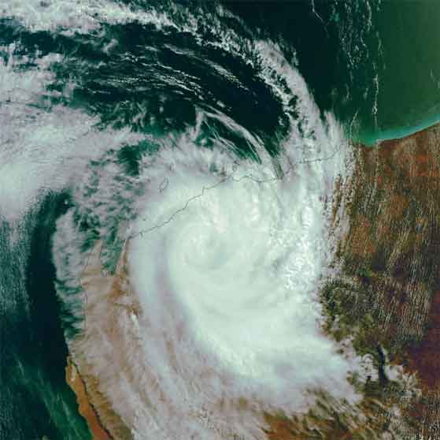
Southern Hemisphere Cyclones
Cyclone Monty, NW Australia, March 2, 2004
Notes:
10

Slide 11
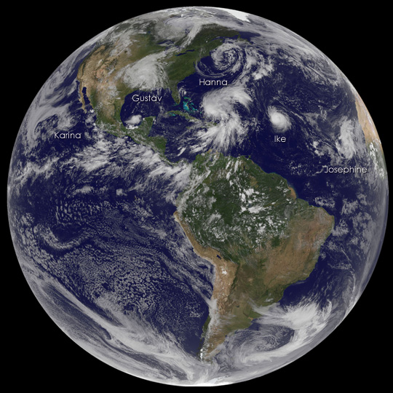
Both Hemispheres
NASA Earth Observatory, September 3, 2008
Notes:
11

Slide 12
Coriolis Force on Earth
The direction toilets and bathtubs drain on earth is not determined by the Coriolis force.
They are to small and they drain too quickly for the Coriolis force to matter.
Notes:
12

Slide 13
Geostrophic Wind
Pressure gradient force pushes air toward low pressure
H
L
Coriolis effect deflects the trajectory

Slide 14
Geostrophic Wind
Wind velocity stops changing when the total force is zero
H
Coriolis
Coriolis
v
v
Pressure gradient
Pressure gradient
L
Coriolis effect cancels the pressure gradient
Velocity parallels the isobars

Slide 15
With friction
Friction slows the wind
Slower speed gives smaller Coriolis deflection
Equilibrium wind velocity crosses isobars
Coriolis
Friction
v
Pressure gradient

