Slide 1
Climate Variability
§15.1–15.3

Slide 2
What is climate?
Weather
Temperature, clouds, wind, humidity. precipitation, storms
And annual changes in all of these
And expected variability from year to year

Slide 3
What is climate?
“Climate is what you expect, weather is what you get.”
Climate is the average weather pattern.

Slide 4
What determines climate?
Latitude
Elevation
Continentality
Proximity to water
Global circulation
Oceanic circulation
Ground cover
Atmospheric composition
Insolation
Orbital factors
Land mass distribution

Slide 5
What does variability include?
Temperature is only part of weather
Temperature influences other variables
Wind
Moisture

Slide 6
What changes climate?
Any change in the factors influencing climate

Slide 7
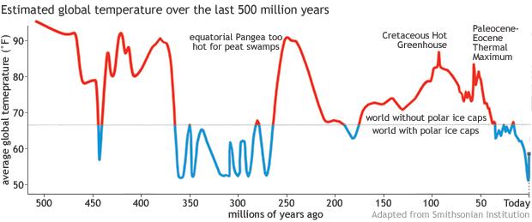
How has climate varied?

Slide 8
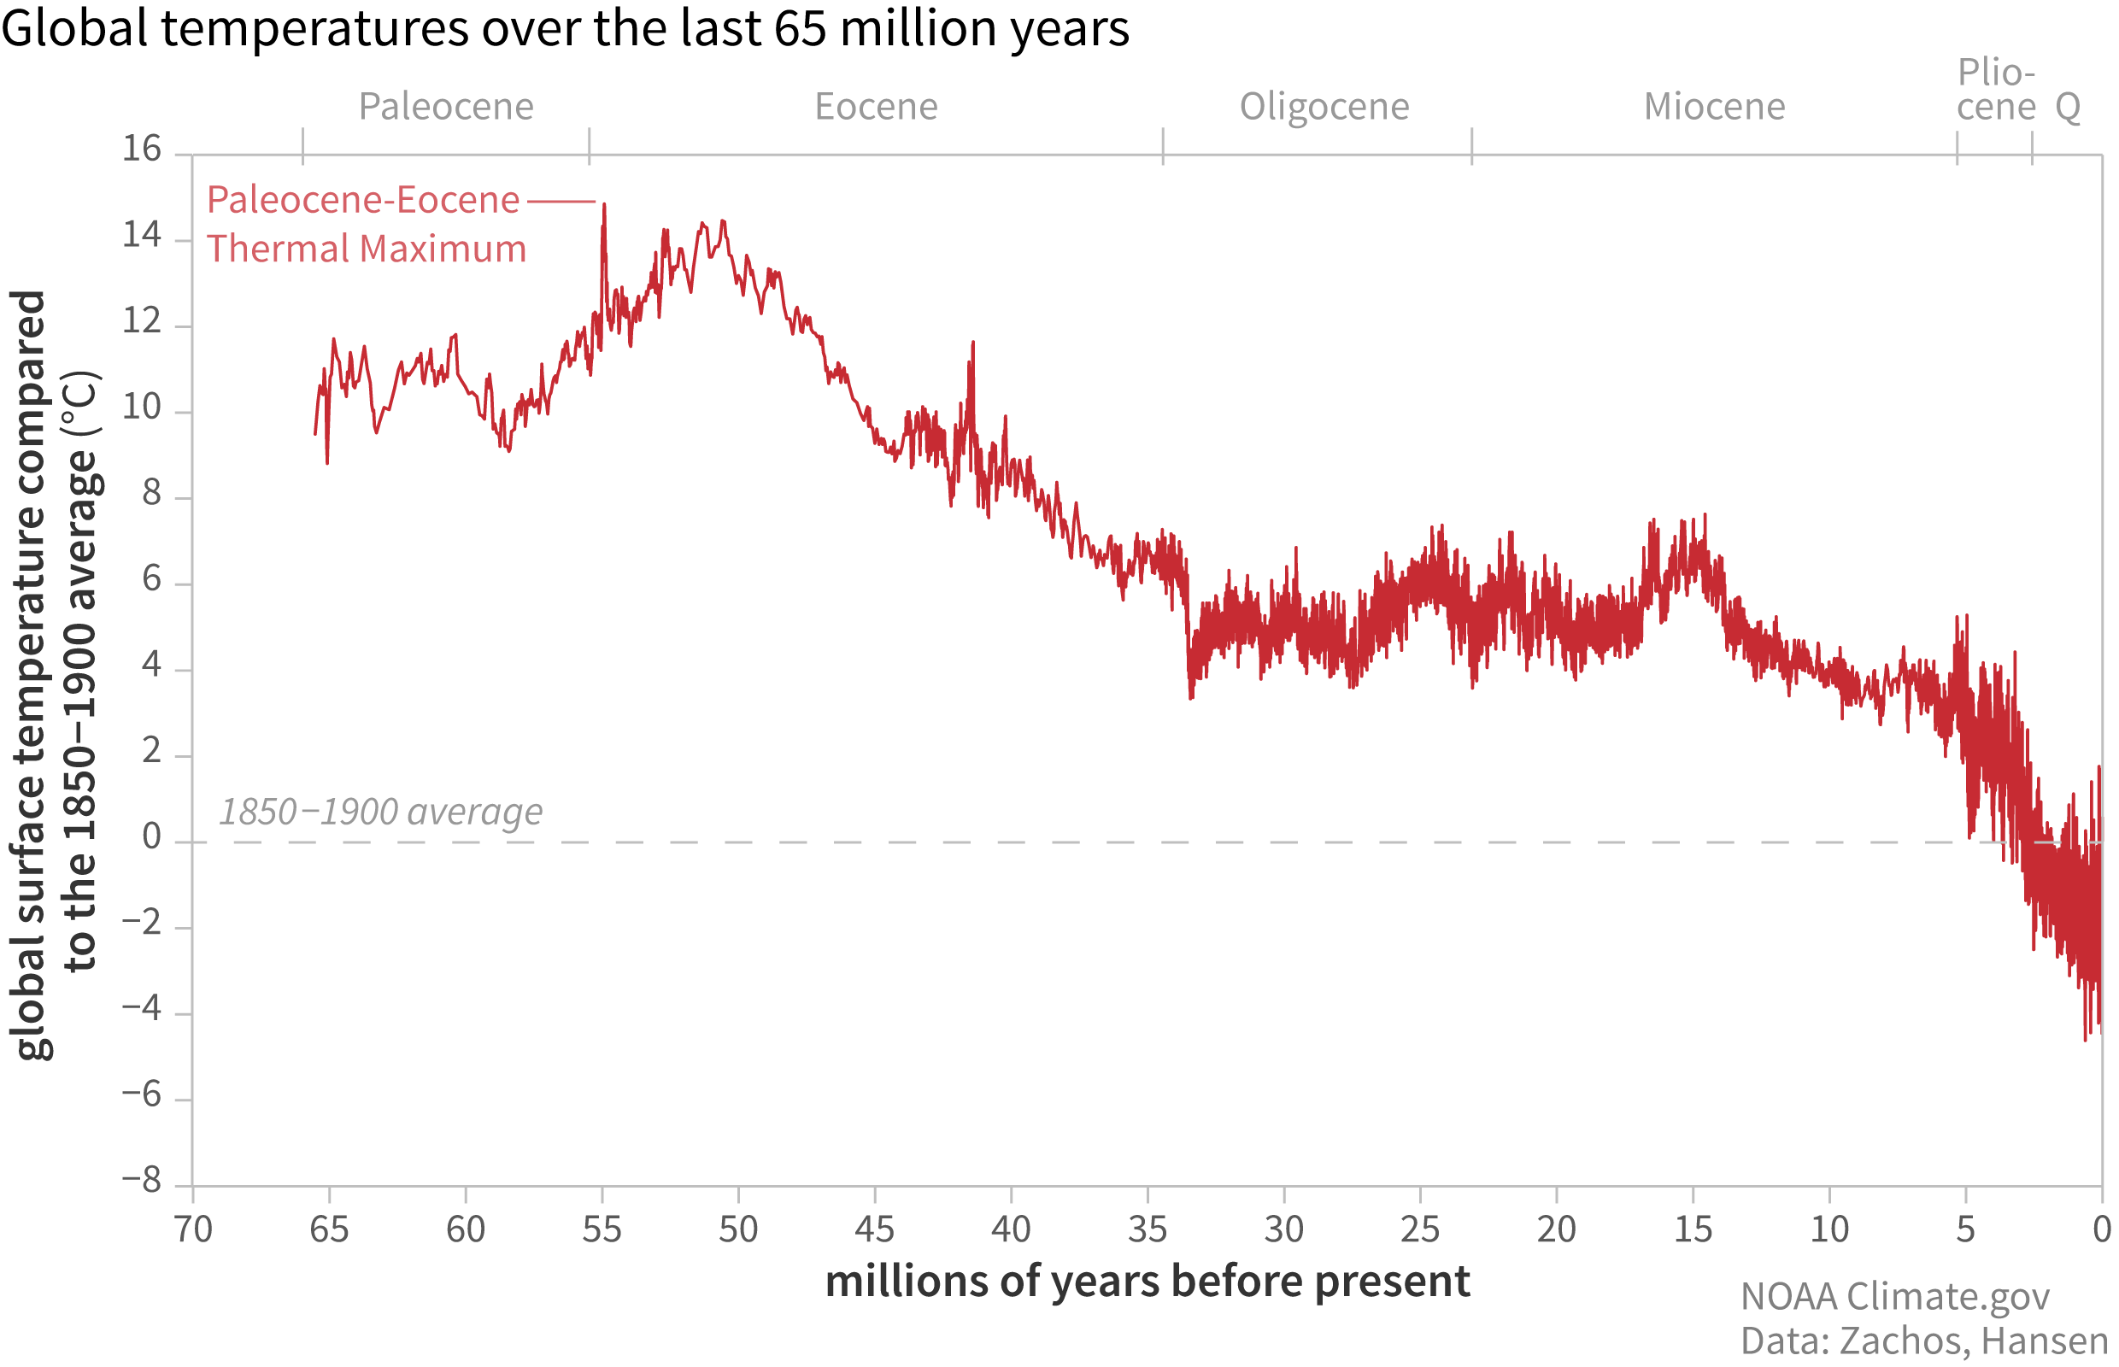
How has climate varied?

Slide 9
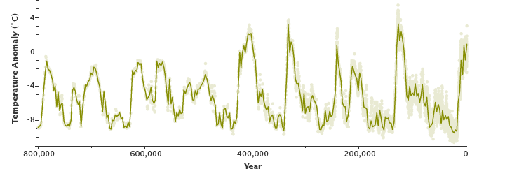
How has climate varied?

Slide 10
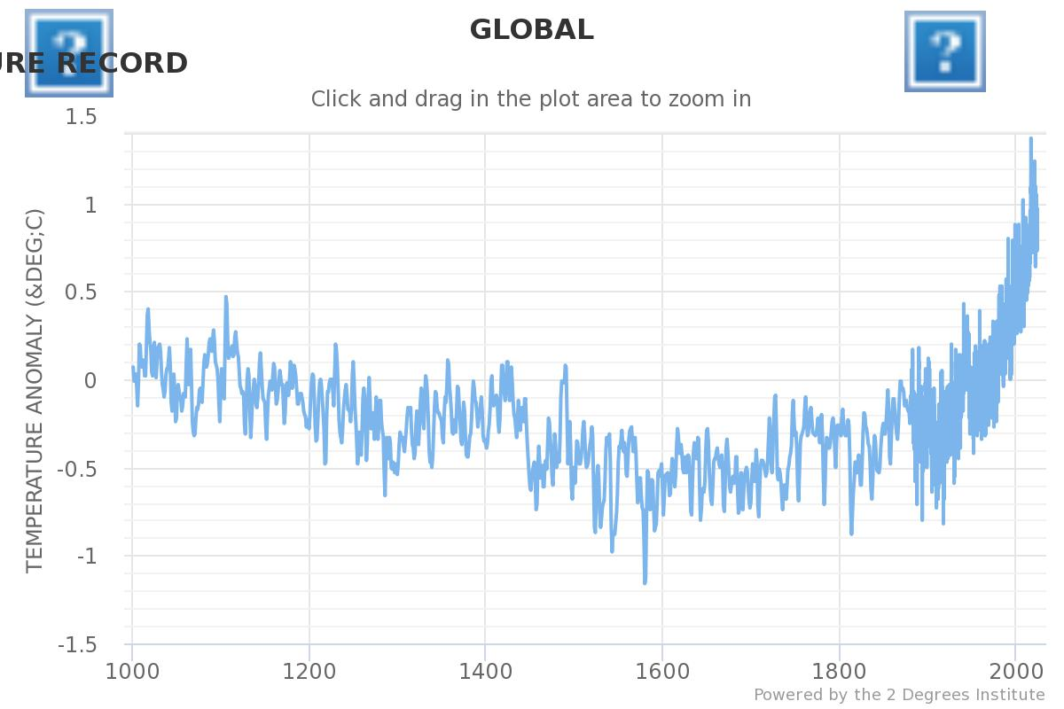
How has climate varied?

