Slide 1
Newton’s First Law
The world is not as it seems
§ 4.1–4.2

Slide 2
What’s the point?
What is the natural tendency of motion?
What governs an object’s motion?
What is a force?

Slide 3
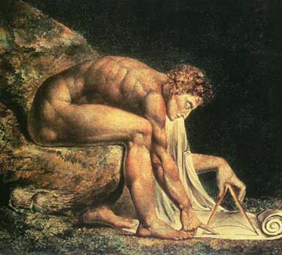
Newton’s First Law
An object’s velocity does not change unless a nonzero net force acts upon it.
If at rest, it remains at rest.
If moving, it continues straight at constant speed.
Representation of Newton by William Blake, 1795

Slide 4
Force
An influence that changes an object’s velocity
Practically: a push or pull

Slide 5
Combining Forces
Forces are vectors.
Forces can add together.
Forces can oppose each other.
Net force is the (vector) sum of all forces acting on a body.

Slide 6
Converse
Equilibrium Rule: An object moving at a constant velocity experiences zero net force.
That means that the forces acting on it all add to zero.
A body with zero net force is in mechanical equilibrium.
Notes:
6
A box sitting on the table ;obviously zero net force.
Pushing on the table without moving it - also zero net force.
Pushing at a constant speed - zero net force! Really! Recall planes, trains, and automobiles.

Slide 7
Static Forces We’ll Encounter
Normal
Friction and Drag
Tension
Weight

Slide 8
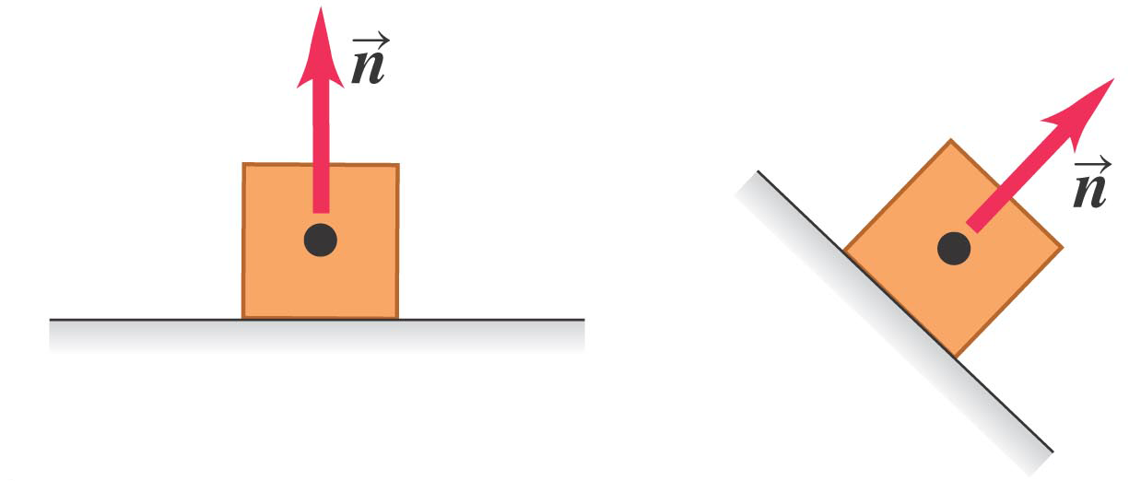
Normal Force
A surface pushes outward on a contacting object
Normal ≡ perpendicular to surface
Source: Young and Freedman, Figure 4.2 a

Slide 9
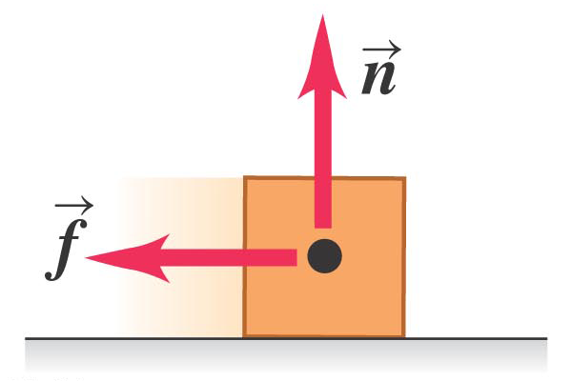
Friction
another surface force
parallel to the surface, opposing sliding
Source: Young and Freedman, Figure 4.2 b

Slide 10
Air Resistance (Drag)
Very complicated
Depends on airspeed: faster airspeed gives greater drag
Intro physics classes often ignore drag because it’s not analytically tractable
Engineers make fun of us for it
We’re doing you a favor

Slide 11
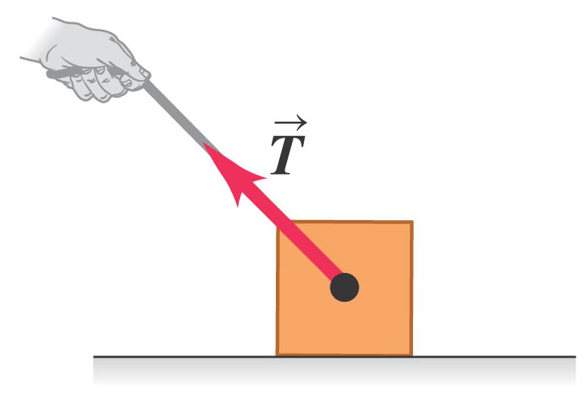
Tension
Acts in the direction of the string or cable
Always inward (you can’t push a string)
Source: Young and Freedman, Figure 4.2 c

Slide 12
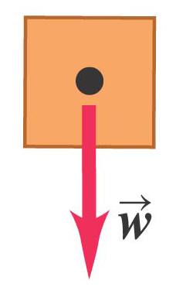
Weight
Force of a gravitational field on an object
Long-range force
Straight down
Source: Young and Freedman, Figure 4.2 d

Slide 13
Gravitational Force
Magnitude of gravitational force is proportional to mass: F = mg.
g = gravitational field; units N/kg.
Direction of gravitational force is toward the center of the earth (down).
At earth’s surface, g ≈ 9.8 N/kg.

Slide 14
Statics
Forces in equilibrium
§ 5.1

Slide 15
What’s the point?
How do forces balance?
What forces must structures withstand?
What is the result of non-balancing forces?

Slide 16
Example Problem
A 25-kg box on a frictionless plane inclined 30° to the horizontal is held in place by a cable parallel to the incline. What is the tension in the cable?
F
25 kg
30°

Slide 17
Question
weight
1 m
T
T
8 m
A hammock slung between trees 8 m apart sags 1 m when a person lies in it. The tension in each rope holding the hammock is
Equal to the weight of the person.
Half the weight of the person.
More than the weight of the person.
Less than the weight of the person, but more than half.

Slide 18
Class Work
weight
1 m
T
T
8 m
Identify the forces acting on the hammock.
Draw a free-body diagram for the hammock.
Find the components of all the forces.

Slide 19
Free-body Diagram
tension
tension
weight
Acceleration = 0, so forces add to zero
Observe the magnitudes!

Slide 20
So, for the hammock…
Tension is the same direction as rope stretch: 4 horizontal: 1 vertical
Add up the vectors!
4
Here, tension is over twice the weight!
1
2
1

Slide 21
Newton’s Second Law
How forces act
§ 4.3

Slide 22
Experience Tells Us
The greater the net force on an object, the more it accelerates.
The greater the mass of an object, the harder it is to accelerate.

Slide 23
Newton’s Second Law
ΣF
a =
m
equivalently,
ΣF = ma
a = acceleration
ΣF = net force
m = mass

Slide 24
Quantify Force
Unit of force: 1 newton (N) = force needed to accelerate 1 kg at 1 m/s²
How much is a newton?
kg m
F = ma = (1 kg) (1 m/s²) =
s²

Slide 25
Group Work
A crate with mass 35.0 kg initially at rest on a warehouse floor is acted on by a net horizontal force of 140 N.
What acceleration is produced?
How far does the crate travel in 10.0 s?
What is its speed at the end of 10.0 s?

Slide 26
We Have Learned
∑F = 0 ⇔ a = 0
∑F = ma
The second law subsumes the first
The first can be true even if the second is not

Slide 27
Group Work
A bowl of petunias of mass m accelerates in free fall at rate g. What is the magnitude of the net force acting on the bowl?

Slide 28
Weight and Weightlessness
Mass and gravity
§ 4.4

Slide 29
What’s the point?
What is weight?

Slide 30
Question
Gravity is constantly pulling us downward, but we are not accelerating downward. This means that
Newton’s second law does not apply here.
Gravity does not apply a physical force.
Some other force exactly opposes the force of gravity.
Gravity stops at the earth’s surface.

Slide 31
A Physics Haiku
Elevator breaks
Susie falls and feels no weight
Gravity still there
Heidi Forbes

Slide 32
Newton’s Third Law
Whenever one object exerts a force on a second object, the second object exerts an equal and opposite force on the first, along the same line of interaction.
F_{A → B} = –F_{B → A}.
We’ll devote much more attention to this later.

